Slide 1
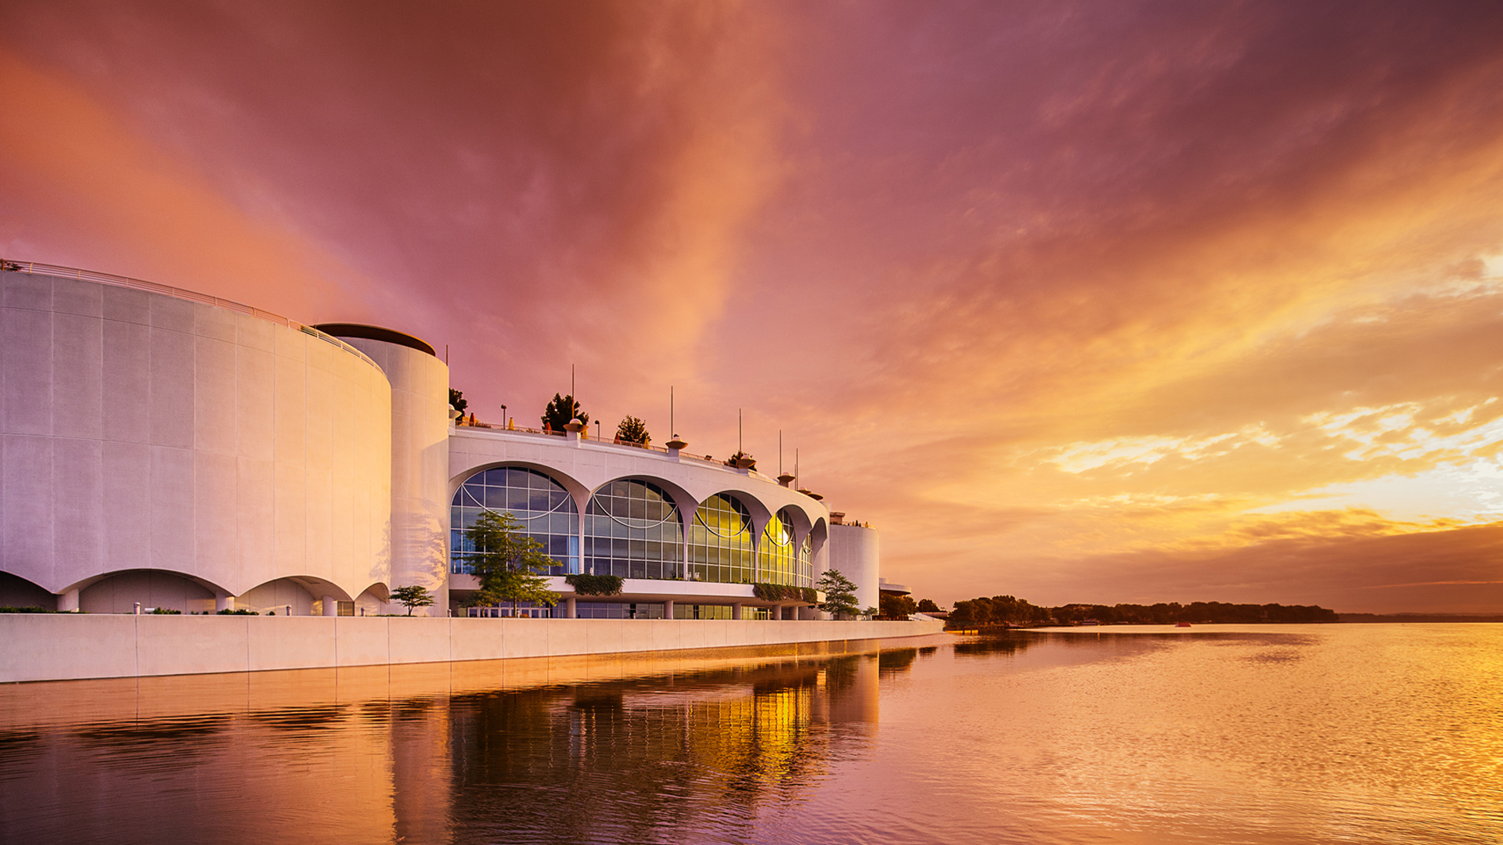
Monona Terrace Community and Convention Center
Kristen Durst, Community and Public Relations Manager

Slide 2
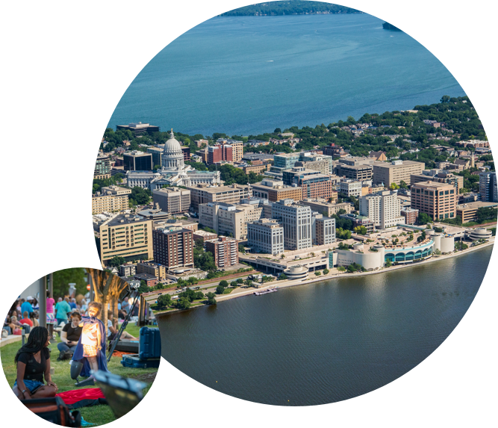
Monona Terrace Key Mandates
To be an economic catalyst
a community gathering place
and a tourism destination
for the City of Madison, Dane County and State of Wisconsin.

Slide 3
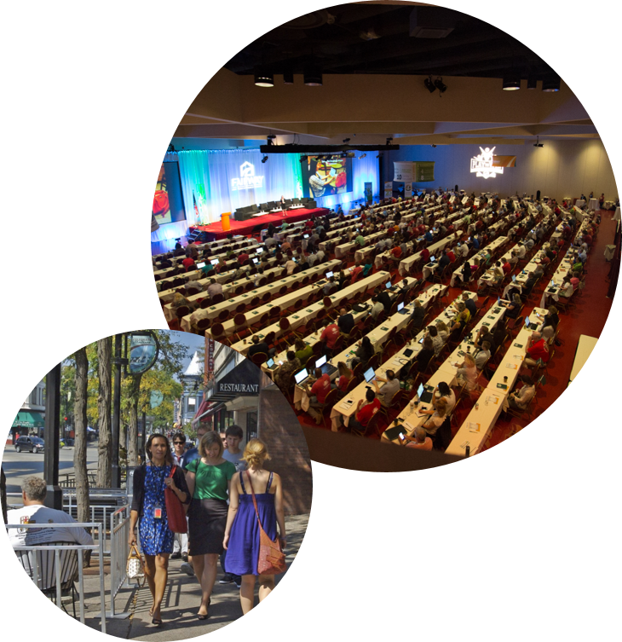
Economic catalyst
Economic impact for the community from conventions and conferences typically averages $33 million per year.
Host 400 to 600 events each year.
Monona Terrace and Monona Catering payrolls and purchasing boost the local economy by another $12 to $13 million per year.

Slide 4
STIMULATING OUR LOCAL ECONOMY
Monona Terrace internal sales team books 400 to 500 primarily state and local events each year that generate between 75% and 80% of overall event revenue for Monona Terrace.
In 2022, we had 46 conventions and conferences, 178 banquets/weddings, 107 meetings, and 19 consumer shows.
Business is on the upswing after a few tough pandemic years. Event revenue is 80% of where it was in 2019, with conventions and conferences still lagging.

Slide 5
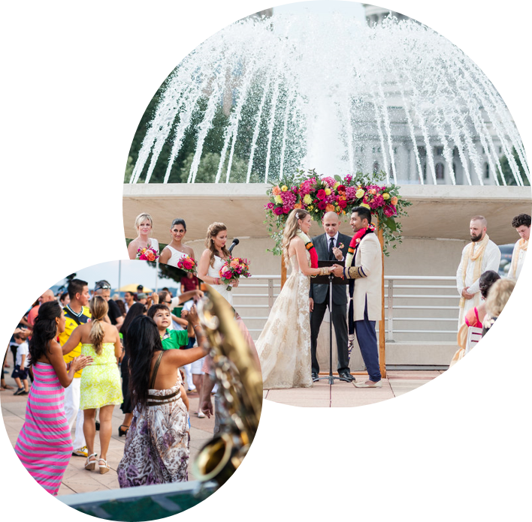
Community gathering place
In 2022, we served 25,488 people through 121 free and low-cost community programs.
We serve our community in meaningful ways providing a variety of hybrid and in person events.
Our Wright Design lecture series and health and wellness programming continue to reach new audiences through expanded offerings.
Our popular summer Concerts on the Rooftop series and Dane Dances! bring thousands of people to our rooftop in the summer.

Slide 6
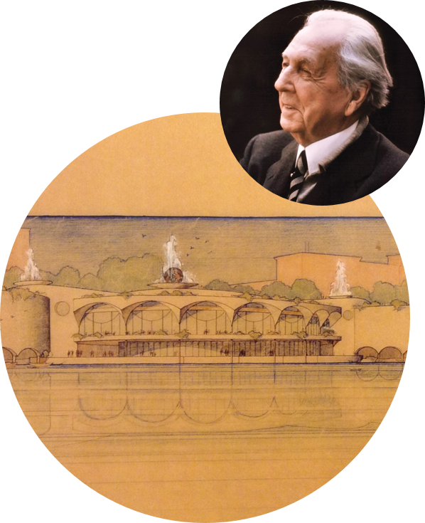
Tourism destination
Designed by renowned architect Frank Lloyd Wright, Monona Terrace is an iconic landmark in Madison visited by guests from around the country and world.
In person tours resumed in summer 2021 on an adjusted schedule, with 1,191 attendees in 2022.
Visitors include student groups, commercial bus tour groups, and locals with visiting friends and relatives.
Monona Terrace is a prime site on the Frank Lloyd Wright Trail promoted by Travel Wisconsin (WI Dept. of Tourism).

Slide 7
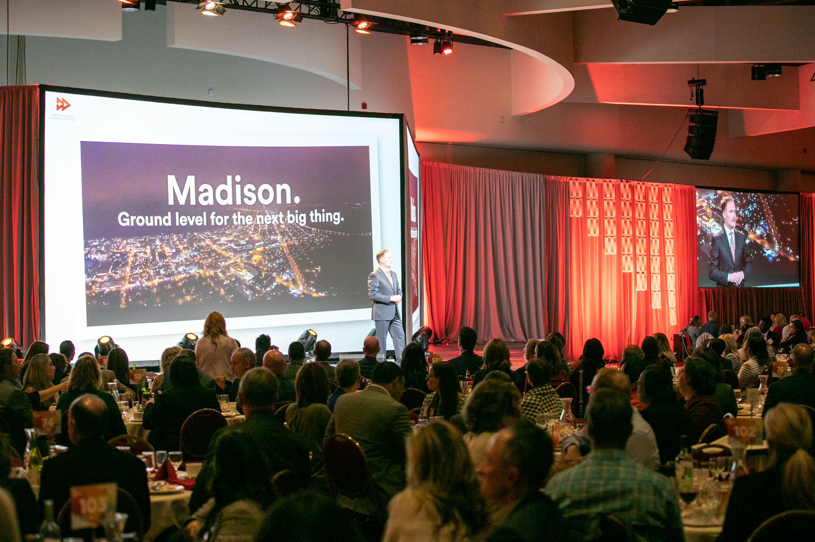
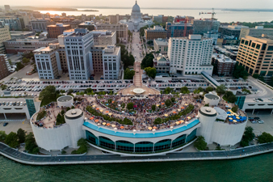
Our mission
To deliver and exceptional and inspirational experience
Vision: to be a globally recognized facility of distinction, offering endless possibilities and extraordinary service

Slide 8
Sustainability & resilience
Monona Terrace was the first convention center in the US to earn LEED Silver certification. Improved performance to earn LEED Gold certification in 2015.
In 2021, Monona Terrace became a LEED Platinum Facility.
The LEED rating system, developed by the US Green Building Council is the foremost program for buildings that are designed and maintained for improved environmental and human health performance.
LEED is a continuous sustainability performance plan and process.

Slide 9
Monona Terrace has an energy use rating 27 percent below similar facilities in comparable climates.
Monona Terrace has installed high efficiency plumbing fixtures, appliances, and a drip irrigation system resulting in water usage that’s 43 percent below the LEED benchmark.
Purchase of green energy to offset 100 percent of electric power consumption and 100 percent of non electric carbon emissions.
Continuing conversion from fluorescent and metal halide lighting to LED technology.
Compost over 29,000 pounds of pre-consumer, organic kitchen waste.
Donation of approximately 5,500 pounds of food to charity each year.
Site gardens host over 6,800 square feet of native plantings used to reseed 162,000 square feet of City of Madison green space.

Slide 10
Inside monona Terrace
Are we taxpayer supported? Essentially no.
Monona Terrace is financed through the Transit Occupancy Tax or Room Tax, which pays for capital improvements and the annual subsidy.
And revenue generated through events, gift shop, tourism.
Designed as an economic catalyst, to grow our local economy (restaurants, hotels, other local businesses) through tourism.
Labor intensive industry, 60% of cost to run Monona Terrace is labor.

Slide 13
“

Slide 14
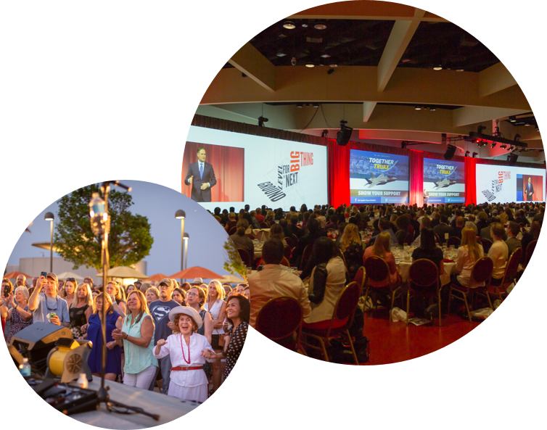
Looking ahead…
Upcoming renovation next year, including carpeting (every ten years)
Judge Doyle Square hotel, Embassy Suites room opening early 2024
Nolen Waterfront Project and Monona Terrace Expansion

Slide 15
NOLEN WATERFRONT design challenge
Three renowned design firms have created master plans for the John Nolen waterfront from Law Park to Olin Terrace.
Public comments are being accepting through March 23.
These plans include the expansion and potential expansion of Monona Terrace, two of the plans include a location to the East, one to the North.
More info at:
https://www.cityofmadison.com/parks/projects/lake-monona-waterfront-design-challenge

Slide 16
Monona Terrace expansion
Our function space is smaller than regional competitors, and ranks last among national comparable venues.
Monona Terrace typically loses a few hundred events each year because the facility is fully booked.
Conventions make up 20 percent of our events, we lose 44 conventions annually due to lack of function space, available dates, and lack of hotel rooms.
A study we commissioned by HVS found we can grow our business significantly by expanding.

Slide 17
