Slide 1
Hawthorne Elementary

Slide 2
Art teacher Julie Olsen leads the Terrace Town project, and this year made it an experience that touched all of the Hawthorne students!
There were contributions by all grades….
Grades 2/3 brainstormed and designed buildings they wanted in the cities.
Grades 4/5 studied infrastructure and created utilities, transportation, and parks and recreation.
Grade k/1 created neighborhoods with houses surrounding a greenspace with trees and a play structure.

Slide 3
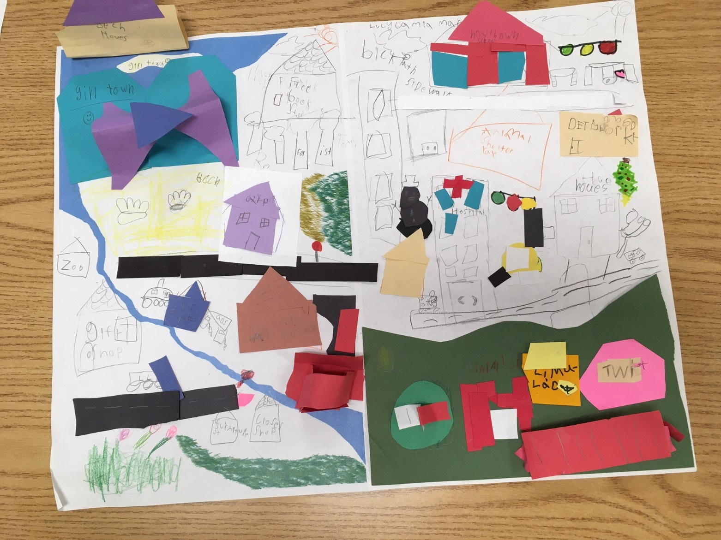
Here are some mapping examples kids did in pairs as part of Mentor Scott Kiley’s presentation…

Slide 4
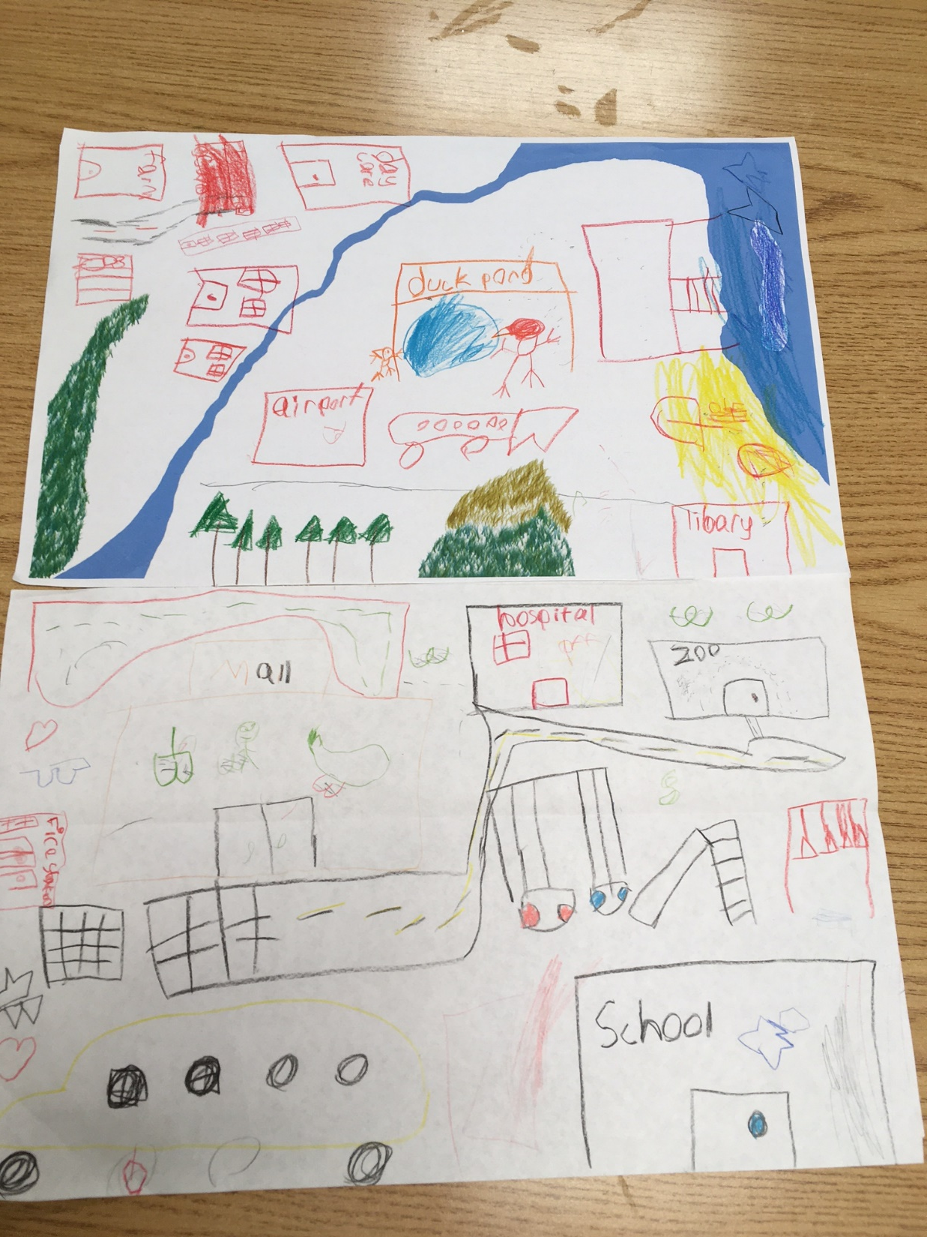

Slide 5
Hawthorne designed and built two cities….
Hawthorne Redesign- A reimagining of the neighborhood
Dream City

Slide 6
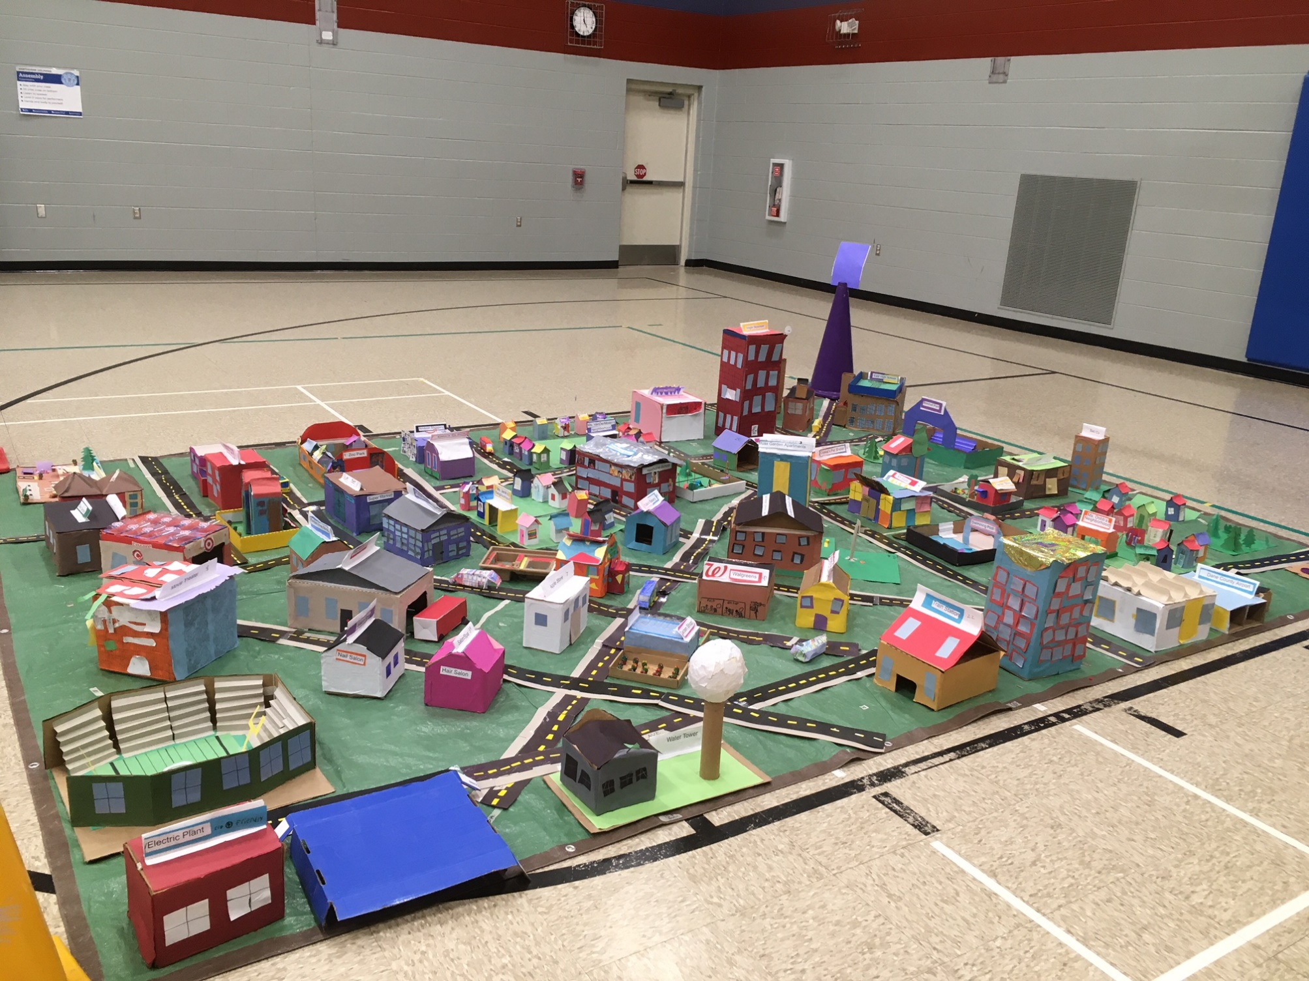
Hawthorne Redesign

Slide 7
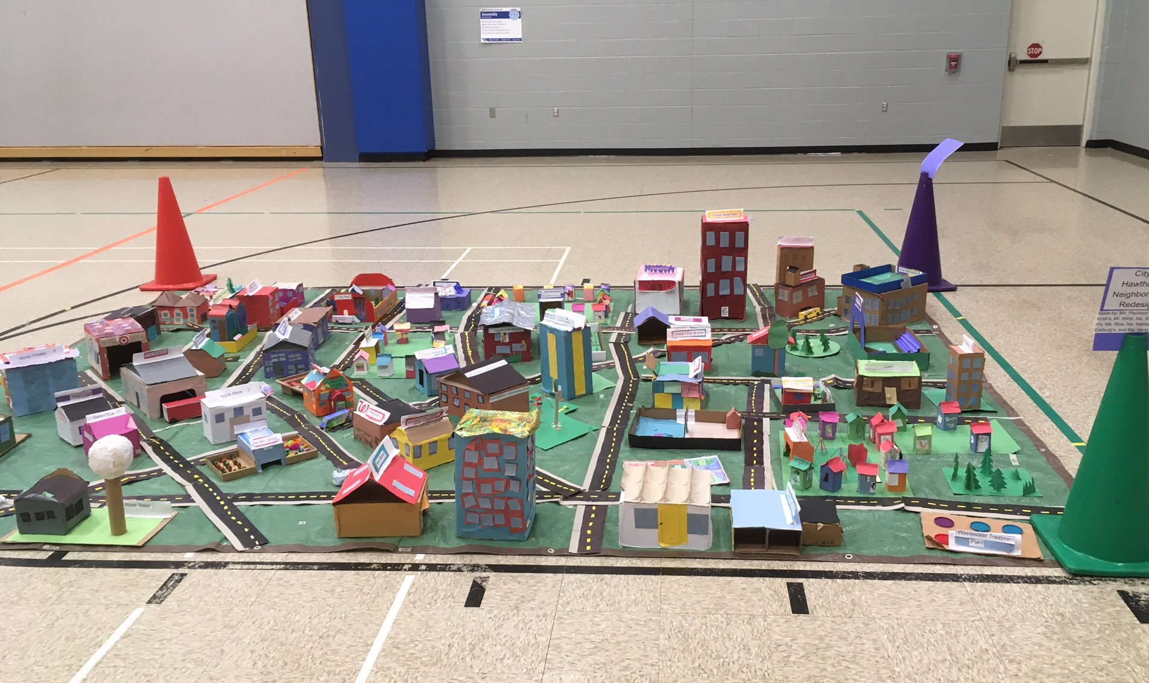
Hawthorne Redesign

Slide 8
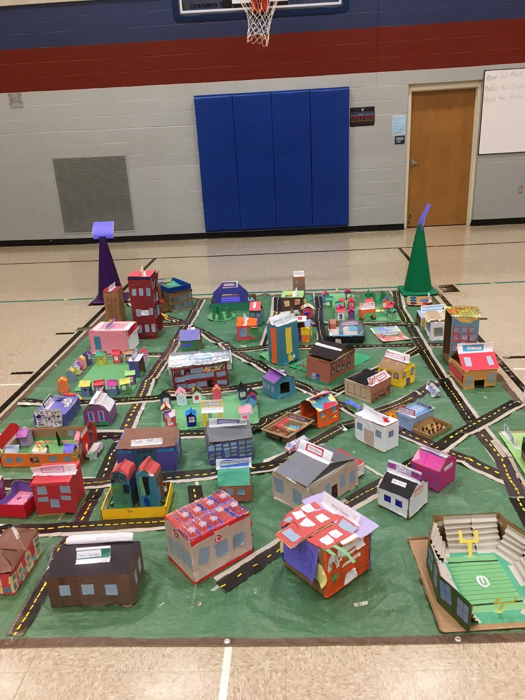
Hawthorne Redesign

Slide 9
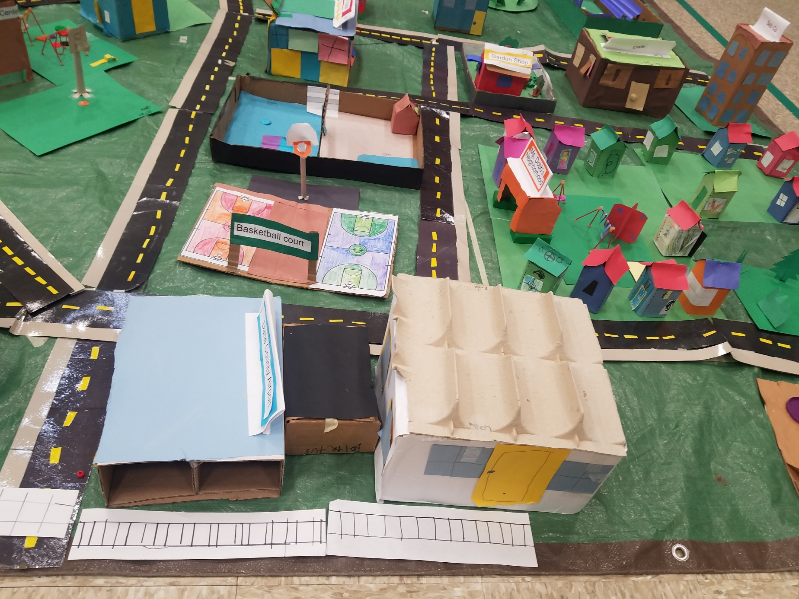
Hawthorne Redesign

Slide 10
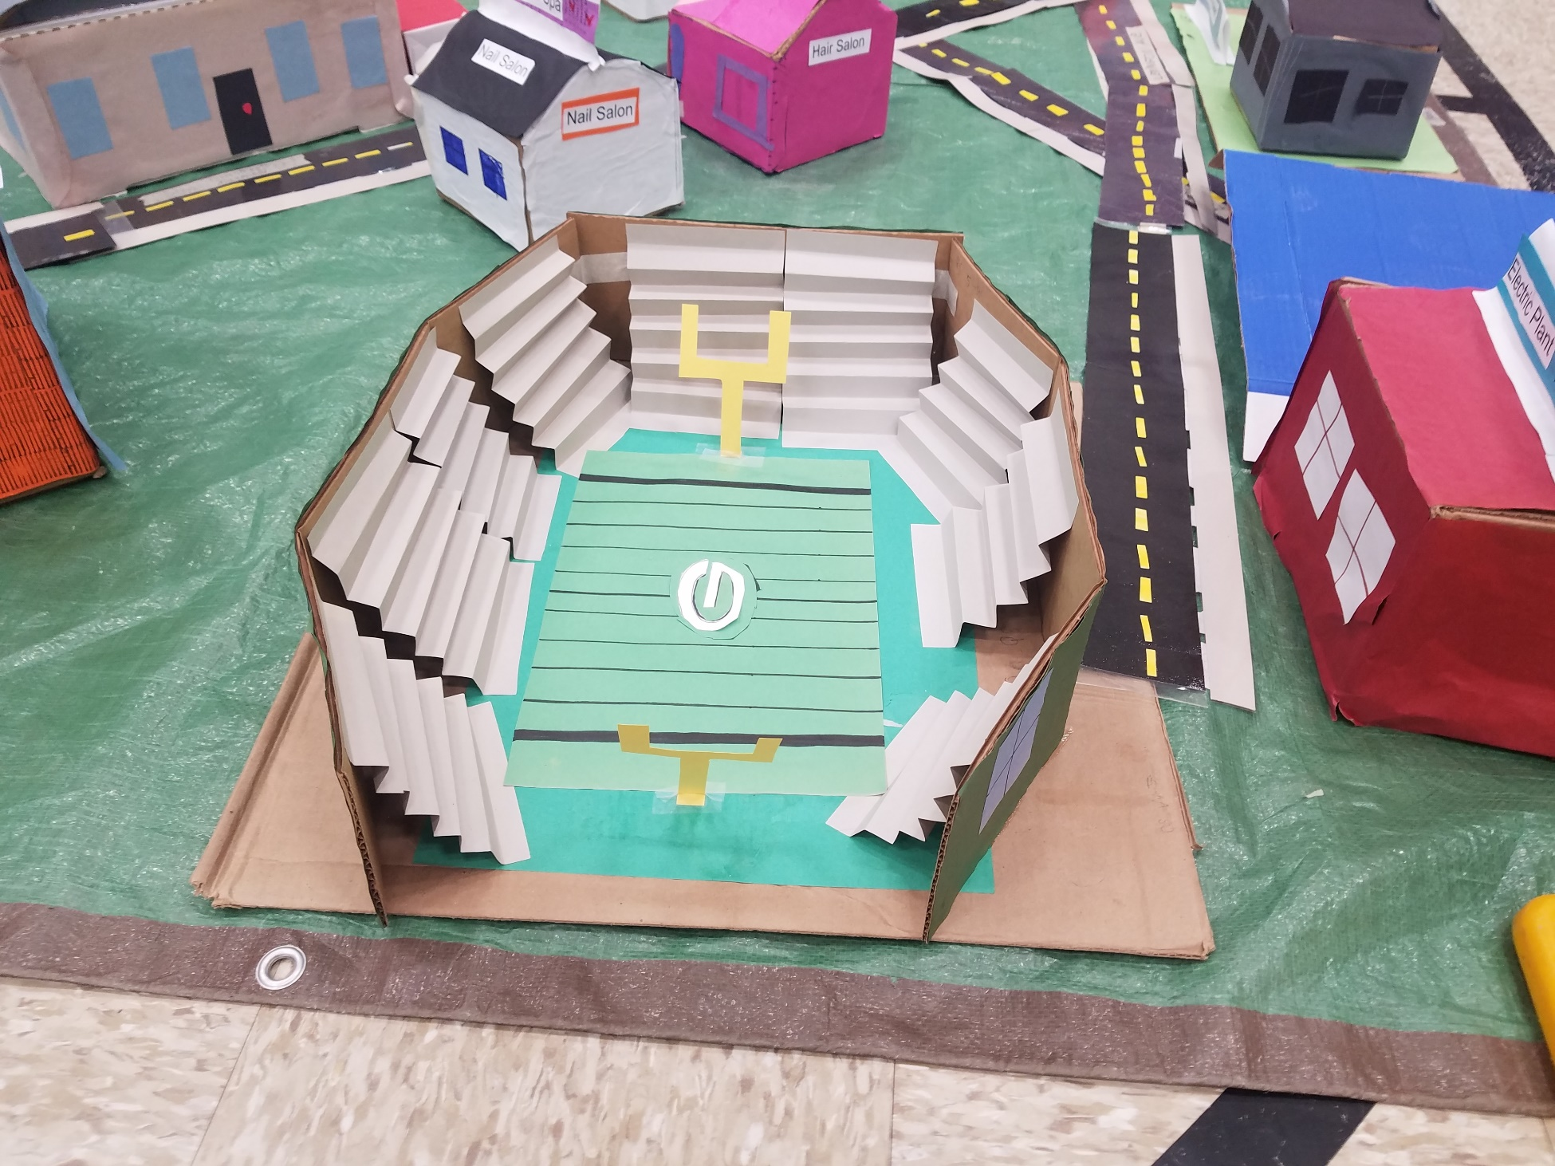
Hawthorne Redesign

Slide 11
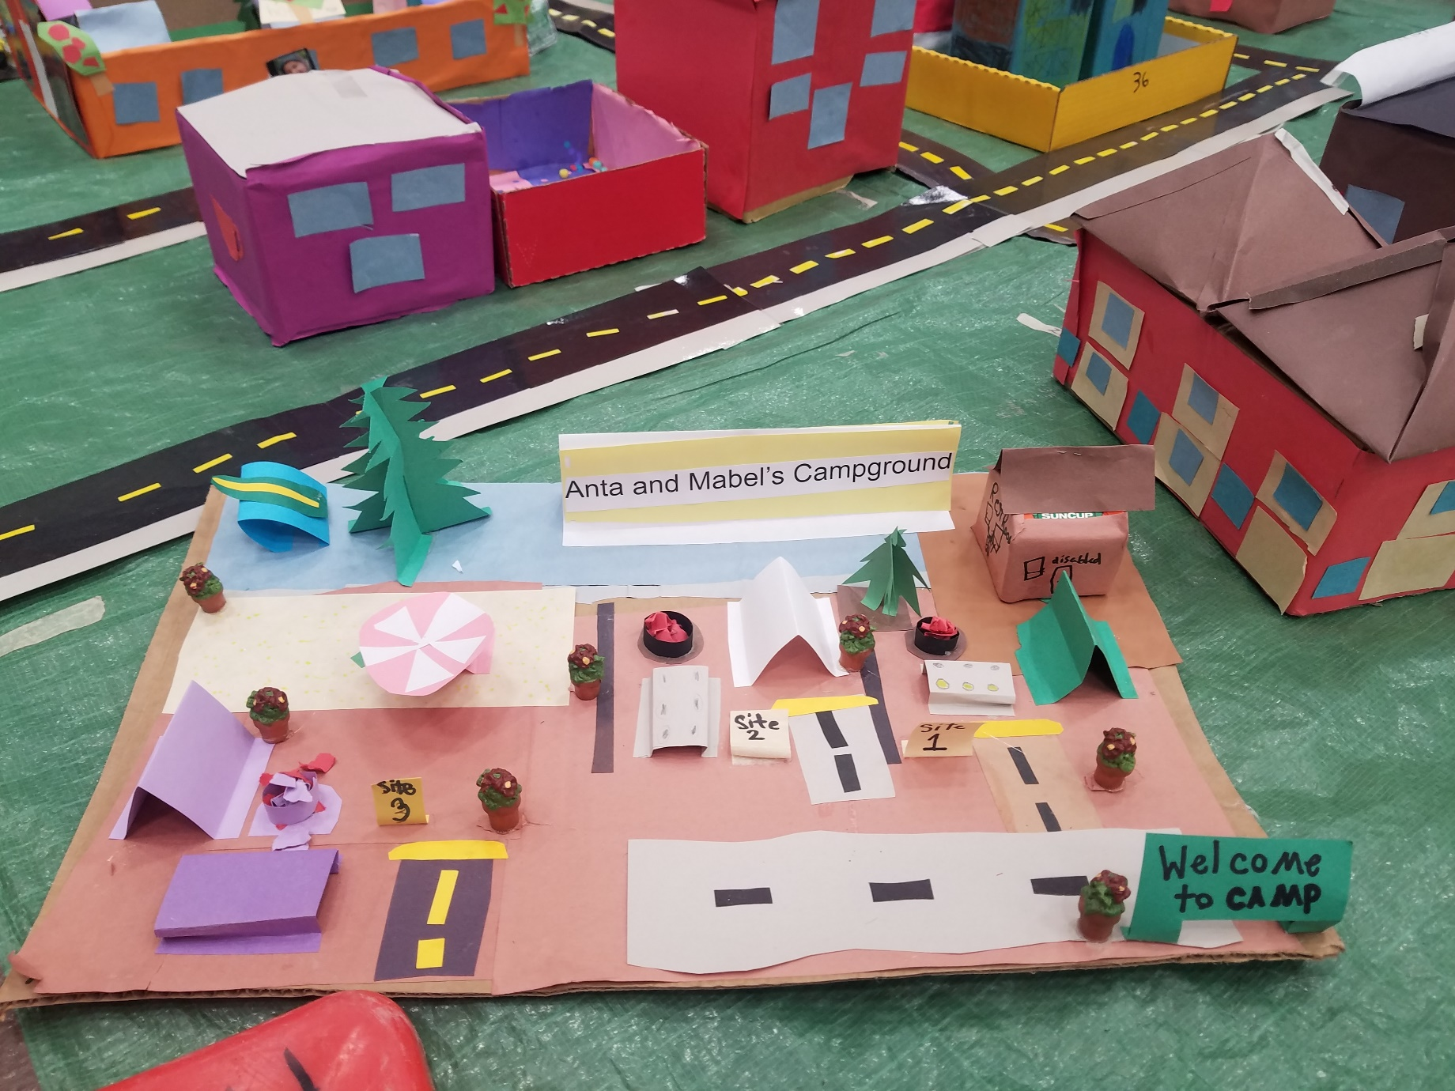
Hawthorne Redesign

Slide 12
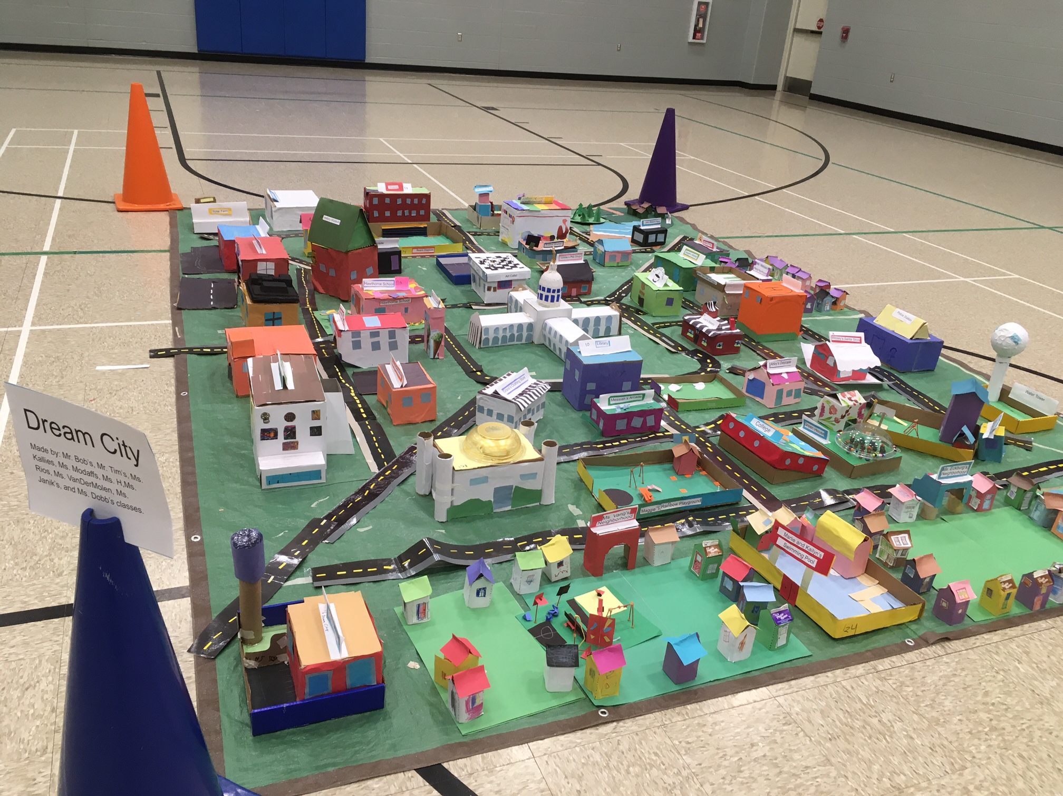
Dream City

Slide 13
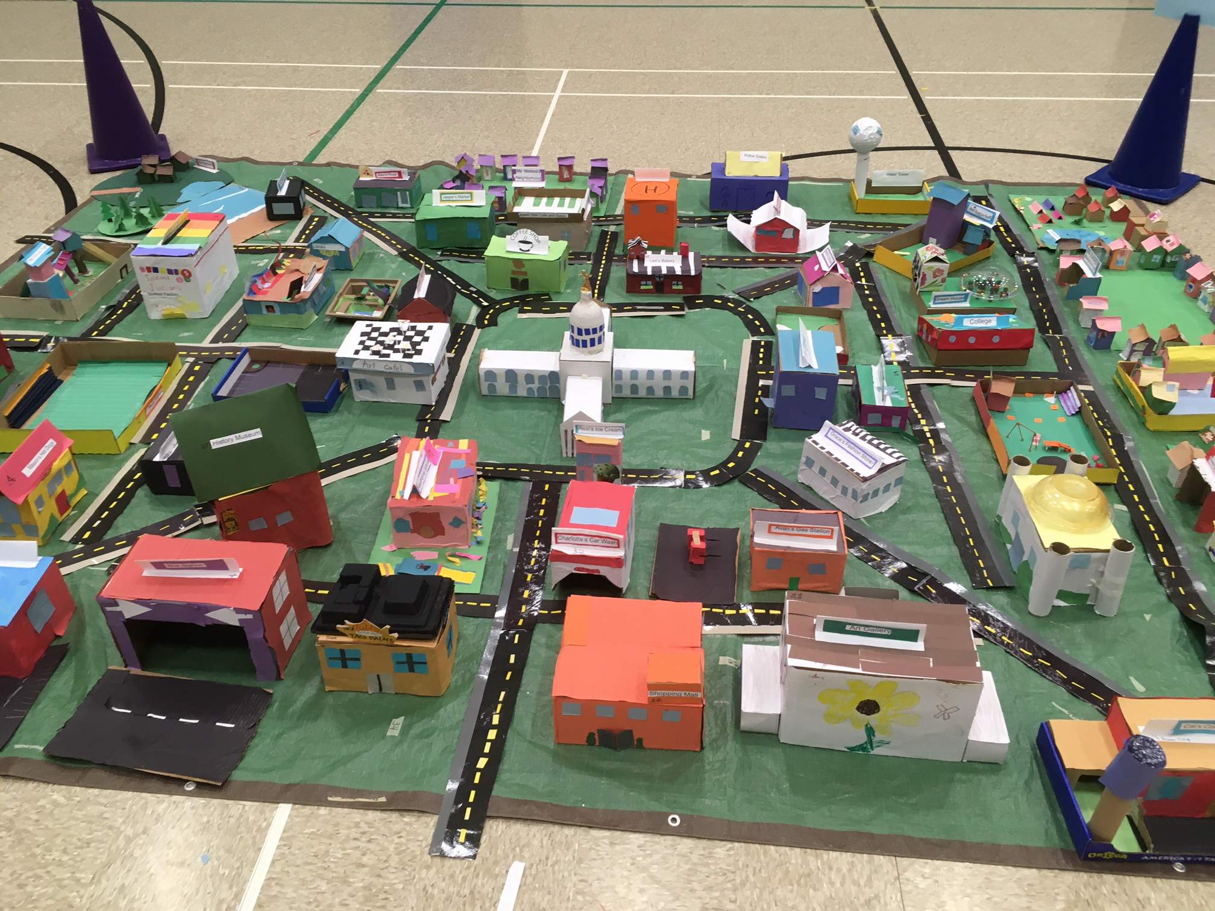
Dream City

Slide 14
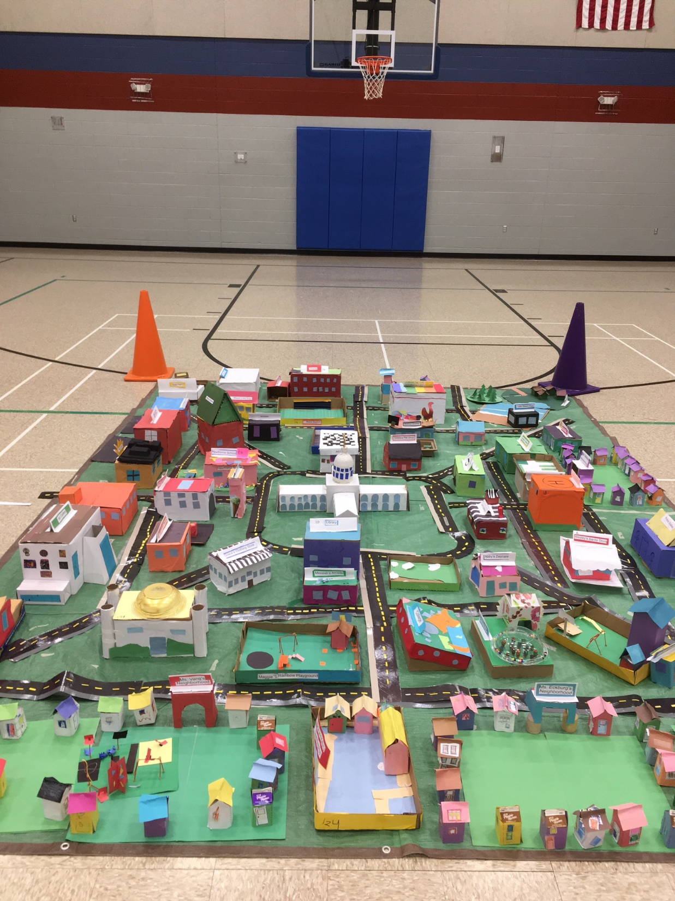
Dream City

Slide 15
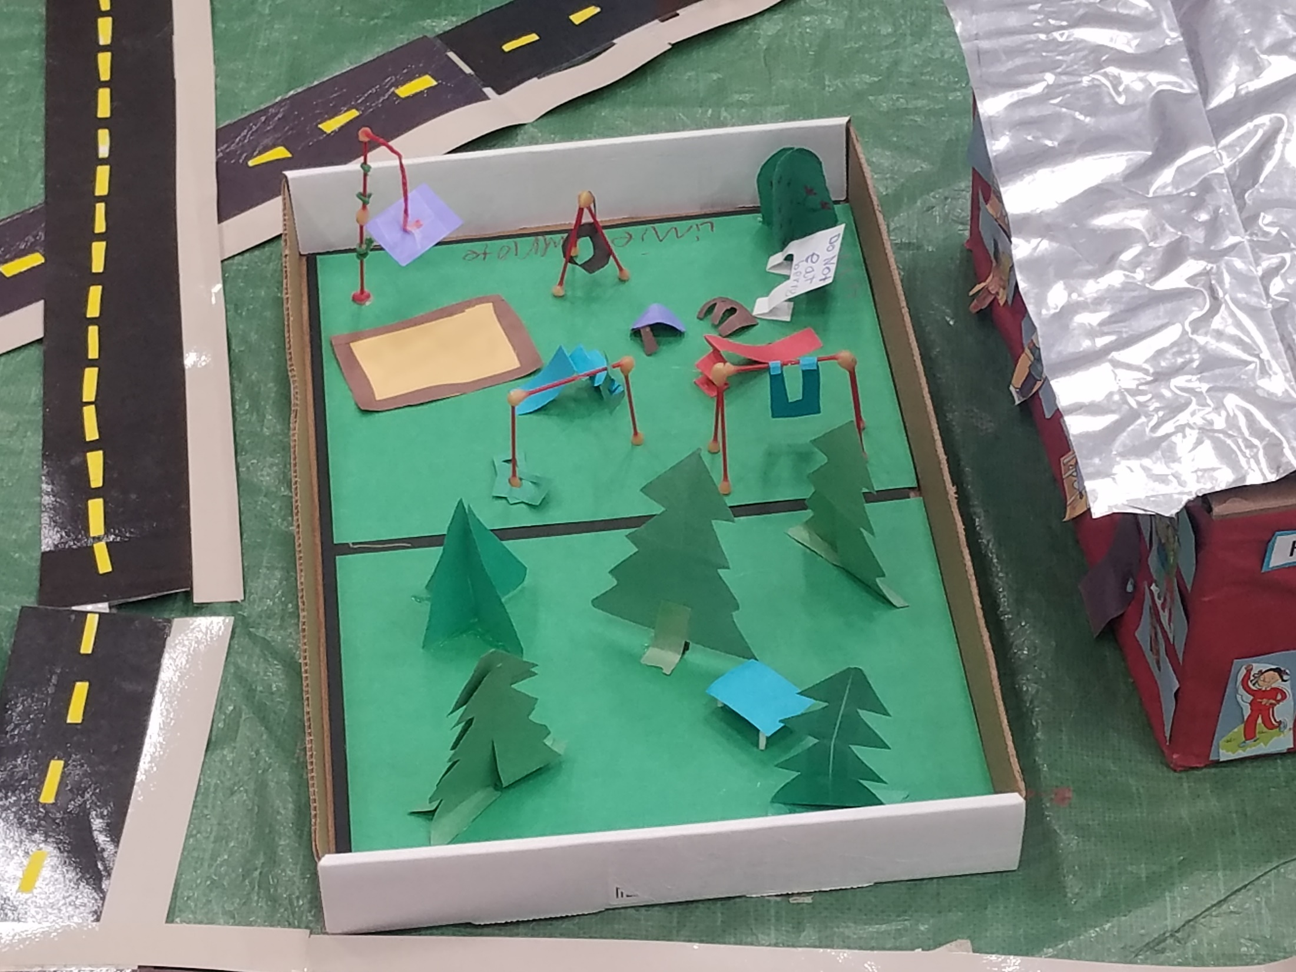
Dream City

Slide 16
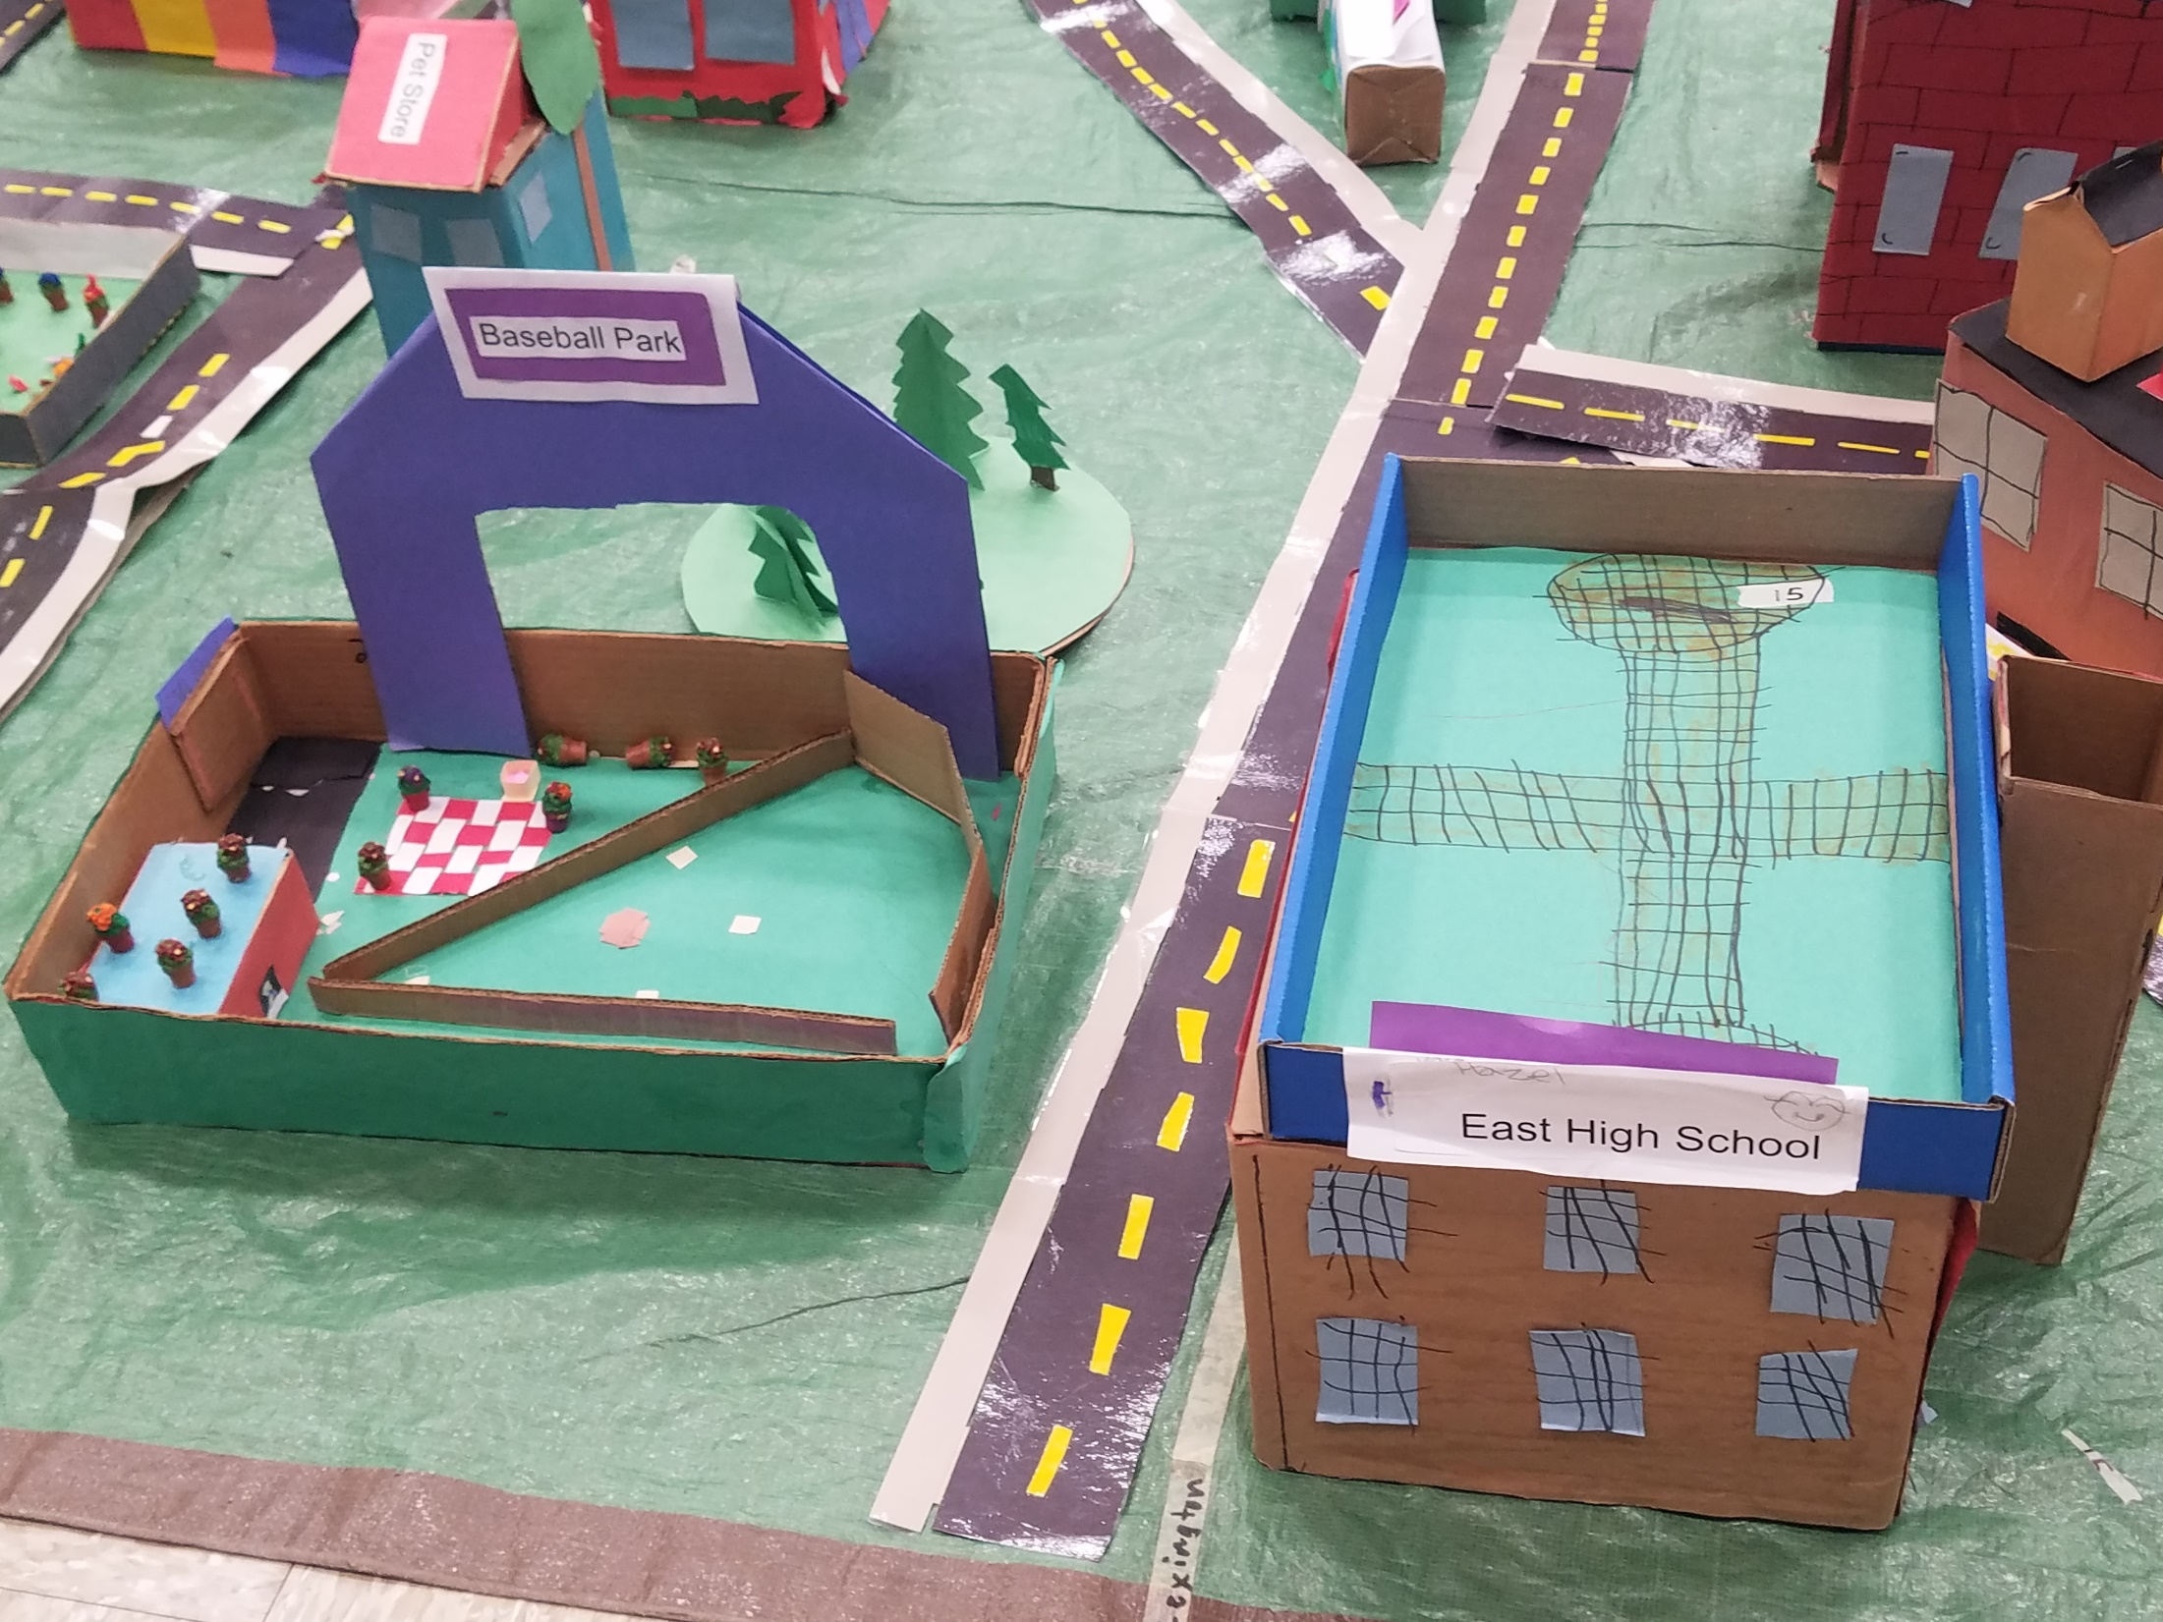
Dream City

Slide 17
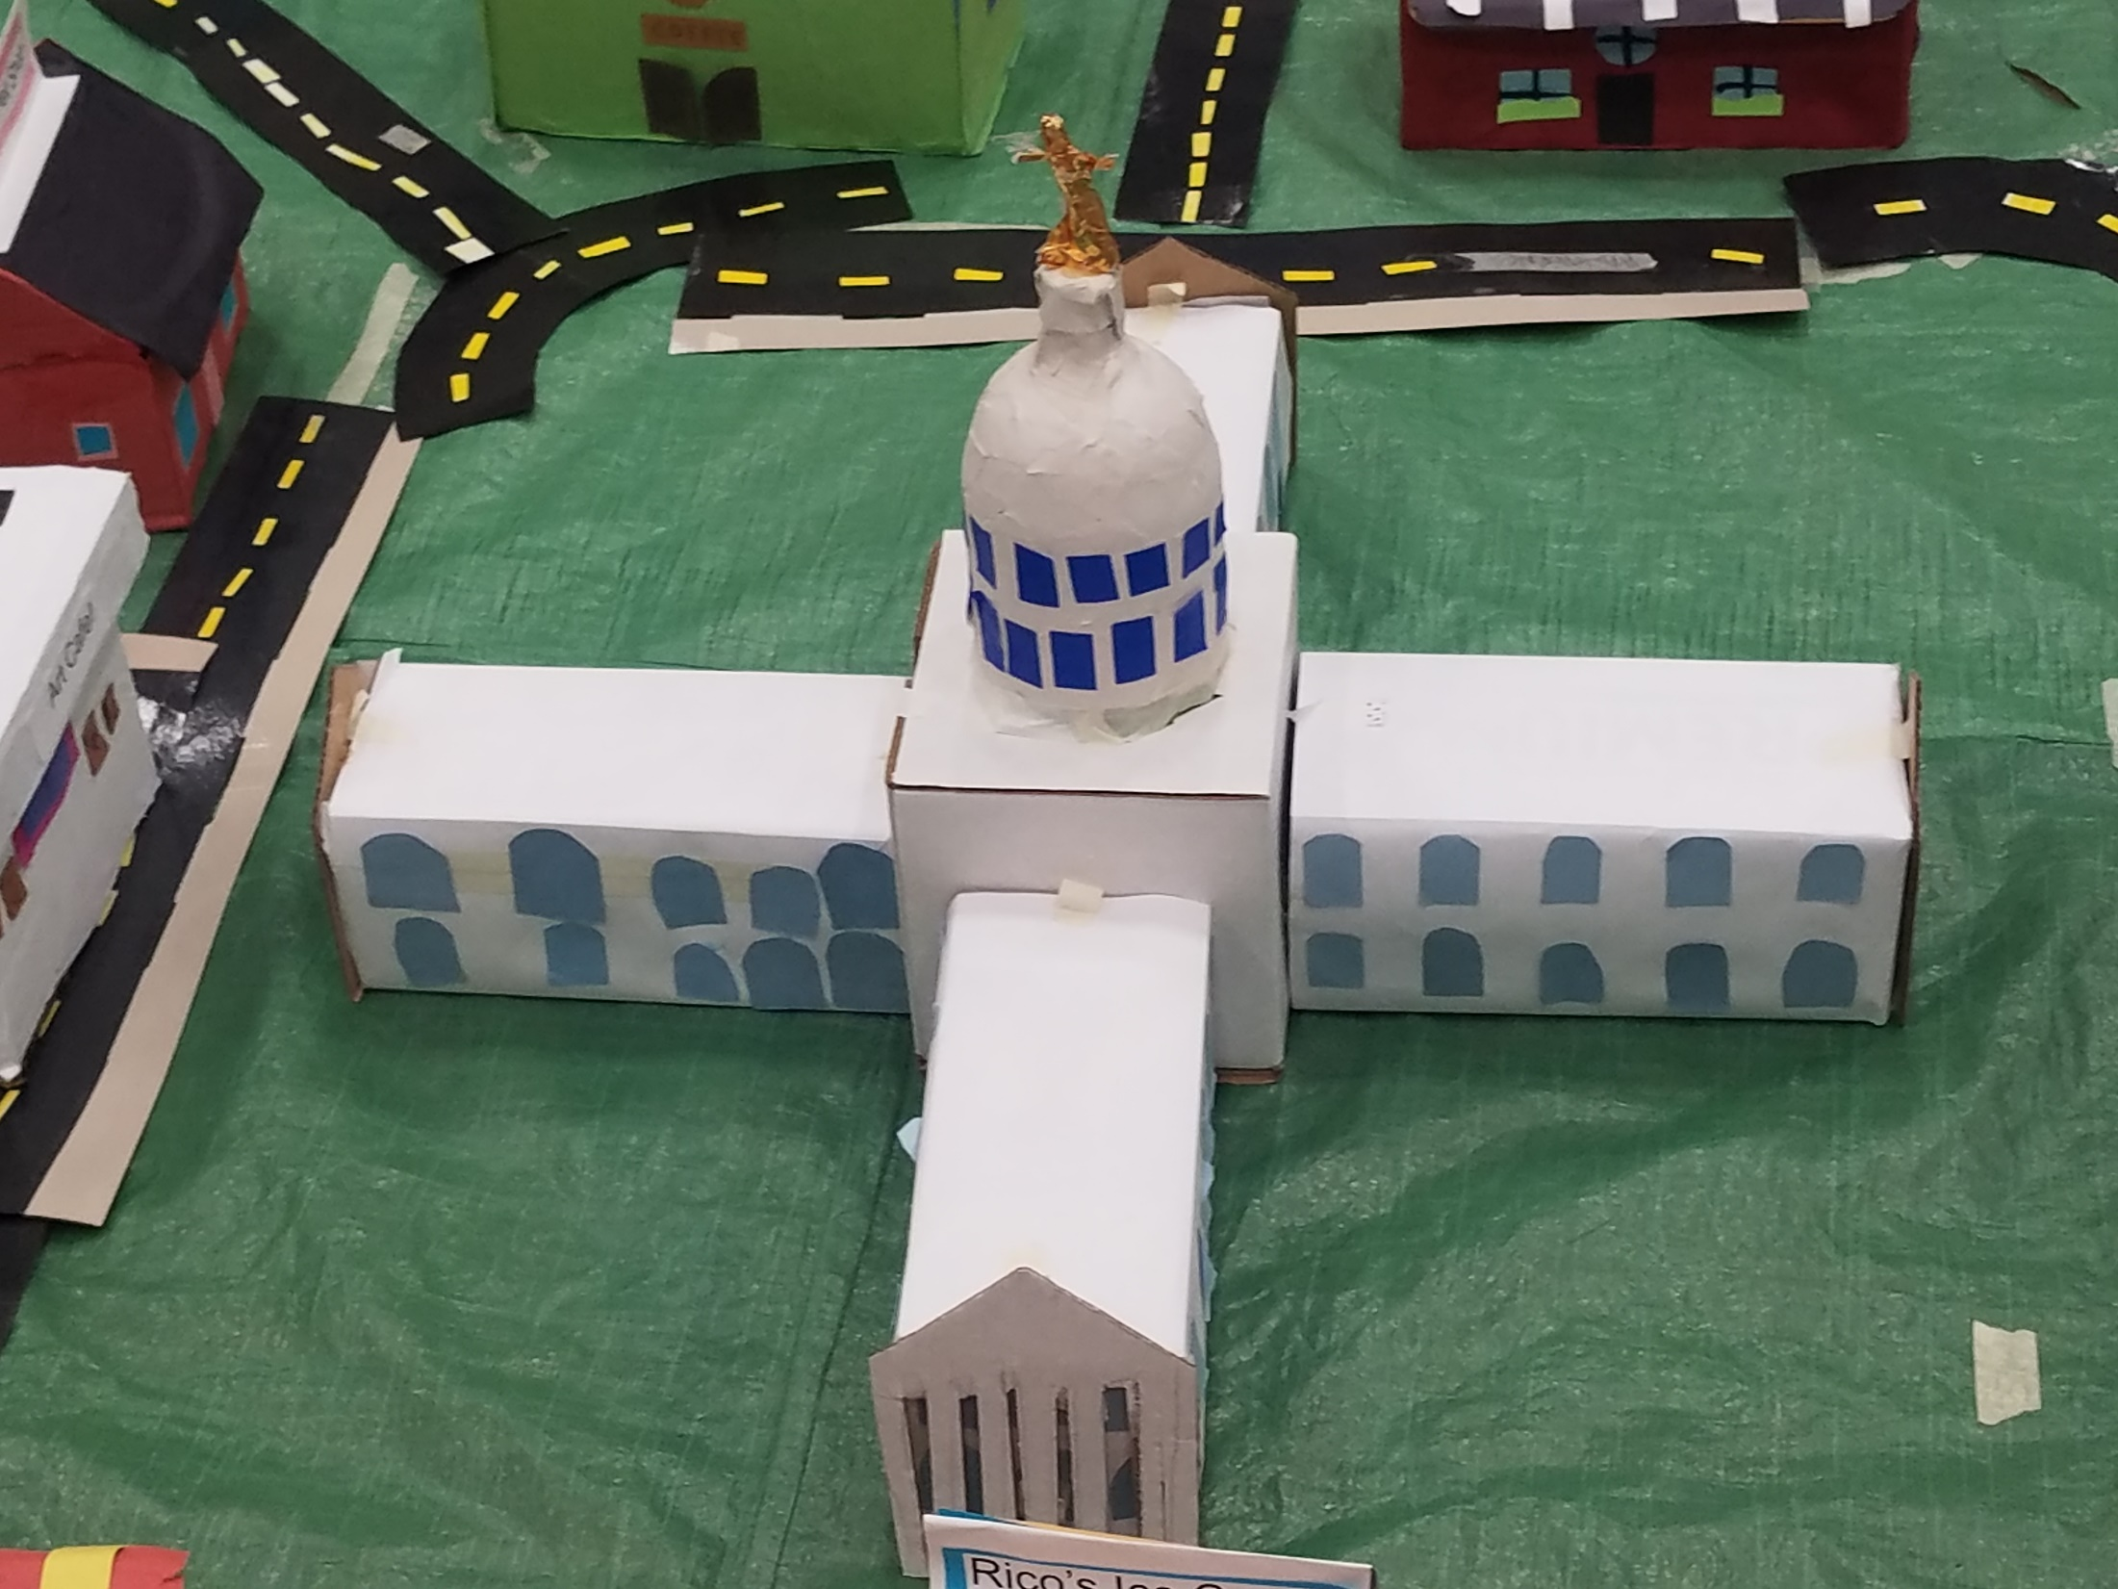
Dream City

Slide 18
All classes 4K- grade 5 visited the cities and played an "I Spy " game looking for what makes a great city. This meshed nicely with curriculum at all grade levels, even our 4 K classes who are currently studying Community Helpers.

Slide 19
Thank you Scott Kiley, our Urban Planner and parent, for assisting with the process, once again!

