Slide 1
Green Building Options
Terrace Town Workshop

Slide 2
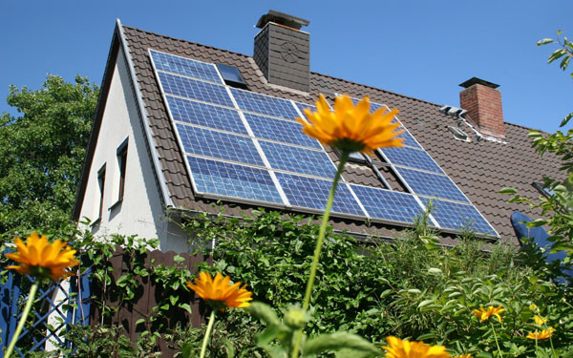
Solar Panels

Slide 3
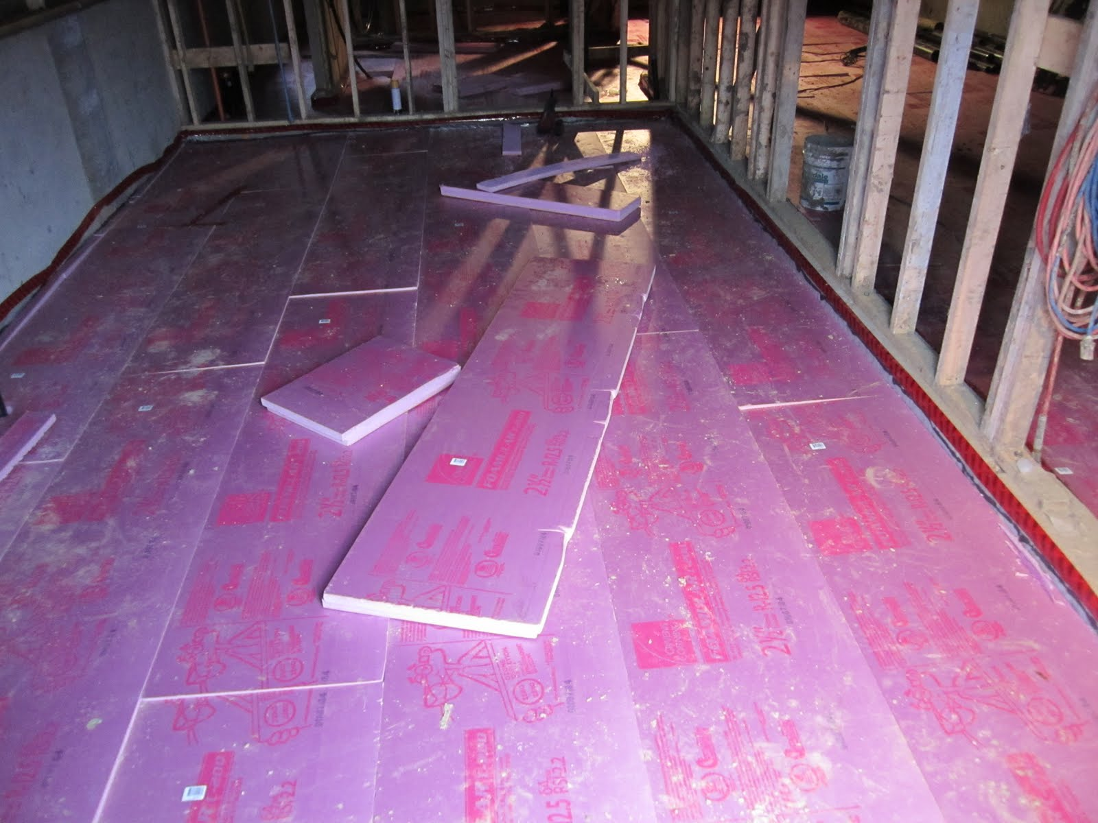
Insulated Basement Floors

Slide 4
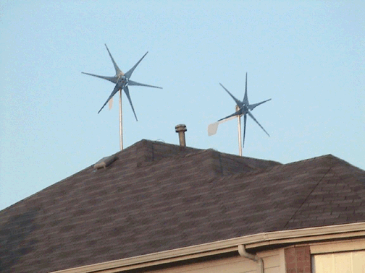
Wind Turbines

Slide 5
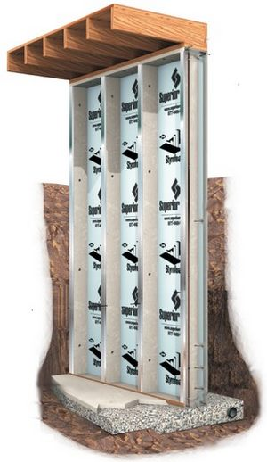
Insulated Foundation Walls

Slide 6
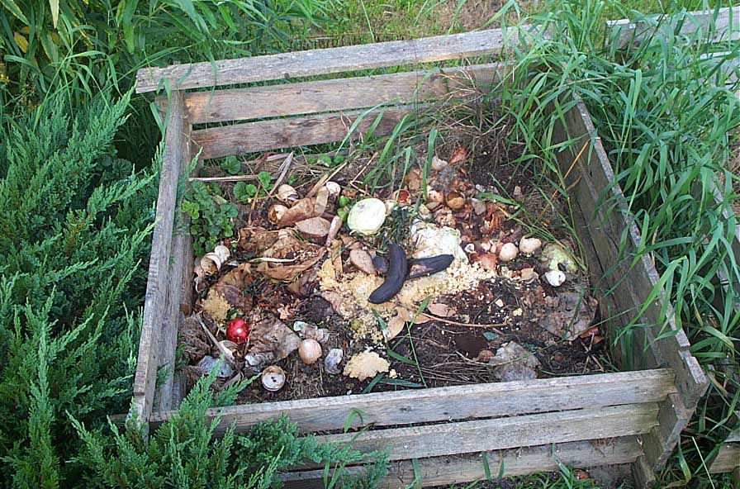
Compost Station

Slide 7
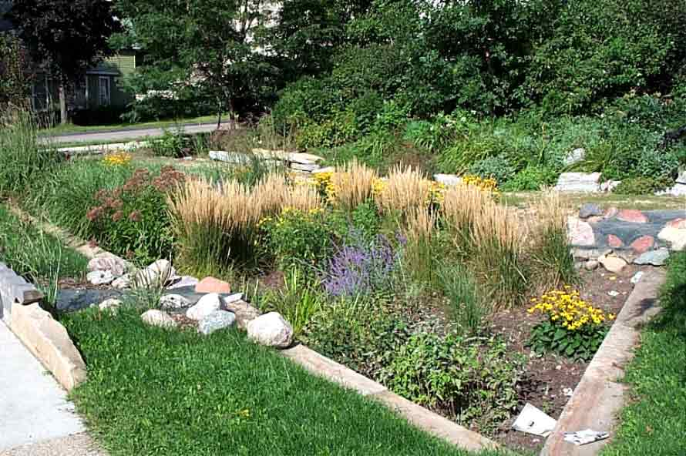
Rain Garden

Slide 8
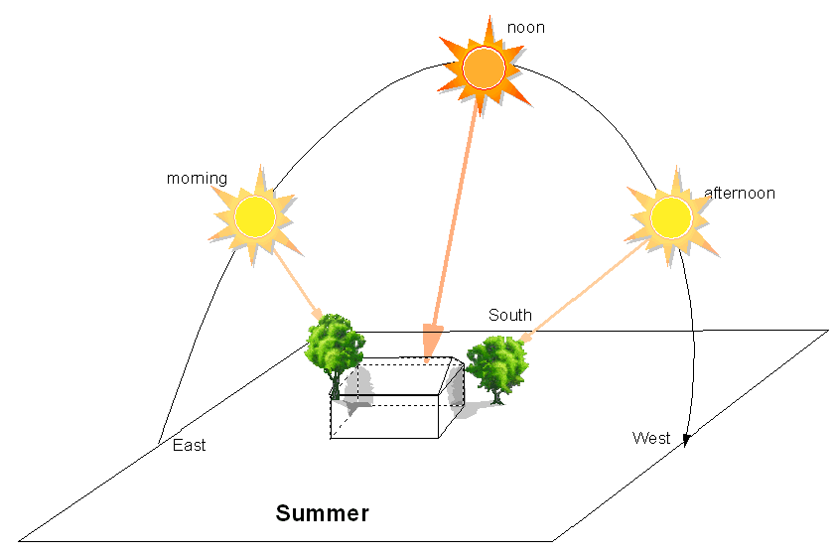
Trees Planted on East and West

Slide 9
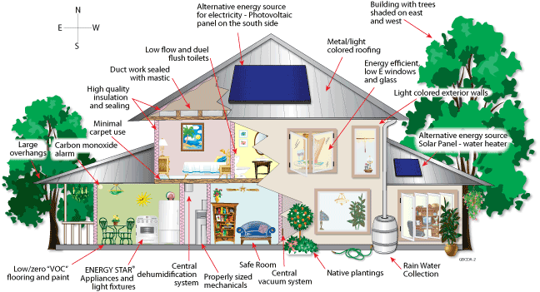
All Together…

Slide 10
Making Livable Communities
Terrace Town Workshop

Slide 11
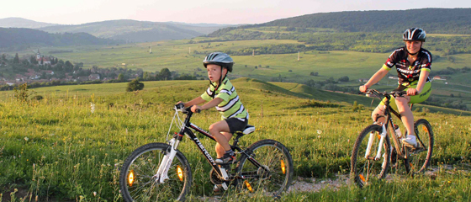
Conserve Landscapes

Slide 12
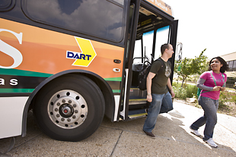
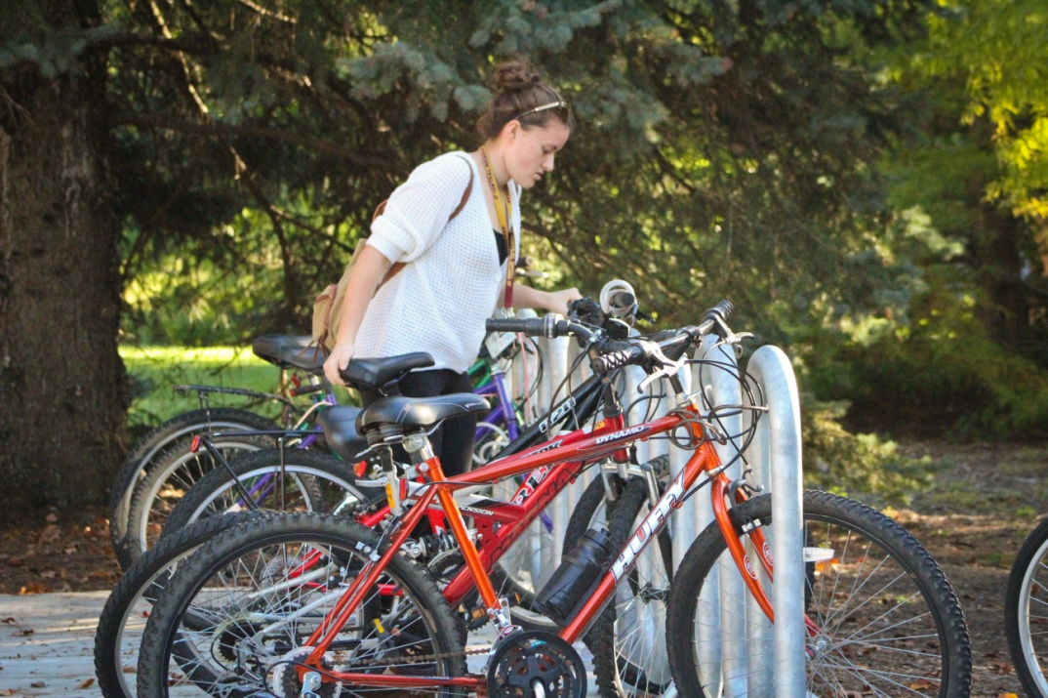
Vary Transportation Options

Slide 13
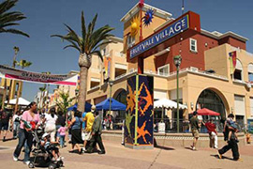
Encourage Mixed-Use Development

Slide 14
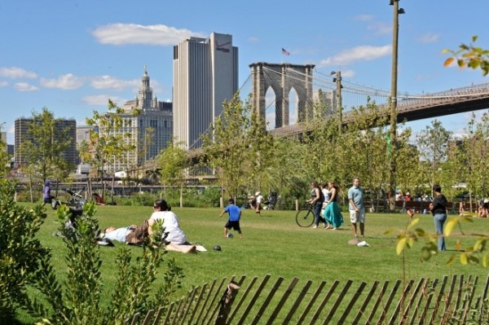
Build Vibrant Public Spaces

Slide 15
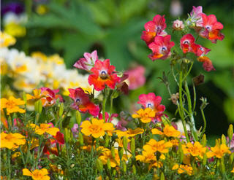
Protect Environmental Resources

Slide 16
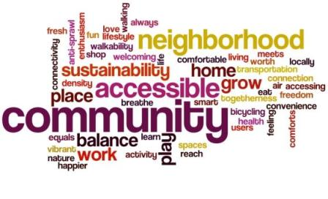

Slide 17
Passive solar for Terrace Town!
Considerations:
Orientation of design features to sun and wind
Exterior surface color
Windows strategically placed
Thermal mass- materials that absorb heat to help in keeping indoors warm or keep cool air out

