Slide 1
Uncommon Buildings

Slide 2
Commercial Buildings
La Cabaret de L’ Enfer
Paris, France 1898

Slide 3
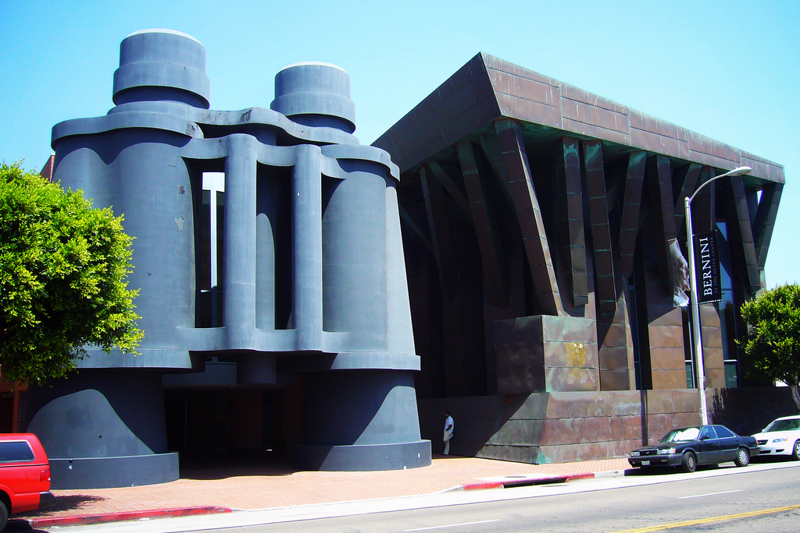
Binoculars Building
Los Angeles, California 1991

Slide 4
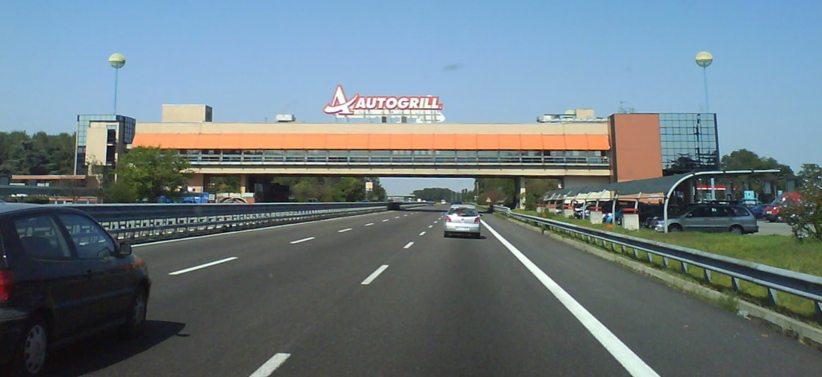
Pavesi Autogrill Restarante Montepulciano, Italy 1967

Slide 5
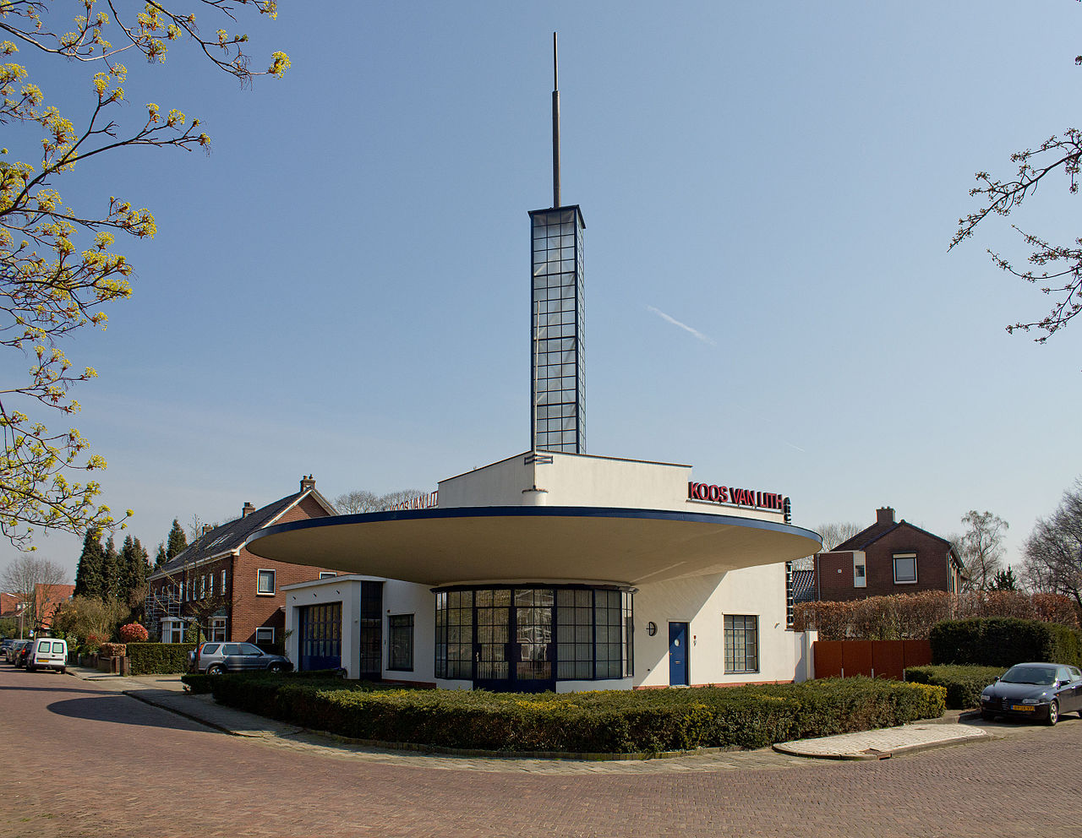
Auto Palace Gas Station
Muldersweg, Netherlands, 1936

Slide 6
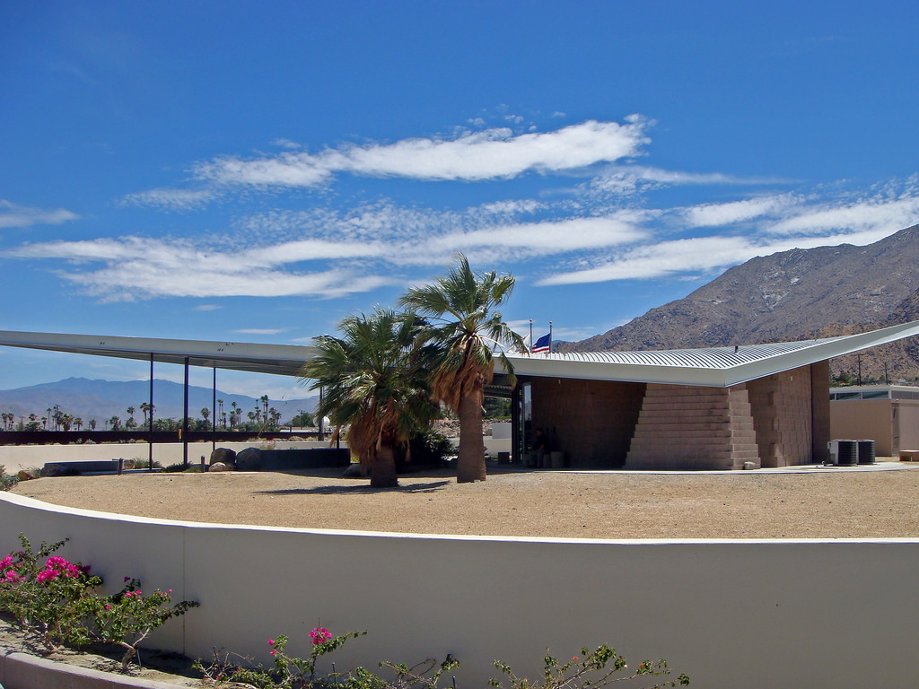
Enco Gas Station
Palm Springs, California 1965

Slide 7
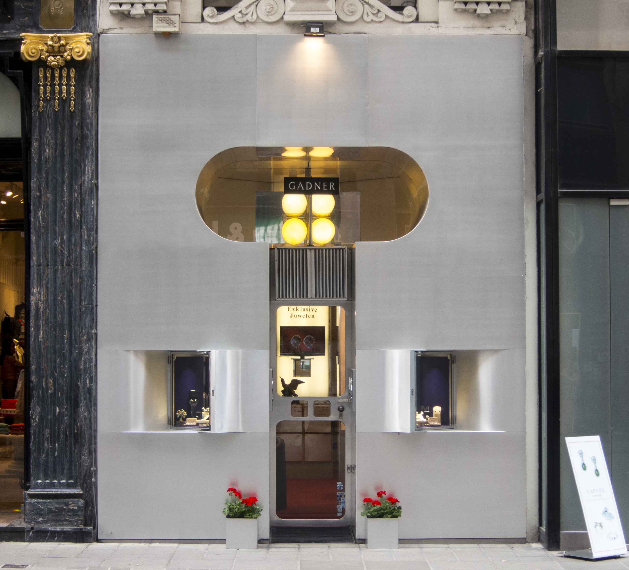
Retti Candle Shop
Vienna, Austria, 1965

Slide 8
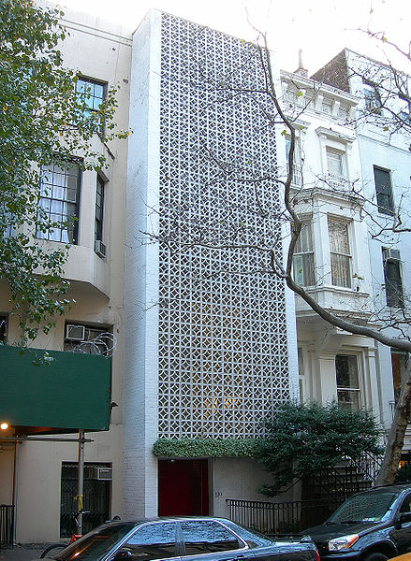
Residential Buildings
Remodeled Brownstone
designed by architect Edward Durrell Stone
New York, NY 1956

Slide 9
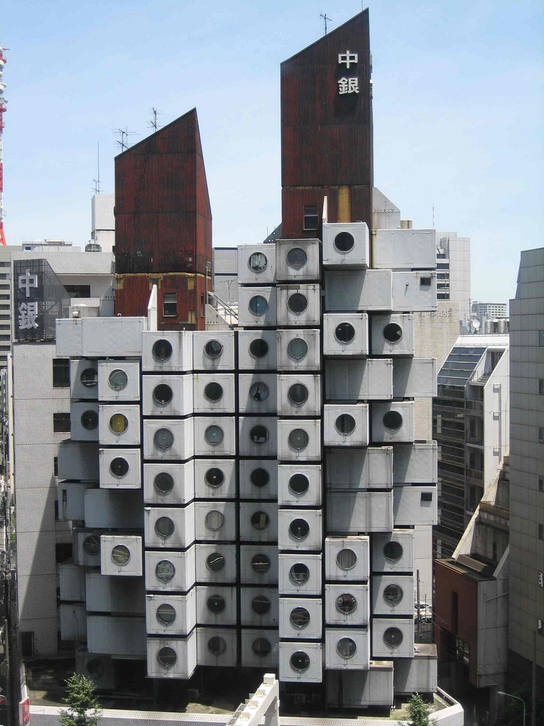
Nakagin Capsule Tower
Tokyo, Japan 1972

Slide 10
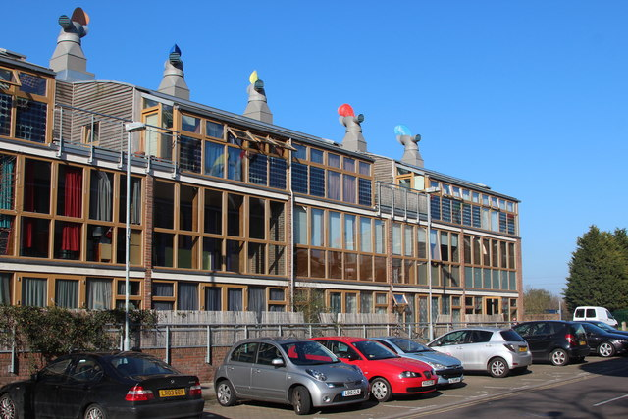
BedZED Zero Carbon Community
London, England 2002

Slide 11
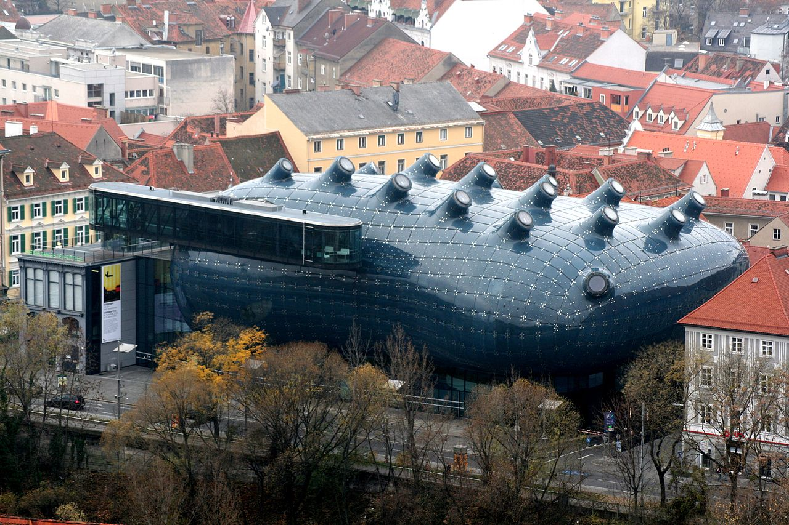
Kunsthaus Graz
Graz, Austria
2003

Slide 12
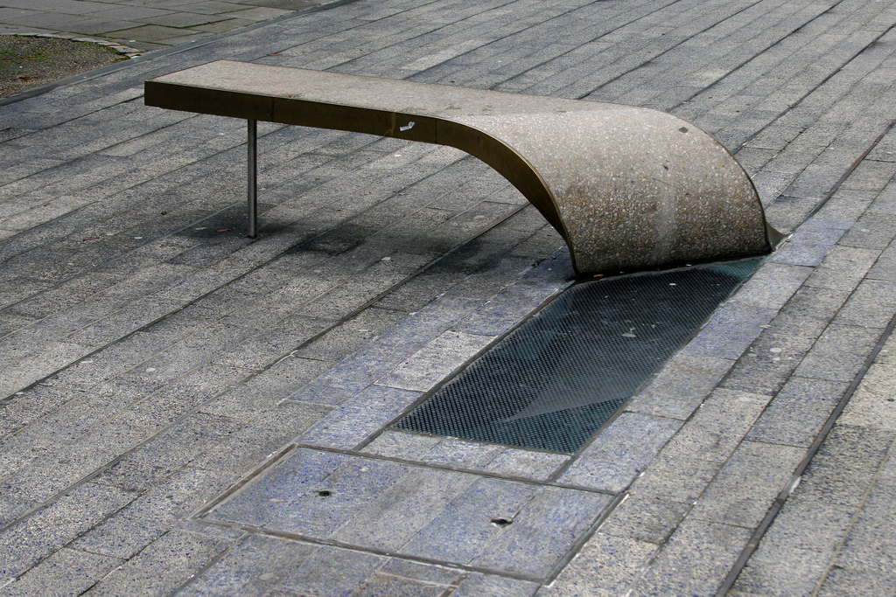
Civic Structures
The Blue Carpet Bench
New Castle, England 2001

Slide 13
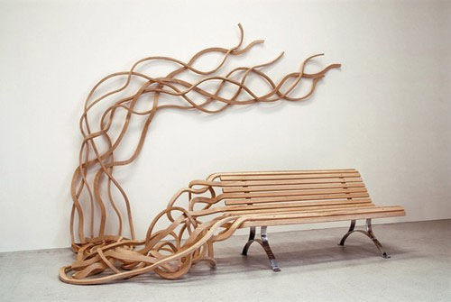
Spaghetti bench
Various locations

Slide 14
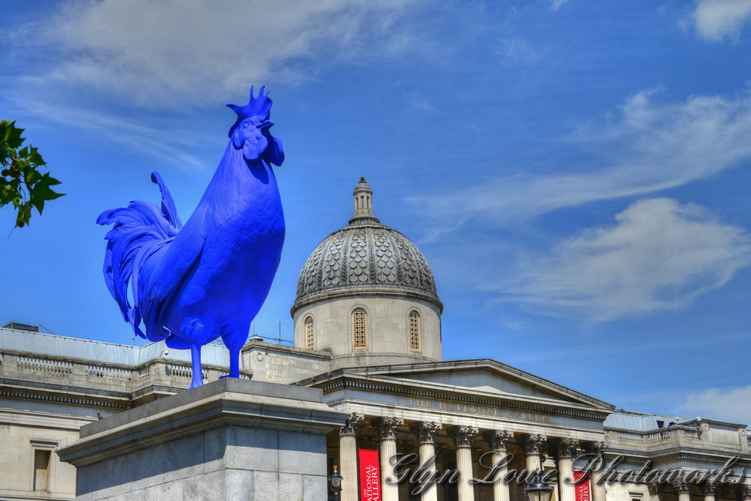
Hahn/Cock Trafalgar Square London, England 2013

Slide 15
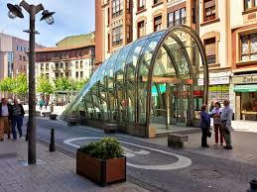
Metro entrance
Bilbao, Spain 1995

Slide 16
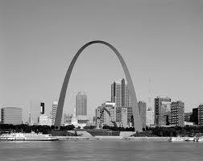
Gateway Arch
St. Louis 1965

Slide 17
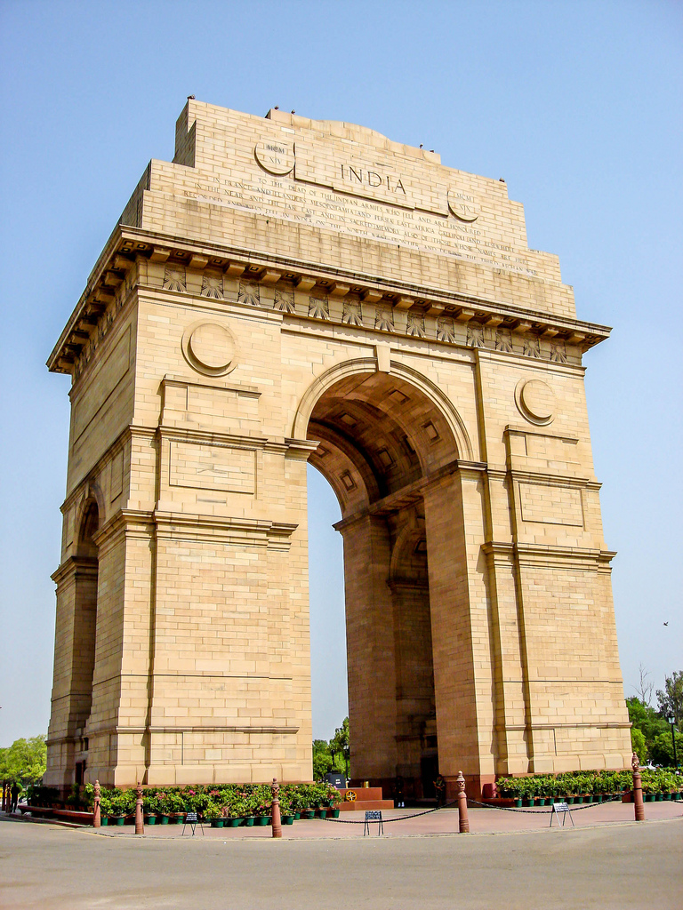
India Gate
Delhi, 1931

Slide 18
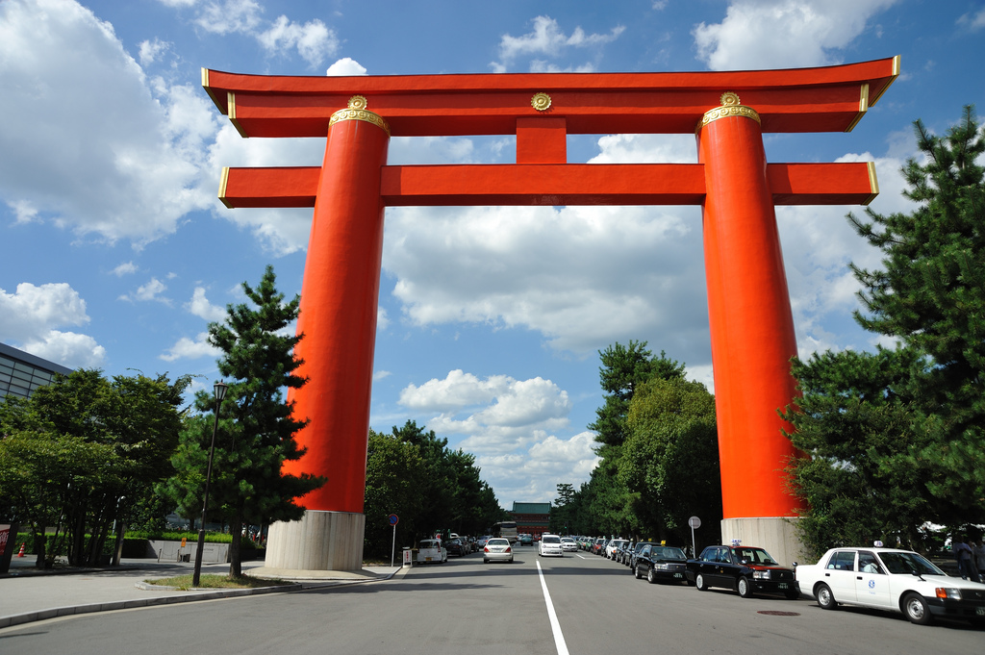
Heian- Jingu Shrine
Kyoto, Japan 1895

Slide 19
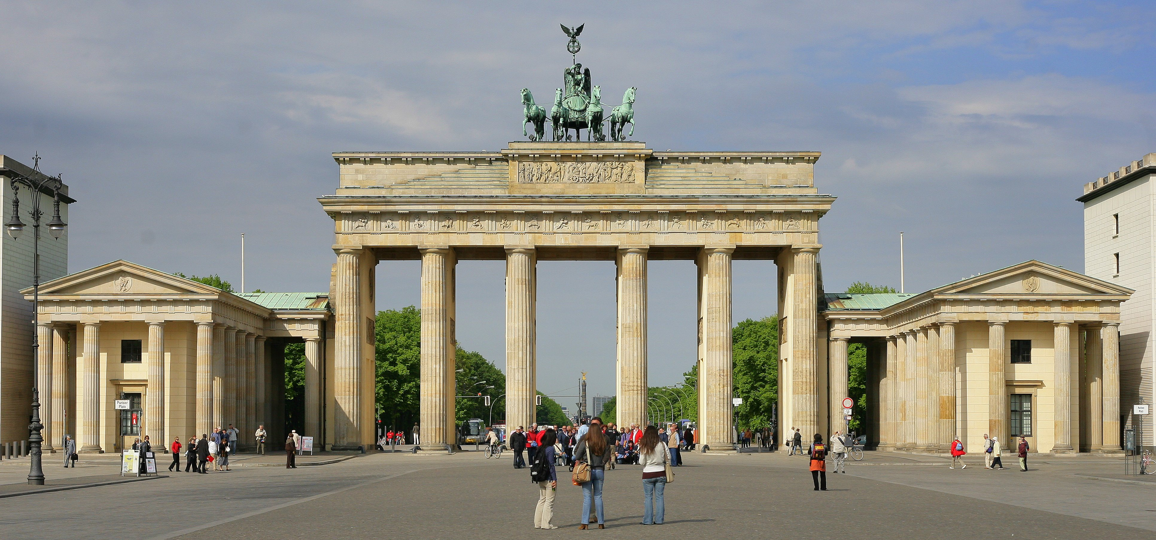
Brandenburg Gate Berlin, Germany 1791

Slide 20
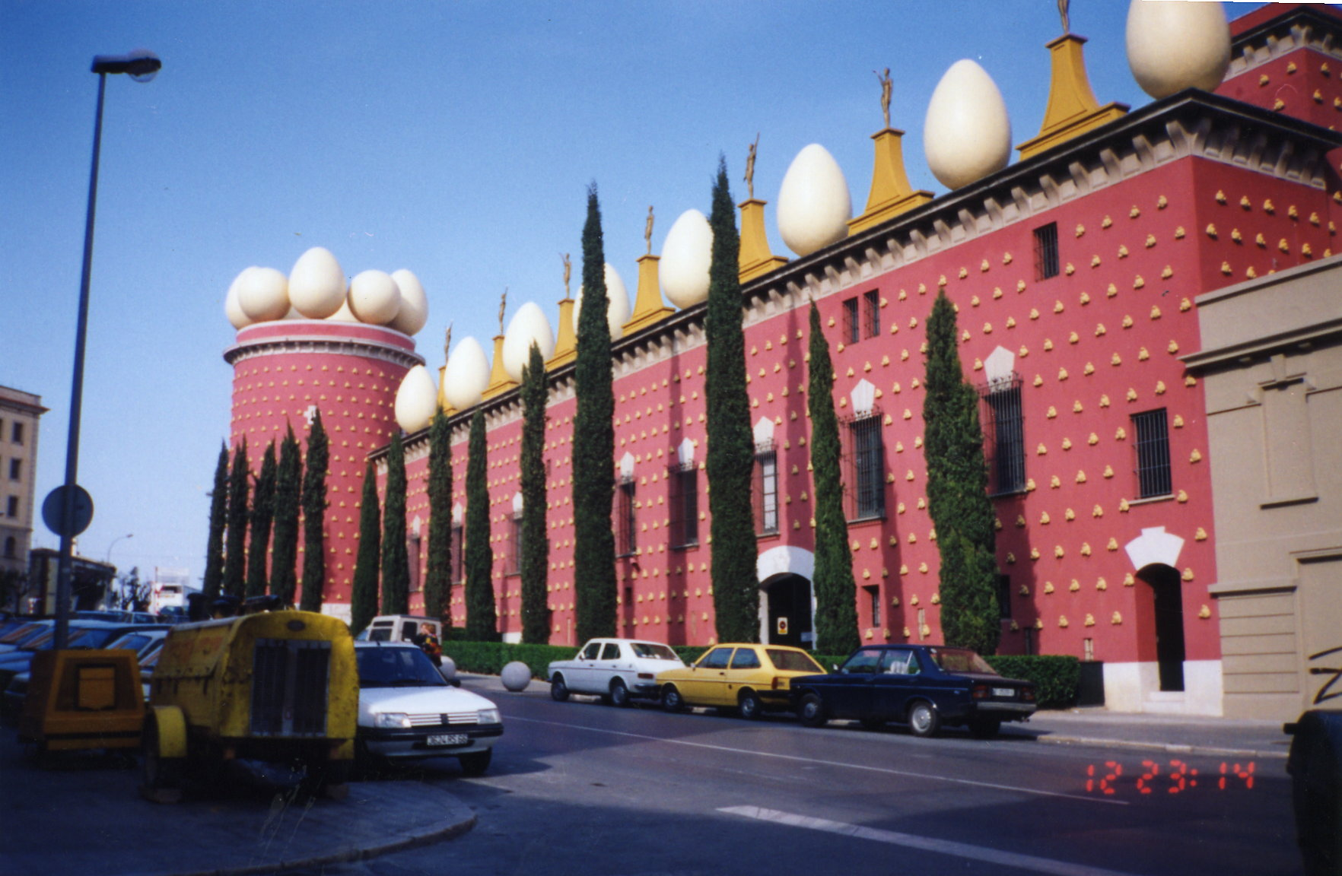
Salvador Dali Theatre-Museum Figueres, Spain 1974

Slide 21
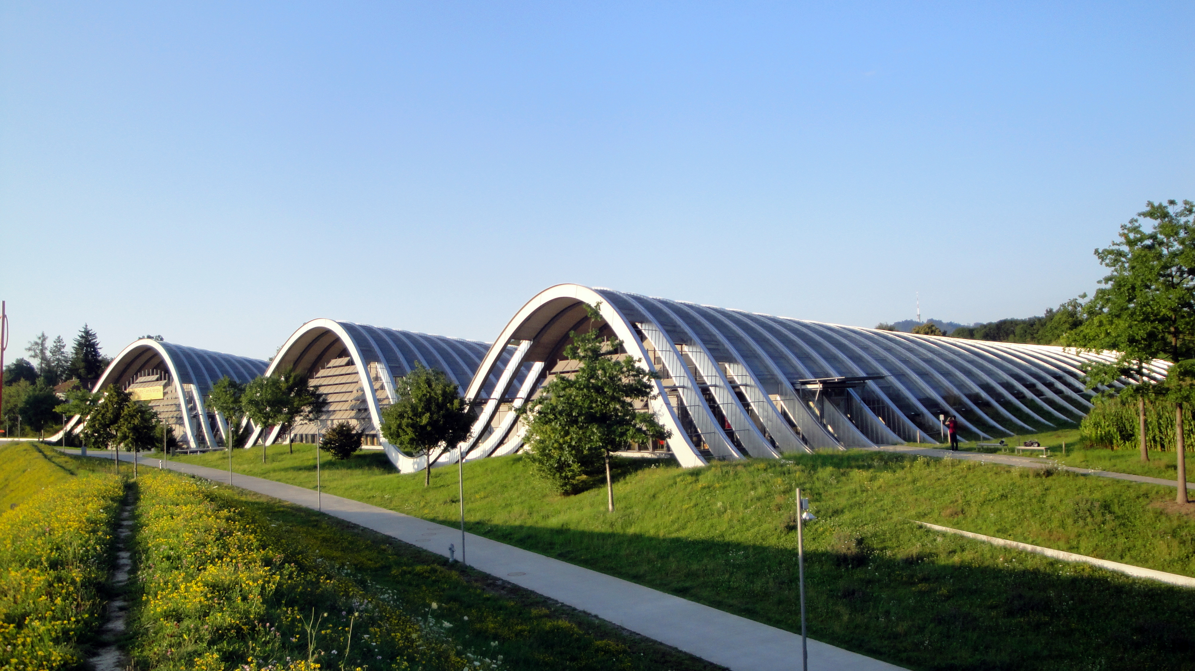
Zentrum Paul Klee Museum Bern, Switzerland 2005

Slide 22
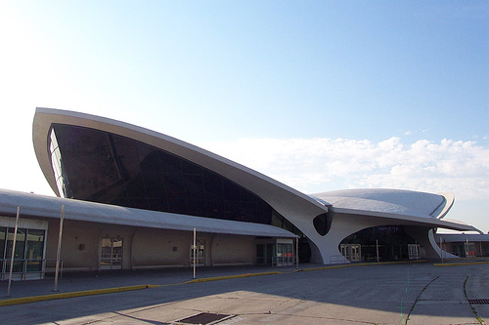
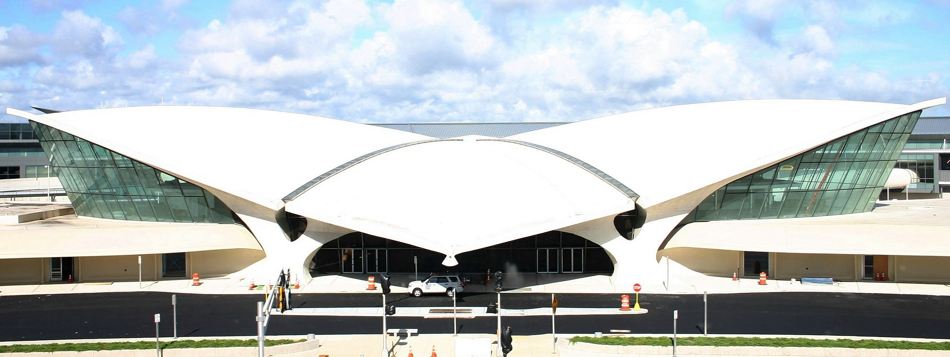
TWA Terminal at JFK International Airport
New York, New York
1962

