Slide 1
Madison Places

Slide 2
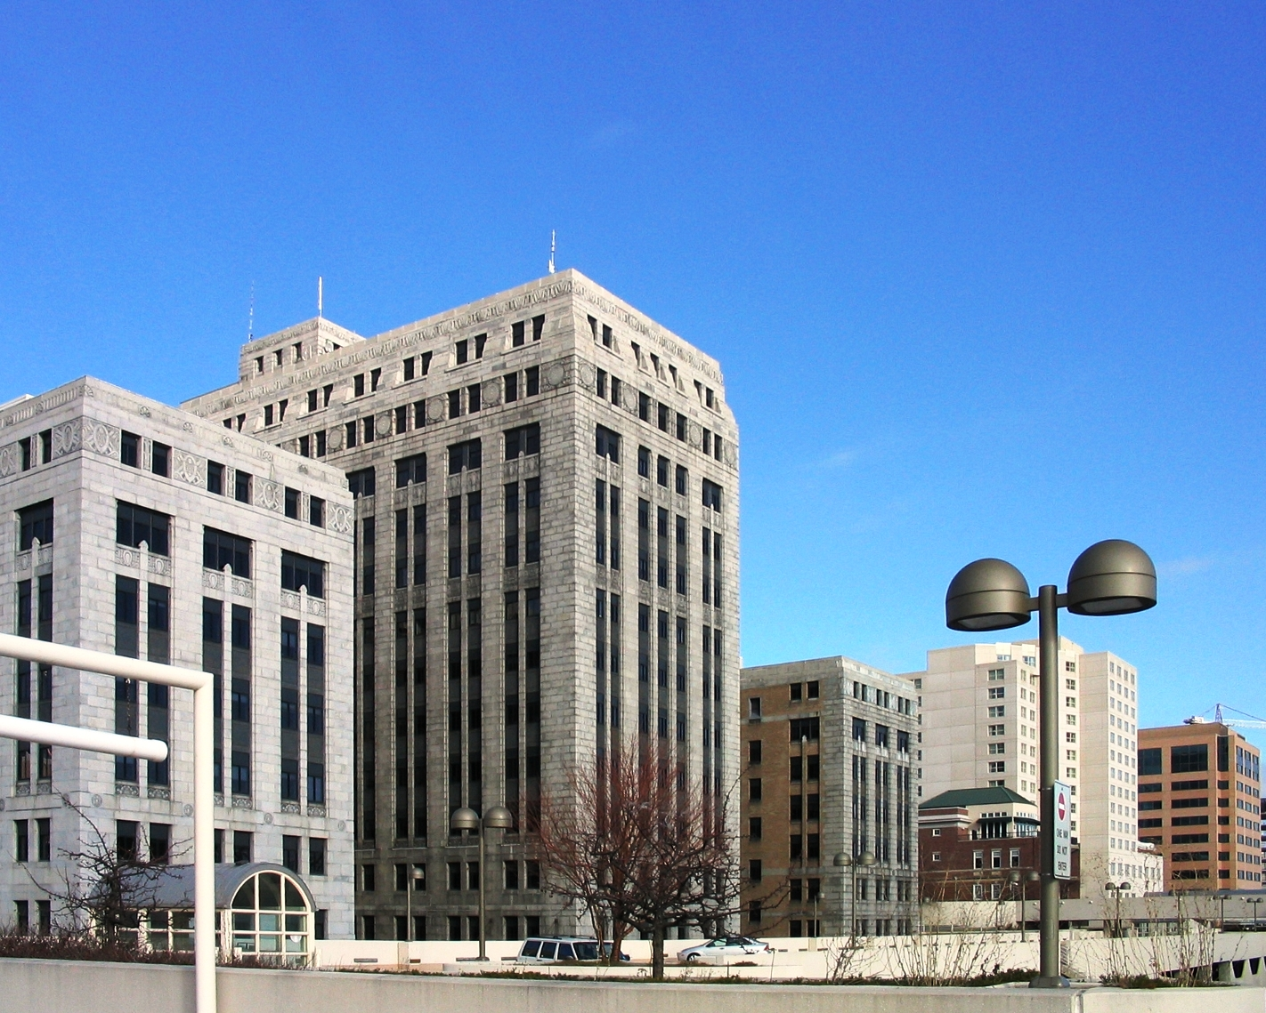
Notes:
1 West Wilson State Government Building

Slide 3
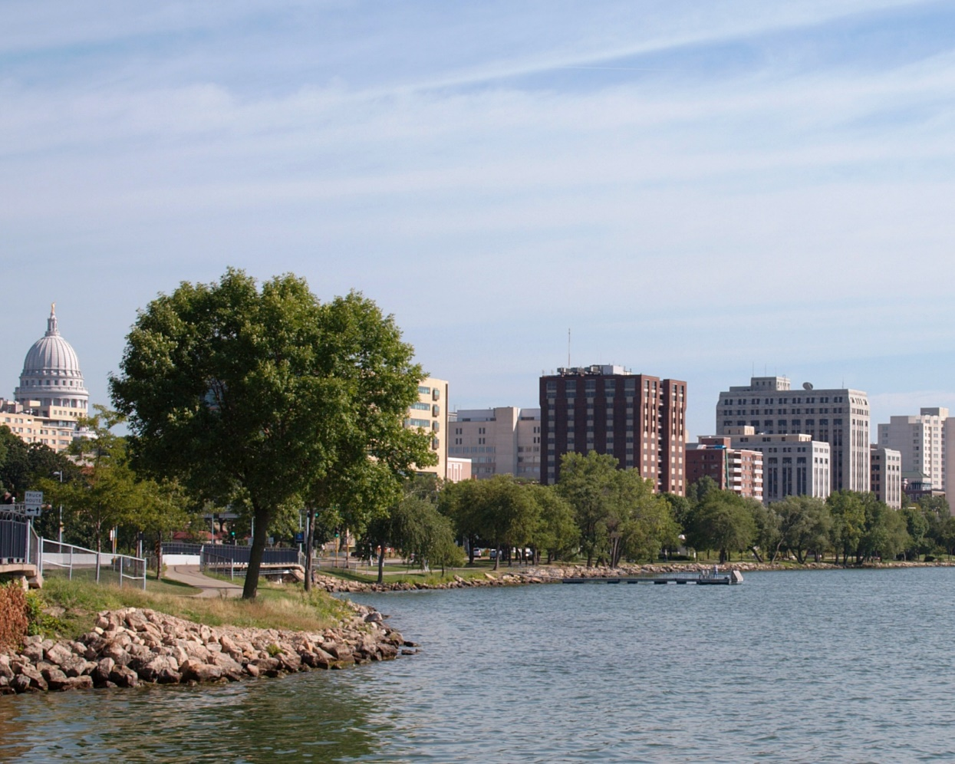
Notes:
Lake Monona Shoreline

Slide 4
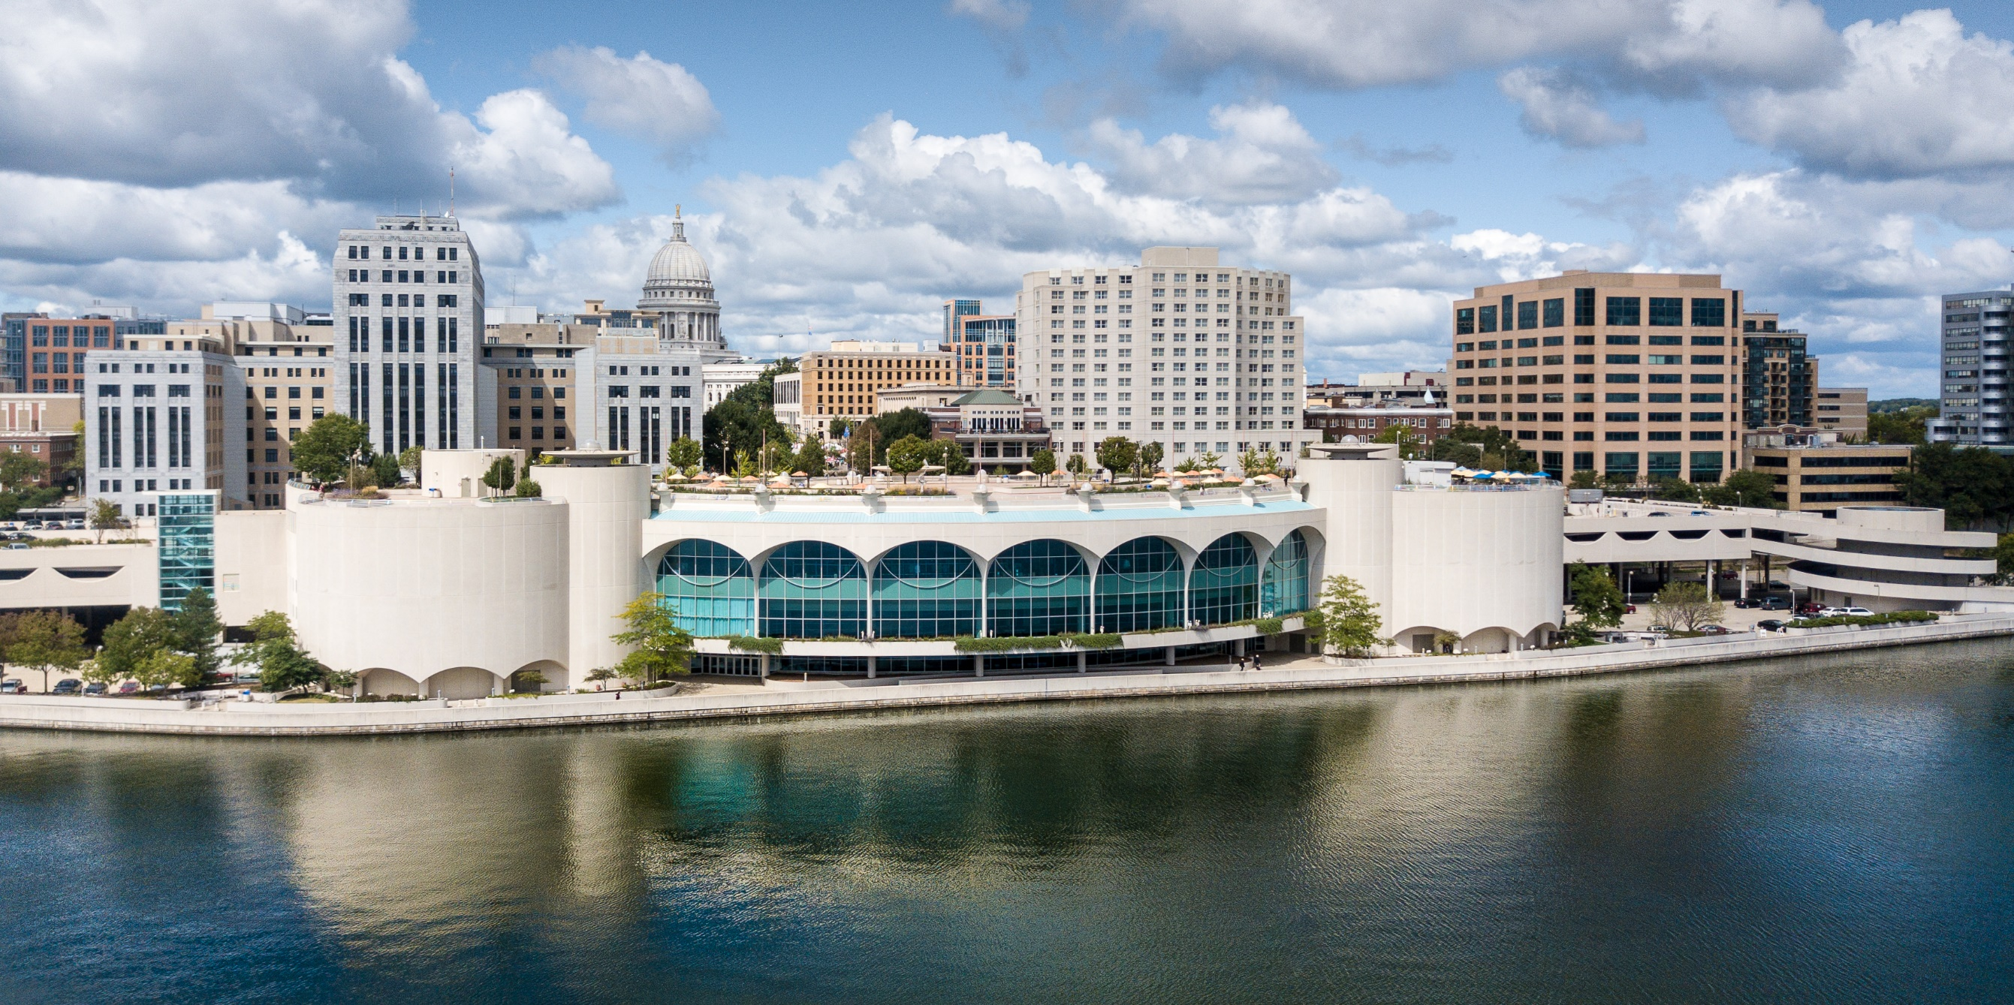
Notes:
Monona Terrace Community and Convention Center

Slide 5
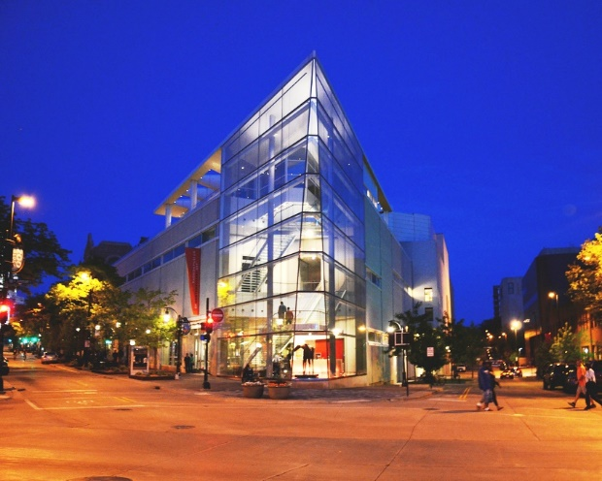
Notes:
Madison Museum of Contemporary Art

Slide 6
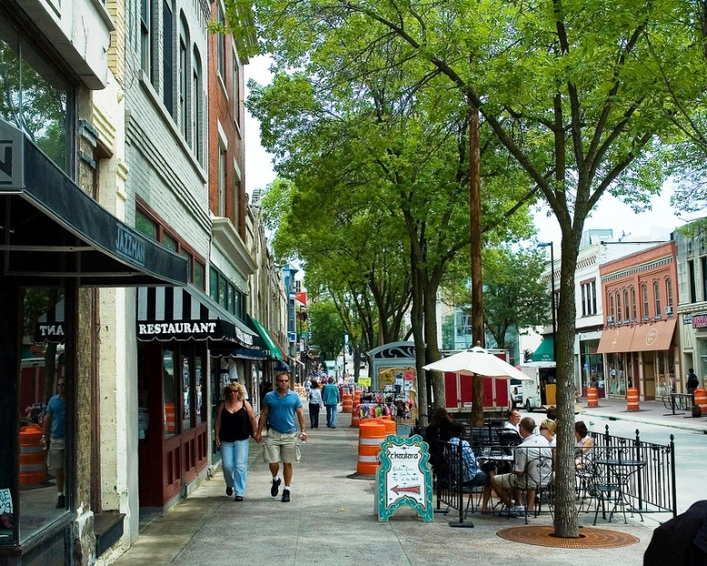
Notes:
State Street

Slide 7
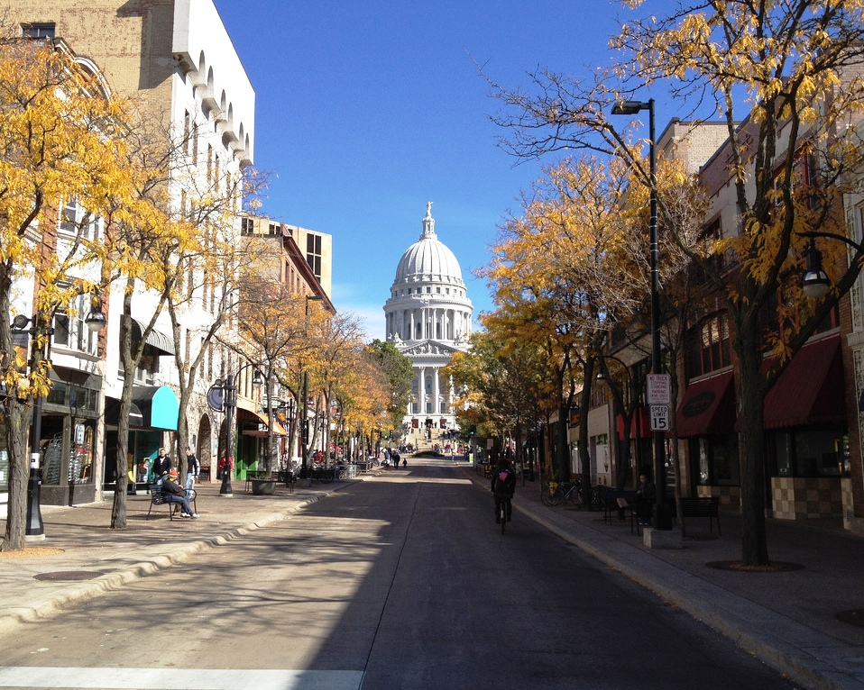
Notes:
State Street

Slide 8
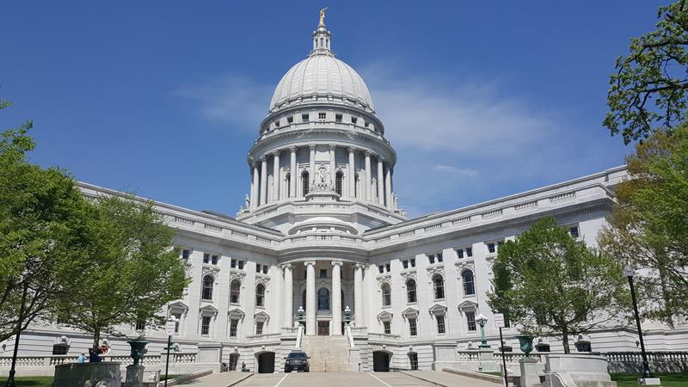
Notes:
Wisconsin State Capitol

