Slide 1
Livable Communities

Slide 2
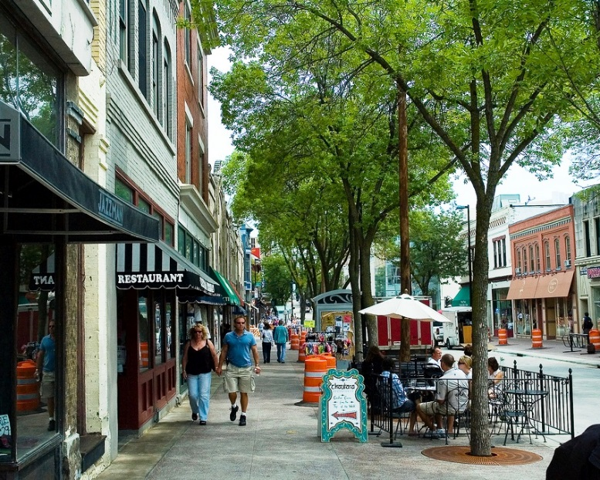
Notes:
Design on a Human Scale

Slide 3
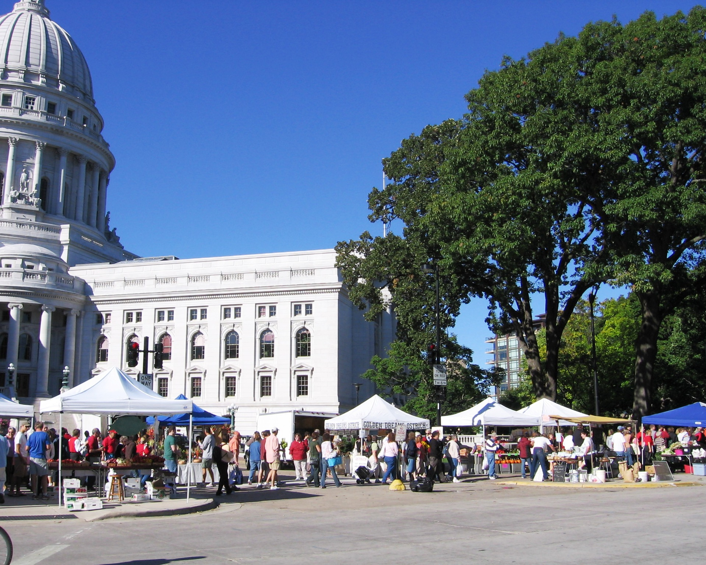
Notes:
Provide Choices

Slide 4
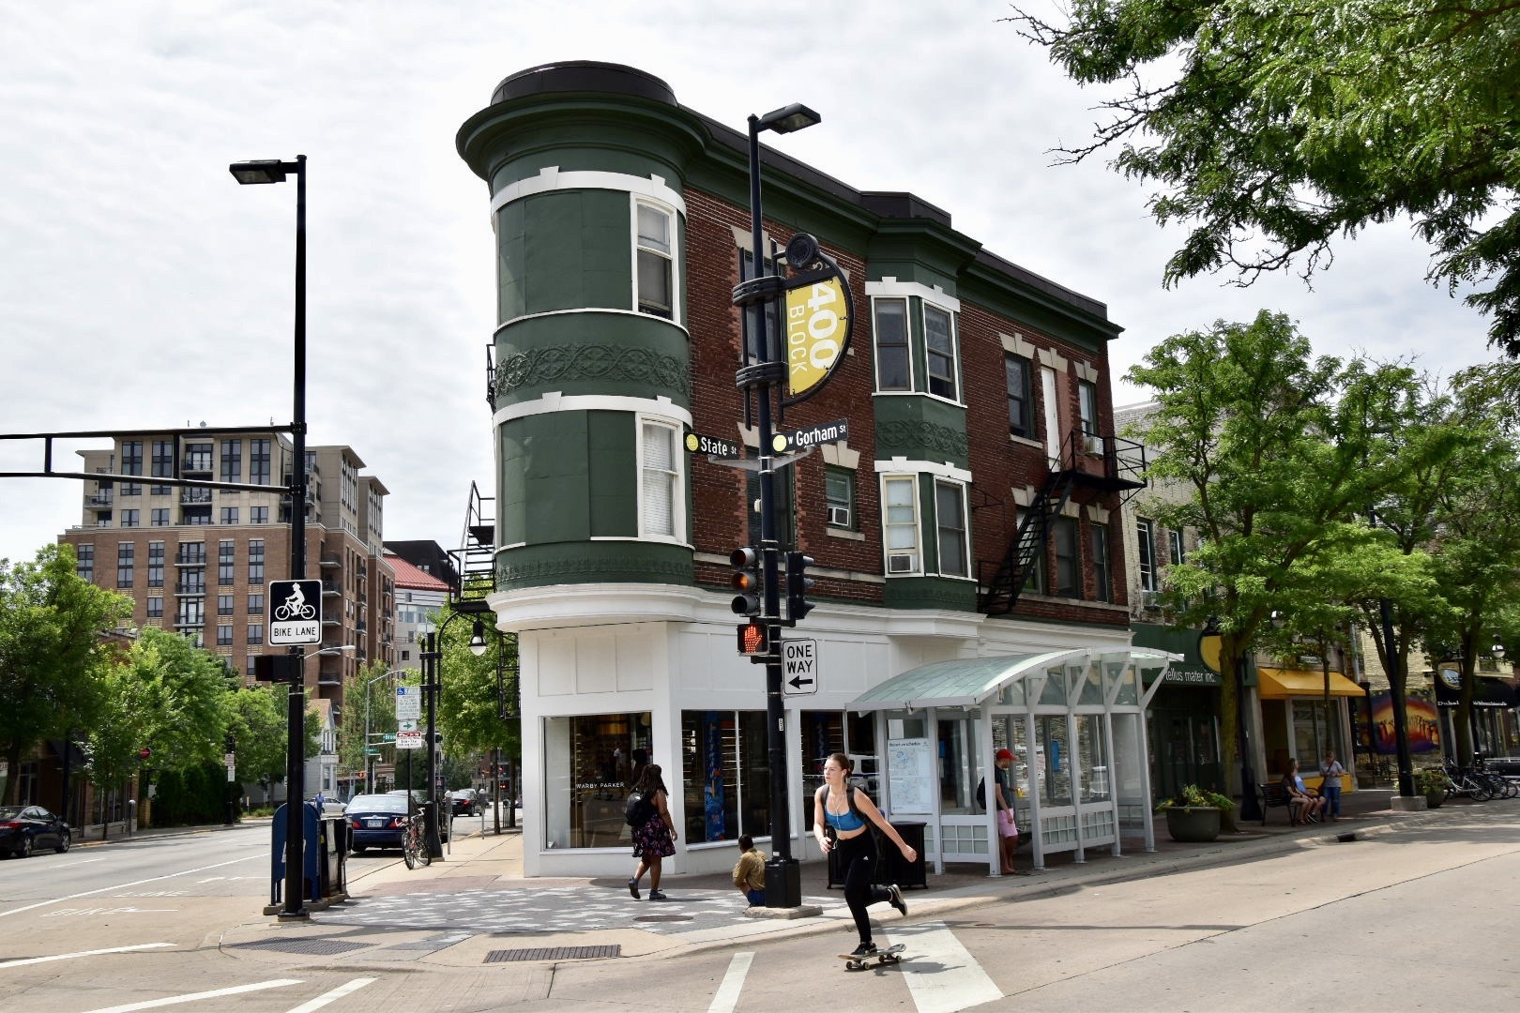
Notes:
Encourage Mixed-Use Development

Slide 5
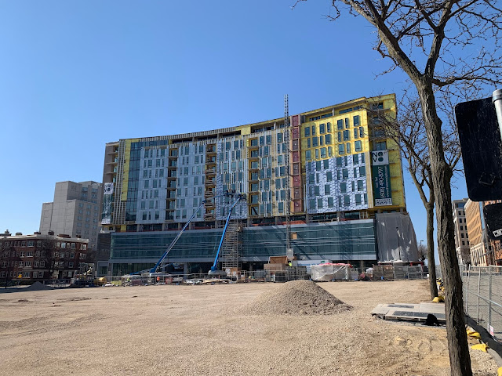
Notes:
Preserve Urban Centers

Slide 6
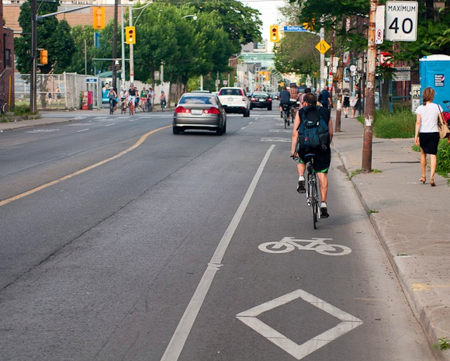
Notes:
Provide Transportation Options

Slide 7
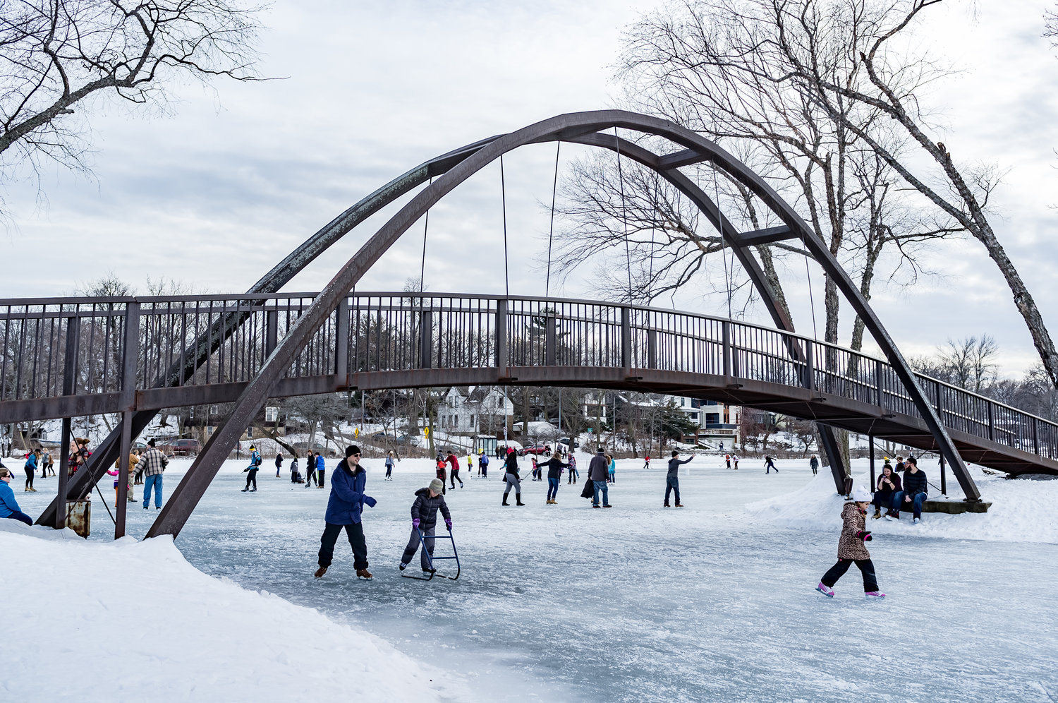
Notes:
Build Vibrant Public Spaces

Slide 8
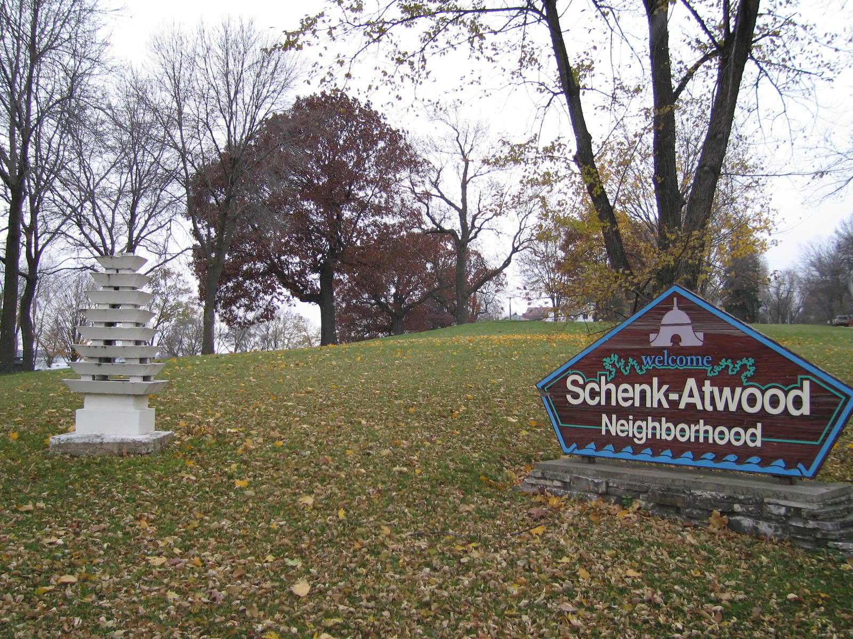
Notes:
Create a Neighborhood Identity

Slide 9
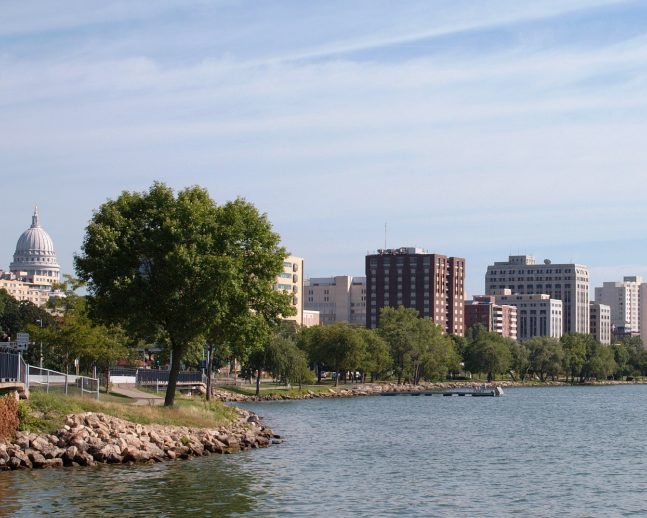
Notes:
Protect Environmental Resources

Slide 10
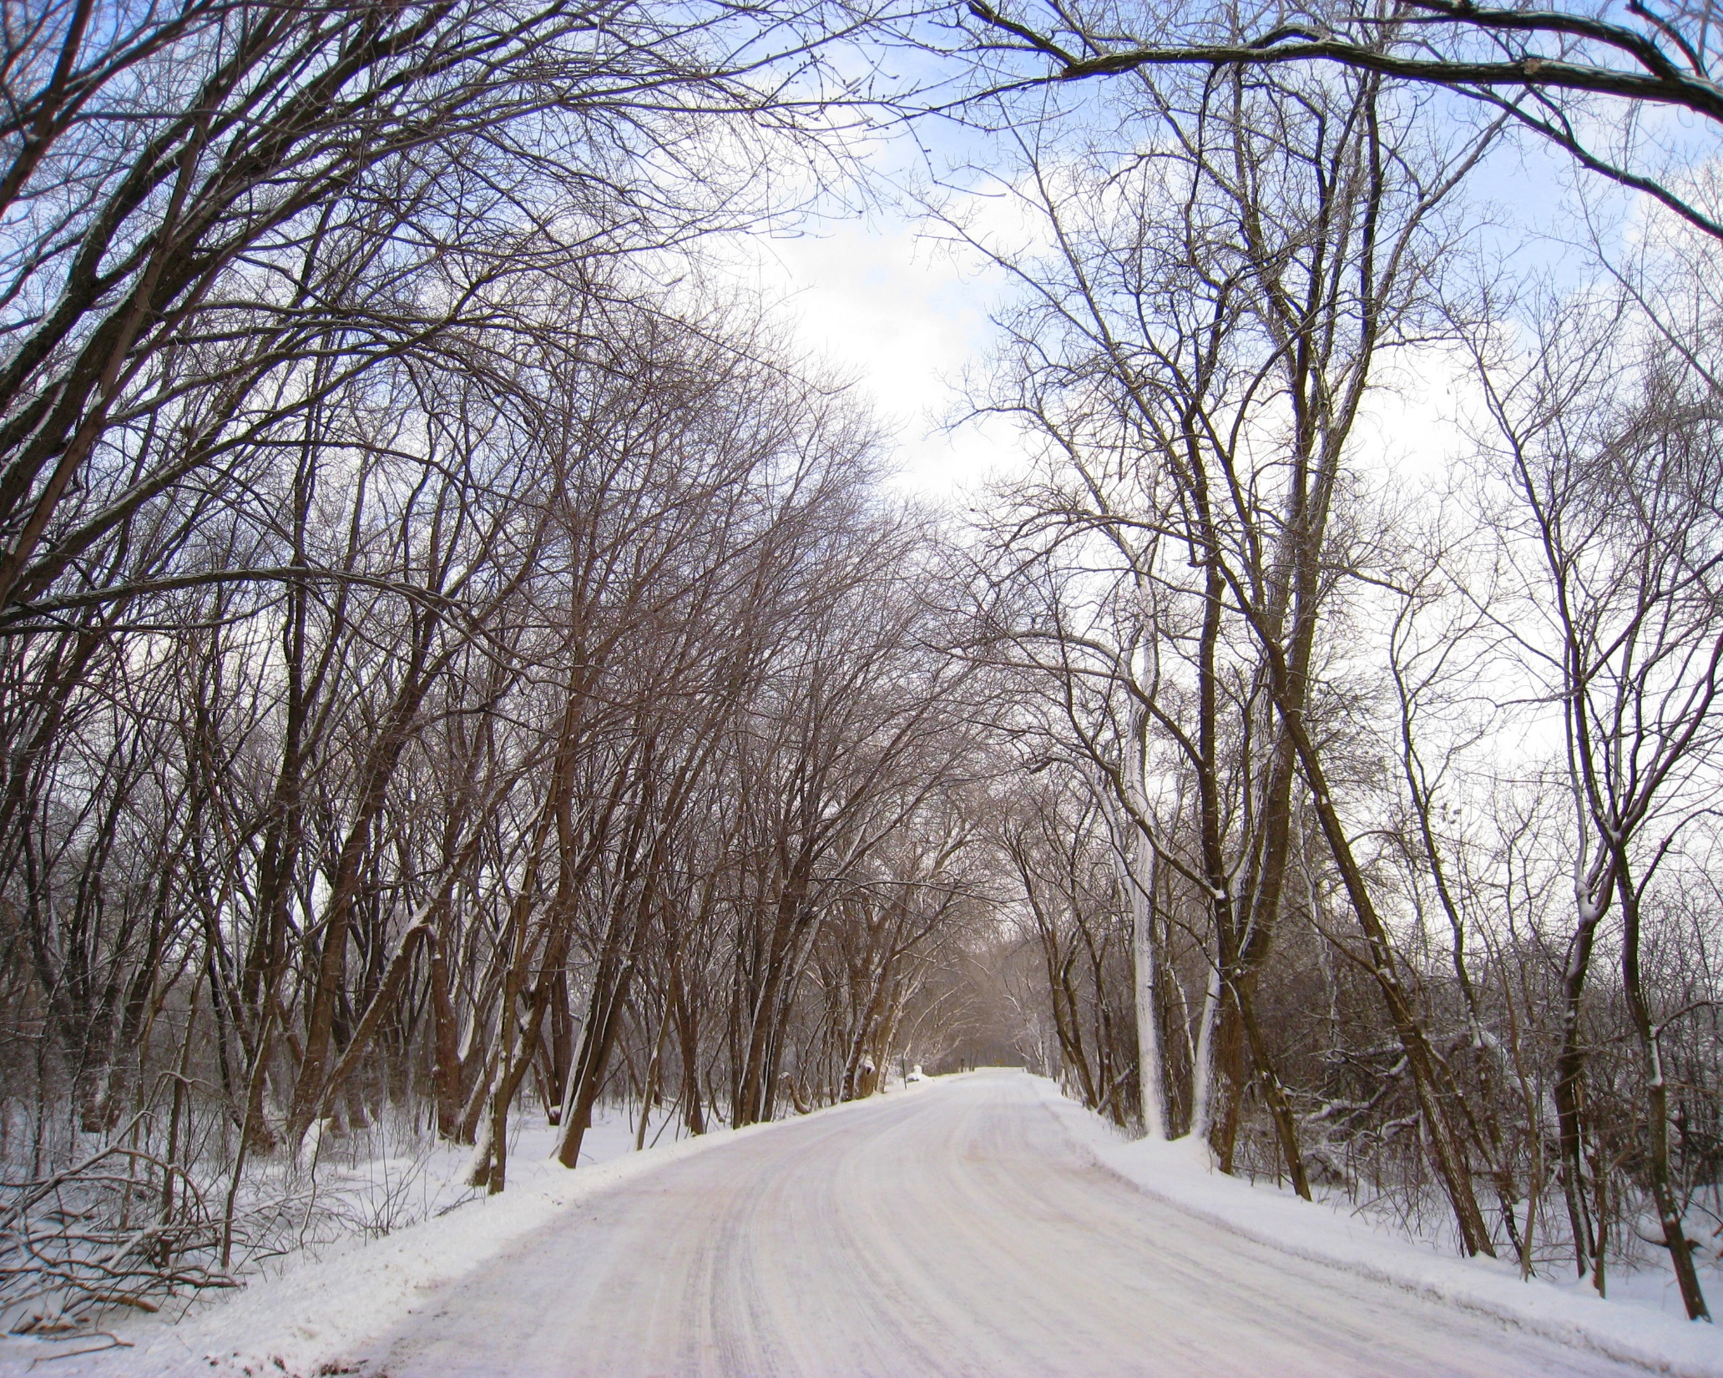
Notes:
Conserve Landscapes

Slide 11
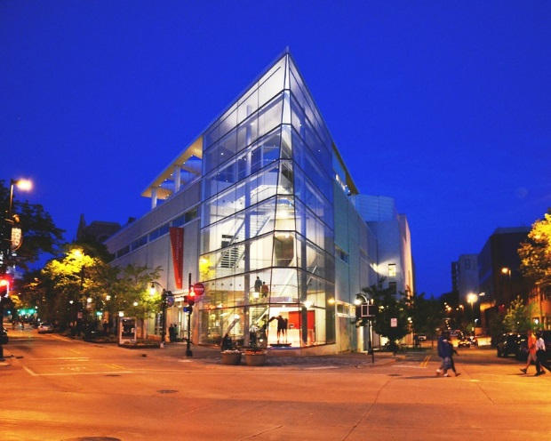
Notes:
Design Matters

