Slide 1
Form and Function
Notes:
Look carefully at the following buildings…

Slide 2
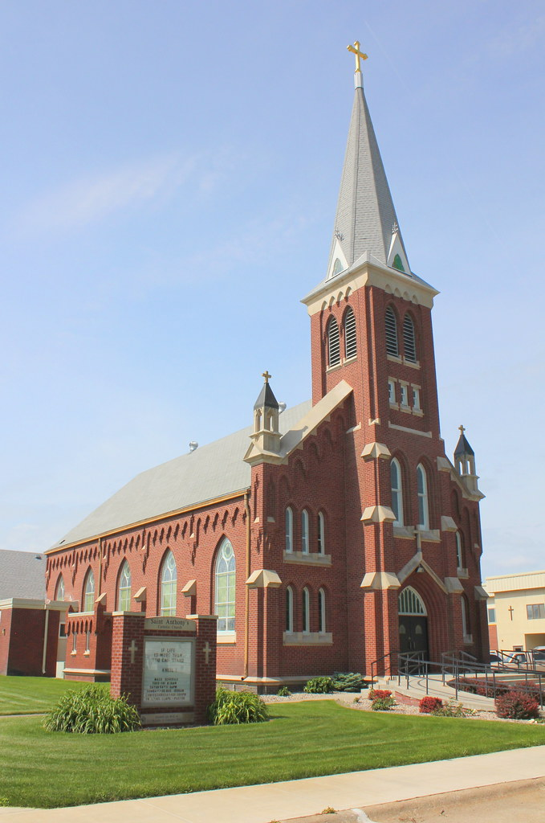
Notes:
What type of building is this? What is its function (what is it used for?)
How do you know?
Can you describe the parts that give you clues to its function?

Slide 3
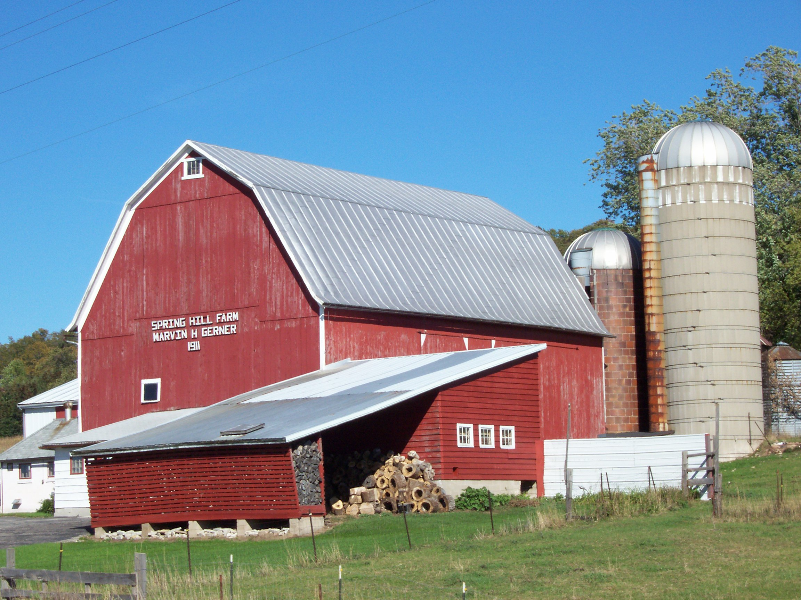
Notes:
What type of building is this? What is its function (what is it used for?)
How do you know?
Can you describe the parts that give you clues to its function?

Slide 4
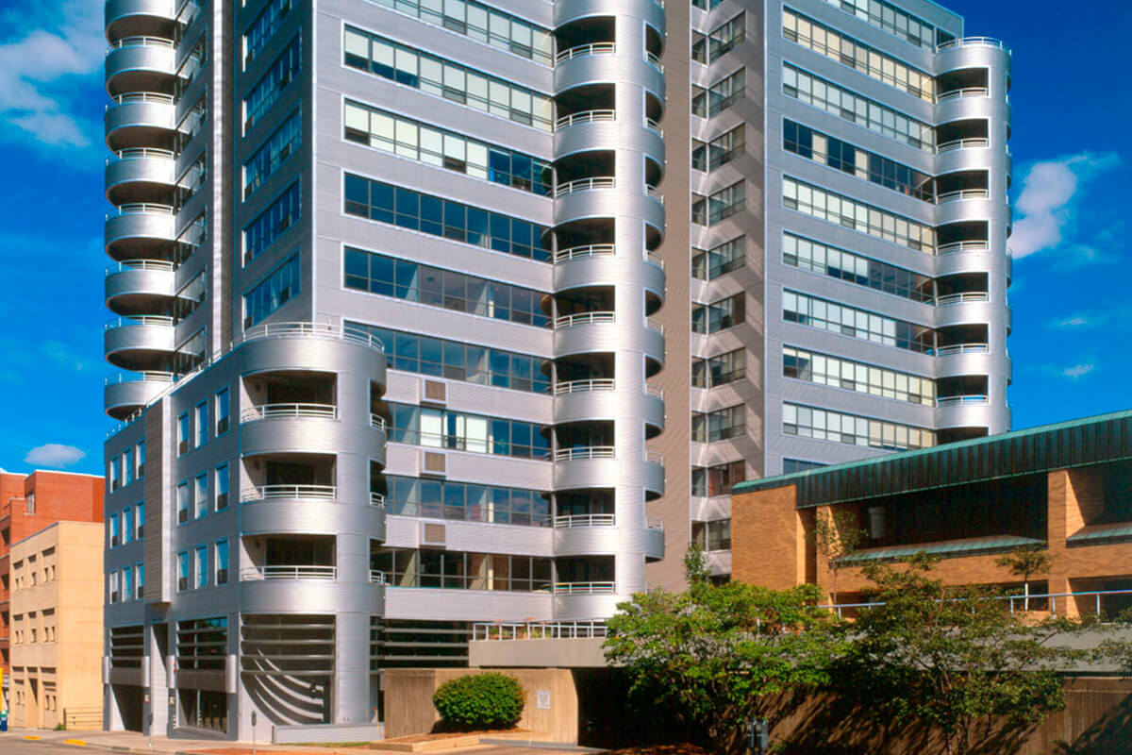
Notes:
What type of building is this? What is its function (what is it used for?)
How do you know?
Can you describe the parts that give you clues to its function?

Slide 5
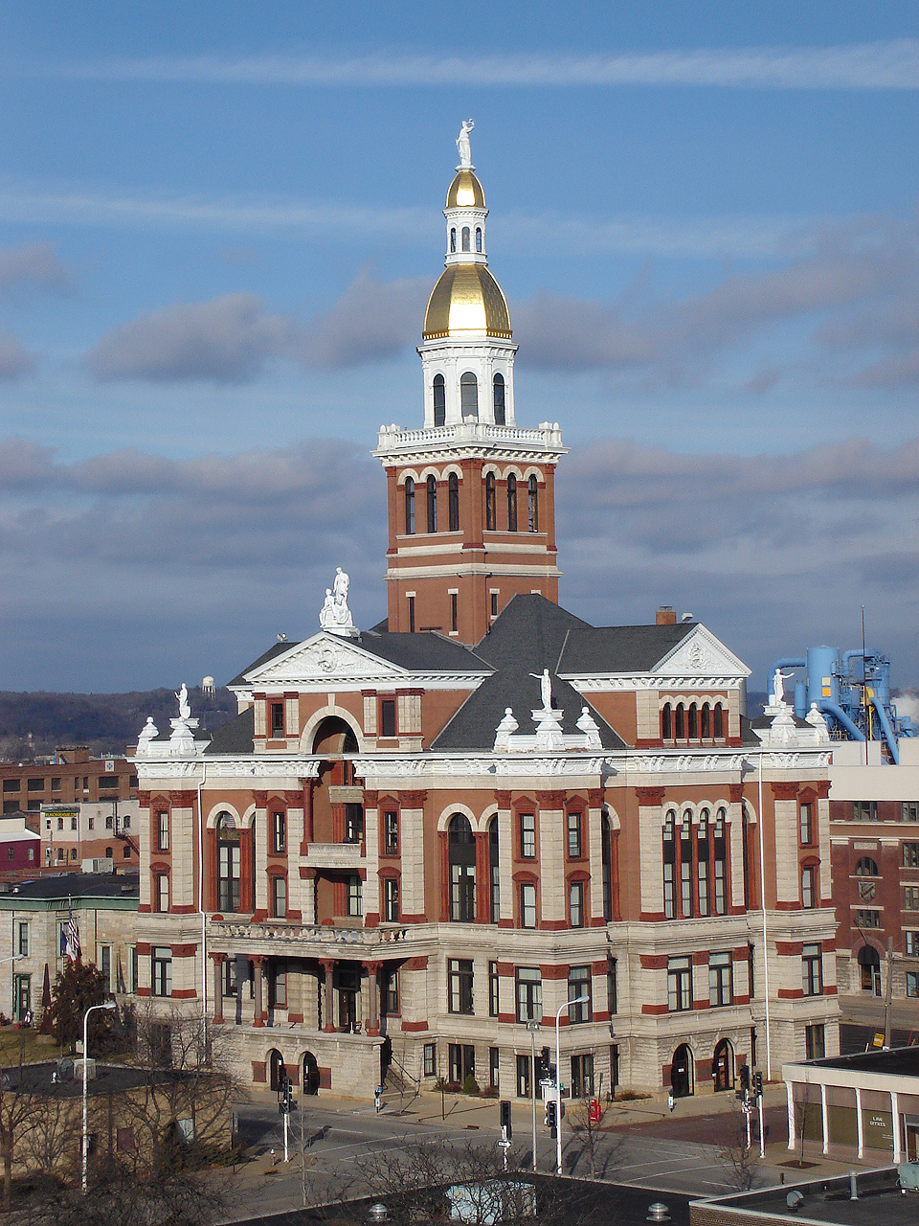
Notes:
What type of building is this? What is its function (what is it used for?)
How do you know?
Can you describe the parts that give you clues to its function?

