Slide 1

Examples of Building Types

Slide 2
Residential

Slide 3
Residential

Slide 4
Mixed Use- Commercial and Residential

Slide 5
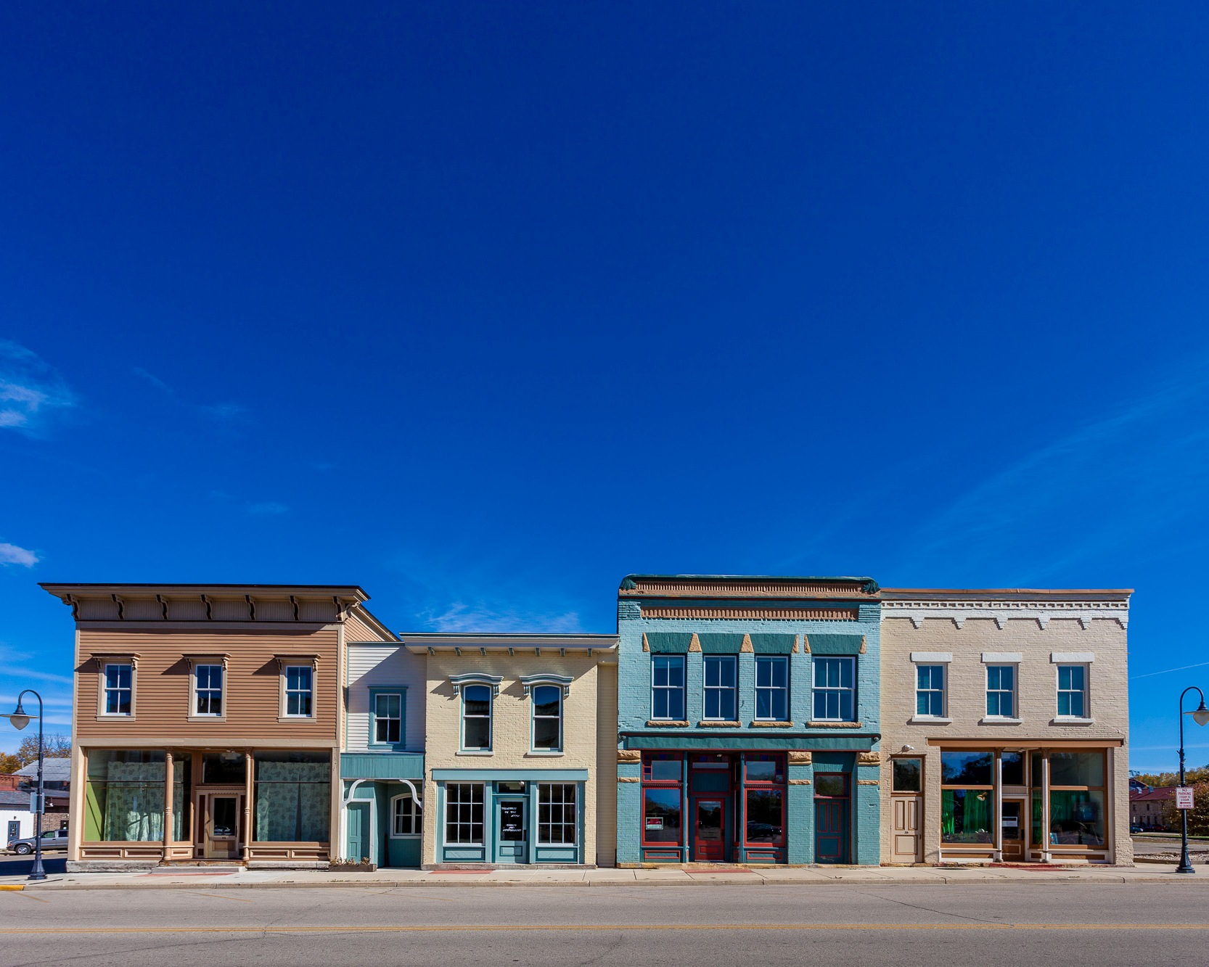
Mixed Use- Commercial and Residential

Slide 6
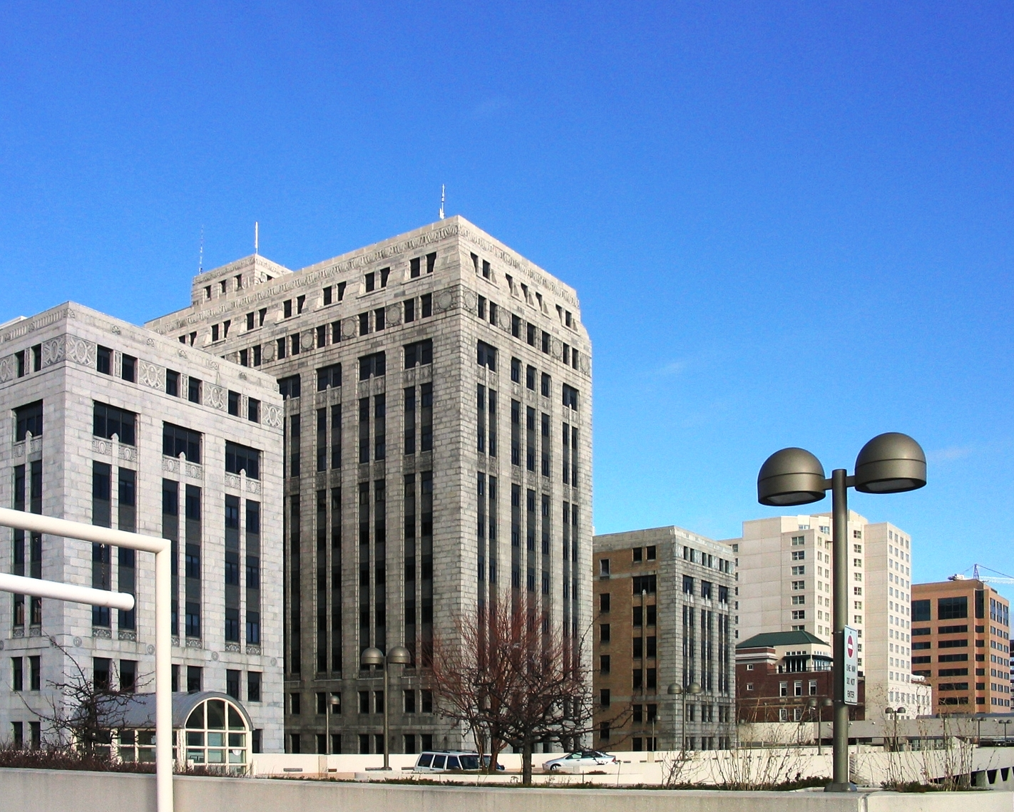
Civic- Government

Slide 7
Industrial

