Slide 1

Communicating for Understanding
Tips for Effective Tours

Slide 2
Communicating for Understanding: Today’s Agenda
Recognizing barriers to effective communication & verifying audience understanding
Reducing barriers by simplifying communication and numbers
Tools to improve understanding: organizing, previewing, transitions and repetition

Slide 3
Adult Literacy Levels
34-55% of adults are at below basic and basic literacy levels
55%
43%
34%

Slide 4
Literacy in Wisconsin
1,500,000
Wisconsin adults
need literacy services

Slide 5
Those with lower literacy tend to interpret more literally.
Piling
Saucers
Ice wall
Pendants
Grammar
Geometry

Slide 6
Almost everyone will have difficulty with comprehension at some point.
It’s much harder for those who:
  Speak English as their second language.
  Are less educated.
  Are under great stress.

Slide 7
Barriers to effective communication

Slide 8
Understanding is affected by:
Complexity and volume of information
Audience listening skills
Presenter style and skills

Slide 9
Signs you’re losing them
Facial expression
Head tilts
Lack of participation
Distracted; focusing on something else
No questions

Slide 10
Bringing them back
Use questions to focus attention
  “Now, would you like to know how it’s possible to grow trees on the roof?
  “Have you wondered how a building is constructed over water?”
Ask the right questions
“What questions do you have?”
“Tell me your questions.”
(NOT) Do you have any questions?

Slide 11
How to know they are understanding

Slide 12
Verify understanding through TeachBack
Asking people to repeat in their own words what they need to know or do, in a non-shaming way.
NOT a test of the person, but of how well you explained a concept.
A chance to check for understanding and, if necessary, re-explain the information.

Slide 13
Verify understanding through TeachBack
Ask to demonstrate understanding
  “I’ve just given you a lot of information. What is one thing in this room that you found surprising?”
  “What will you remember most about this… room?” Or at the end of the tour “This building?”
  “I want to be sure I explained everything clearly. How would you say the design of this room illustrates principles frequently used by Frank Lloyd Wright?”
Do not ask: “Do you understand?”

Slide 14
Reducing barriers to understanding

Slide 15
Reducing barriers to understanding
Make sure you’re being heard
Avoid background noise
Lower pitch of voice (esp.
women)
Slow down, but not too much

Slide 16
Reducing barriers to understanding
Speak clearly and slow down
sorrymyemaillookslikethisbutmycomputerdroppedandmyspacebarbroke
Notes:
Notice the lack of white space between words, and how hard it is to concentrate on the content of the message.
When you speak too fast, you do the same thing with your spoken words. You don't leave any nice spaces of silence between phrases and sentences, thus making your listeners work too hard.

Slide 17
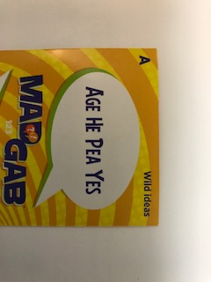
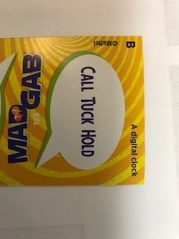
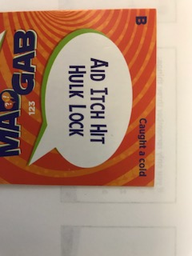
Reducing barriers to understanding
Slow down
Notes:
This is an audience challenge to see if they can figure out what is said – shows how we smear words together.

Slide 18
Use plain, simple language
20% of American adults read at or below the 5th grade level.

Slide 19
Use plain, simple language
Jargon: An example
Notes:
30 Rock Video

Slide 20

Use plain, simple language
Using/Avoiding Jargon and Acronyms
What are 3 words you use in your tours that might be considered jargon—terms or abbreviations that you might commonly use but which might not be familiar to guests?
1.
2.
3.
Notes:
Would ask them to take a moment and jot down jargon related to the tours.

Slide 21
Use plain, simple language
Avoiding or Defining Jargon
Curvilinear
Organic Architecture
Shelter/freedom
Compression/Release
Breaking the box
Harmonious environment
Indirect lighting
Usonians
Froebel blocks
Pendants
Green purchasing
LEED
GFRG
Notes:
This would be shown to see how many of these were not mentioned
LEED: Leadership in Energy and Environmental Design
GFRG: Glass fiber reinforced gypsum

Slide 22
Use plain, simple language
Use words familiar to visitors
Green purchasing

Purchasing products with a positive effect on our health and the environment

Slide 23
What is a way to say two of these words in plain language?
Use plain, simple language
Pilings
Spires
Indirect lighting
Saucer light
Sconces
Notes:
We’d give them a little time to come up with answers, then share and discuss.

Slide 24
Use plain, simple language
Defining or illustrating terms visitors should know
Compression/release

Here you see an effect called comprehension/release. You see a lower ceiling when you enter, then a few steps later the ceiling rises dramatically.

Slide 25
What is a way to define or illustrate two of these words in plain language?
Use plain, simple language
Organic architecture
Curvilinear
Pendants
Natural materials
Notes:
Would give them time to come up with answers, then discuss.

Slide 26
Use one-idea sentences
Use plain, simple language
No: The rooftop garden, which has nearly 11,000 donated tiles, allows public access and community events and was designed to make sure rainwater drains and plants and trees could grow.
Yes: The Rooftop Garden was designed for public access and community events. Its unique construction effectively drains rainwater. The structure supports planters for trees and other plants. The floor includes nearly 11,000 donated tiles.
Notes:
This gets at the concept that we tend to run things together into long sentences, which is better in written communication, but in oral communication, it can be easy to lose one’s train of thought in all the clauses, phrases, etc.

Slide 27
Communicating numbers

Slide 28
Communicating numbers
THERE ARE 3 KINDS OF PEOPLE IN THIS WORLD…
Those who are good at math and those who are not.
Notes:
Answer = 10 persons/1000 (30% missed)
Answer = 0.1% (75% missed)

Slide 29
Communicating numbers
Pop Quiz
A person entering a contest has a 1% chance of winning. If 1,000 people enter, how many would you expect to win?
A person driving in Madison has a 1 in 1,000 chance of an auto accident. What percent of people driving will have an accident?
Answer: 10
Answer: 0.1%
Notes:
Would have them take this challenge as a demonstration of how we think we are better in math than we are.
Answer = 10 persons/1000 (30% missed)
Answer = 0.1% (75% missed)

Slide 30
Communicating numbers
Less is more—only relevant information
Reduce need for calculations
Frequency, not percent
Familiar objects as analogies

Slide 31
Analogies

Slide 32
What numbers do you use in tours?
Notes:
Will ask them to come up with ideas

Slide 33
What analogies could you use?
Each piling can support at least 120 tons.
There are 352,610 square feet in the building.
The building extends 90 feet beyond the shoreline.
The Exhibit Hall is 20 feet high.
Notes:
Will ask them to come up with ideas
350,00 square feet= a little over 6 football fields

Slide 34
How can these dates be effectively communicated?
1867 – FLW Birth
1909 – Nolan City Plan
1911 – Taliesin construction began
1954 - City referendum approved
1990 – Taliesin Architects consult on convention center
1994 – Construction Begins
1997 – Monona Terrace Opens
Notes:
Will ask for ideas on how to better do this
FLLW birth 2 years after Civil Wars ended
Wright was 44 years old when he began Taliesin
MT opens nearly 60 years after the project began

Slide 35
Organizing for understanding
Notes:
This starts your part

Slide 36
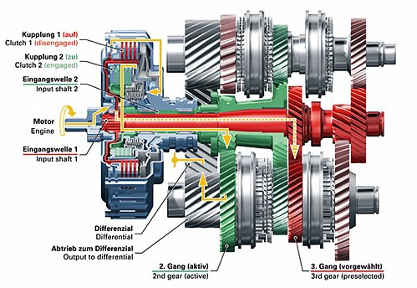
Only “need to know” concepts
Notes:
Story of how auto mechanic comes out after repair holding unrecognizable piece of equipment and attempts to explain, when what you really want to know is:
Can it be fixed?
When will it be done?
How much will it cost?

Slide 37
Only “need to know” concepts=
The Big “So What?”
Why should the visitor care about the information you are providing?
What does the room or tour station best illustrate?
What is not illustrated but still might be pertinent to the space?
Put most important information at beginning and end of your presentation of the space.

Slide 38
Ballroom Activity
Which of these items would you not include in a presentation of the Ballrooms?
Activities as a convention center
Various lighting examples
A feeling of being connected to nature and the outdoors
Meeting height limitations by using compact trusswork
Notes:
Do poll here

Slide 39
Chunking Information
Break up material into manageable bite-size chunks
Group together related information
Limit to 5 pieces of information at a time; 3 even better

Slide 40
Chunking Information
Which items would you pair together in your presentation?
A. Chandeliers
Compact trusswork
Indirect lighting on walls
D. Flexible walls
E. Types of events we host as a convention center
F. Current design is very close in height to Wright’s concept

Slide 41
Chunking Information
No, this Wright roof doesn’t leak! Special precautions were taken to provide rooftop drainage so that the roof will not leak. First, the poured concrete floor slab was sloped for drainage. The workers then prepped the concrete slab with a primer coat. The first and subsequent layers of roofing material is a membrane which is applied with a gas torch by uncoiling the membrane and heating it as it is unrolled: roll it out and torch, roll it out and torch, repeatedly. When heated, this material melts and adheres to the primer coat. Each layer is about 1/8" thick. A second torch-applied layer follows, applied in the same manner as described above overlapping the seams. On the top layer of membrane, a drainage mat is installed which allows the water to run through. A filter fabric is placed on top of the drainage mat to filter out sand and dirt while still allowing water to pass through and drain on the concrete slab below. The next layer is comprised of two layers of 2" thick rigid (very high density) Styrofoam insulation, staggering the joints. On top of the insulation, workers place 4 adjustable pedestals for each tile. The pedestals are leveled and filled with a grout-like substance that acts to stabilize the pedestals so that the Rooftop Garden floor surface (the pavers we stand on) can be level.

Slide 42
Chunking Information
No, this Wright roof doesn’t leak! We have a sophisticated system of layers that drains water off the roof.
First, the poured concrete floor slab was sloped for drainage.
Next workers applied several layers of water-resistant membrane to the slab with a gas torch. The membrane is heated so that it melts and sticks.
The next step in constructing the roof was to add a drainage mat that allows water to run through.
A filter fabric was installed to filter out sand and dirt.
After the fabric, workers added two layers of 2" thick, rigid, very dense Styrofoam insulation.
How do we get the rooftop pavers so level? There are 4 adjustable pedestals for each tile at the corners. The pedestals were leveled and filled with a grout-like substance to stabilize them.

Slide 43
Previewing & Transitions

Slide 44
Preview what’s coming up
  Preview information to let visitors know what’s in store. This will better prepare them to understand what you’re about to communicate.
  Examples:
  “Today I’m going to share with you how Frank Lloyd Wright changed the way we experience buildings. We’ll take a look at specific examples here at Monona Terrace.”
  “Now let’s move to the Grand Terrace to see how Frank Lloyd Wright connects us with our beautiful natural setting.”

Slide 45
Use transitions between topics
  Use transitions to carry themes through your tour and reinforce main messages.
  Examples:
  “Earlier I mentioned that one of the three purposes of Monona Terrace is as a community gathering place. The youth dance demonstrations we hold on this Rooftop Garden is a great example.”
  “Now as we go indoors, let’s take a look at how circular shapes continue be an important part of the design.”

Slide 46
Use transitions between topics
  More examples:
  “Monona Terrace can meet the needs of a variety of different group sizes and events. We just saw how we can serve a small group in the Dane Room, now let’s see how we can accommodate conventions and large meetings in the Exhibit Hall.”
  “I mentioned that Tony Puttnam had some unique challenges in adapting the design for our contemporary convention center. Here’s another example…”

Slide 47
Repetition

Slide 48
Repeat key phrases across sentences
Examples:
“Frank Lloyd Wright chose curvilinear forms, exterior color, and building symmetry in homage to the State Capitol. Tony Puttnam continued curvilinear concepts in his interior design. Note the circular elements in the ceiling and the carpet.”

Slide 49
Communicating for Understanding
Tips for Effective Tours
Notes:
Questions?

