Slide 1

Docent Training
Storyboarding Your Tour Part 1

Slide 2
Zoom Protocols Here
Use Q & A to ask a question or comment
Please don’t use Chat function
We’ll open it up for discussion at the end of the PowerPoint

Slide 3
How We Got Here…. Here
Thanks to Joe Veneto for introducing me to this material during the Essential Experiences process.

Slide 4
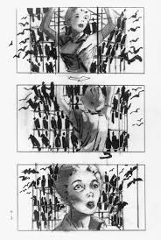
What is a Storyboard? Here
a sequence of drawings, typically with some directions and dialogue, representing the shots planned for a movie or television productionnd dialogue, representing the shots planned for a movie or television production.

Slide 5
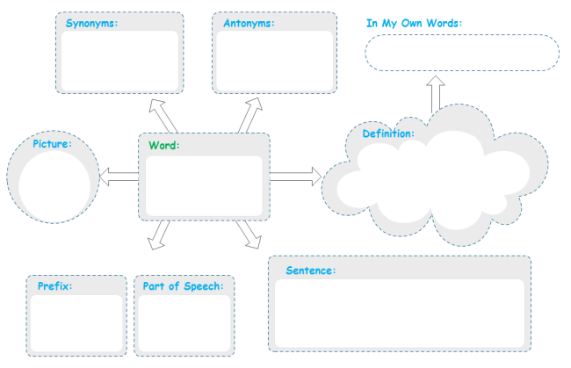
What is a Storyboard? Here
In our case, we’ll use a storyboard as a graphic organizer, also known as a knowledge map, concept map, story map, cognitive organizer, advance organizer, or concept diagram. It’s a pedagogical tool that uses visual symbols to express knowledge and concepts through relationships between them. The main purpose of a graphic organizer is to provide a visual aid to facilitate learning and instruction., representing the shots planned for a movie or television production.

Slide 6
The Premise is…
Informational Elements:
Diversity of tour content and delivery methods is desirable, and will result in higher audience engagement.

Slide 7
Informational Elements or
Communication MethodsHere
Informational Elements:
Explanation
Story
Demonstration
Activity/Participation
Video/Performance
Inquiry/Q&A
Motion/Transitionuiry

Slide 8
Sensory Elements
Taste
Touch
See
Smell
Hear

Slide 9
Experiential Filters
Here
Core Ideas: Key “Big Ideas”
Props: For our purposes, visual aids beyond the architecture. i.e. Laminated photos, Level 3 exhibit items, Guerrero photos
Interactivity: Audience participation i.e. inquiry

Slide 10
Experiential Filters
Planting Seeds: i.e. lasting impressions, actions to take following the tour, key take-away ideas
Feelings & Emotions: emotional connections, lessons learned, universal themes
Wow! Moments: Surprise, Amaze or Delight, Connect two things in a new way

Slide 11
Next Steps Here
You’ll receive a piece of mail that includes these materials for this exercise…
1 11 x 17 inch sheet of paper
Storyboard legend
Post-it notes
Communication Methods Stickers
Sensory Star Stickers
Filter Circle Stickers

Slide 12
Next Steps Here
Instructions:
Write down 10-12 talking points from your tour. Put one each on a post-it note and attach the post-it to the 11x17 sheet.
Above each talking point, write the location or tour stop where you present the idea.
Now use the labels and stickers to indicate the type of information, filters, and sensory elements to “code” each idea.

Slide 13
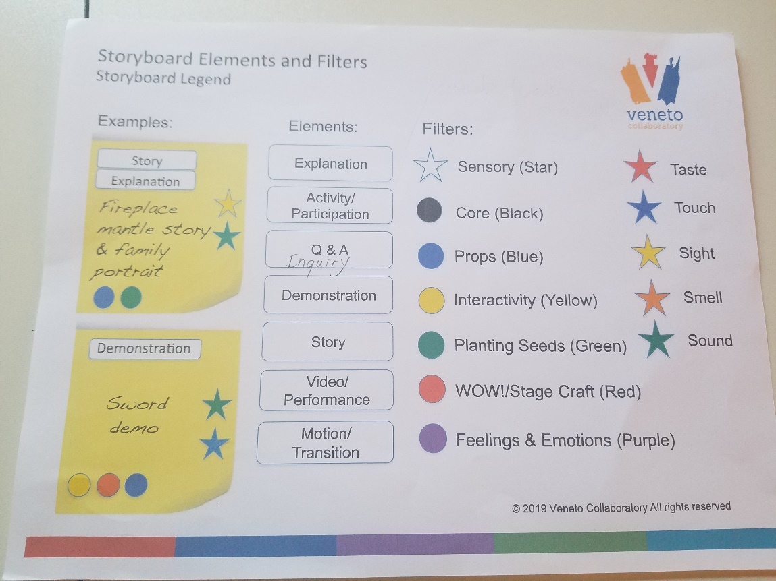
LegendHere

Slide 14
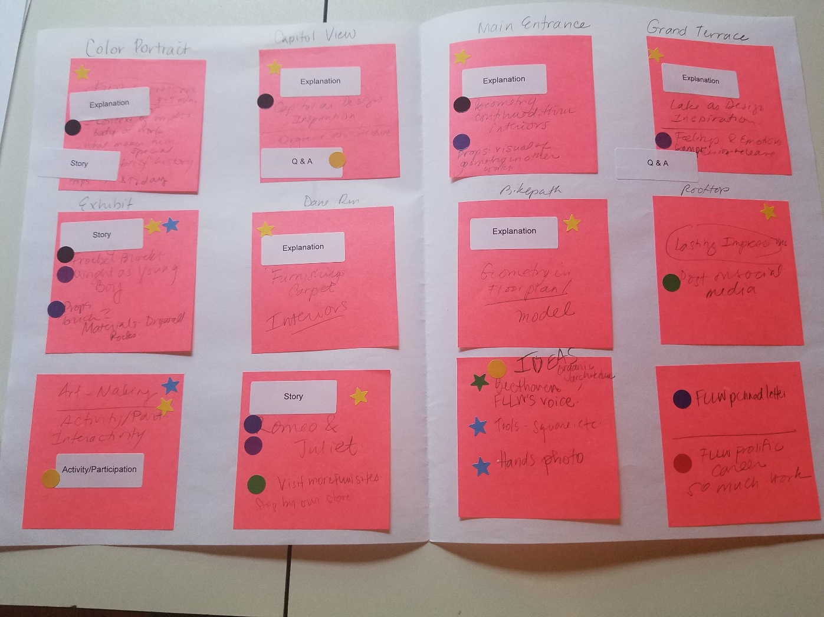
My Storyboardre

Slide 15
Next Steps Here
Review your storyboard and record the following-
Do you see a majority of one or two labels or stickers? If so, what are they?
What areas did you see little or no representation? Of these, which have potential that you’d like to explore further?
Other findings that you’d like to discuss?
Send your answers to Heather at hsabin@mononaterrace.com.

Slide 16
Next Steps Here
At the next meeting, I’ll present my findings and how I used the information with my own tour script.
I’ll also present a summary of your findings and we’ll discuss.
Follow up?

Slide 17
Questions and Discussion

