Slide 1

Terrace Town for First-Timers
Tug on anything at all and you’ll find it connected to everything in the universe.
-- John Muir

Slide 2
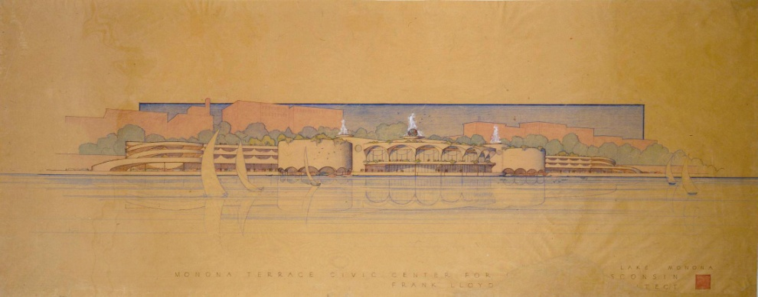

Why Monona Terrace?
Architecture education mission because of Frank Lloyd Wright design
LEED Gold certification drove sustainability theme “Going Green!” in 2008. It is still a focus of the program.

Slide 3

Still going strong…
Terrace Town has been offered biennially since 2000 to Dane Co elementary students
It has grown from 350 students in its first year to over 1400 in recent years
Notes:
Serve Dane County elementary students primarily; some middle

Slide 4
We are Award Winning!
Monona Terrace staff received Special Jury Recognition for the “Golden Cube Award” awarded by the International Union of Architects

Slide 5
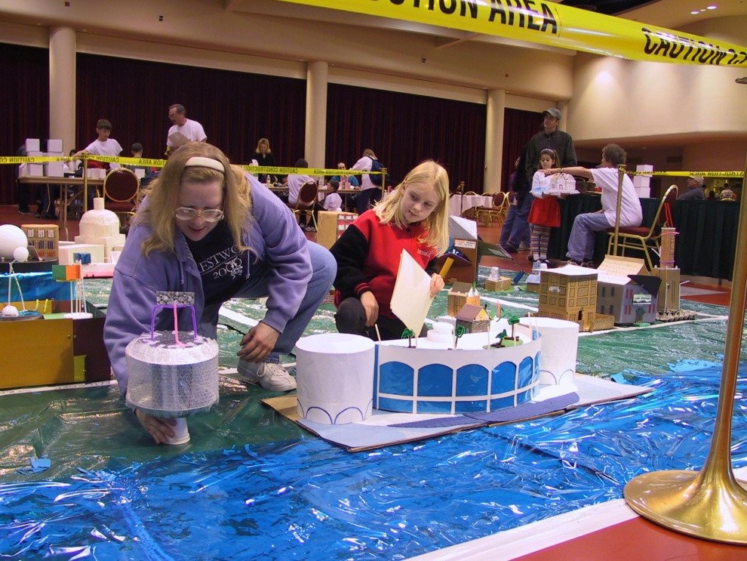
A Multi-Phase Program
Teacher & Mentor Kick-off Workshop- October 29
January 31
School Day
at Monona Terrace
2 hour visit
February 1
Public Open House at Monona Terrace
Notes:
Kick off program in November. Teachers start before “holiday vortex.”

Slide 6
Monona Terrace’s Program Goals
Students will learn how cities are planned, what makes a quality sustainable city, and how they can participate in the improvement of their environment.
Educators will develop curriculum about the built environment that supports academic standards.
The program connects schools to community resources, and engages architecture and planning professionals in the education of youth in their community.

Slide 7
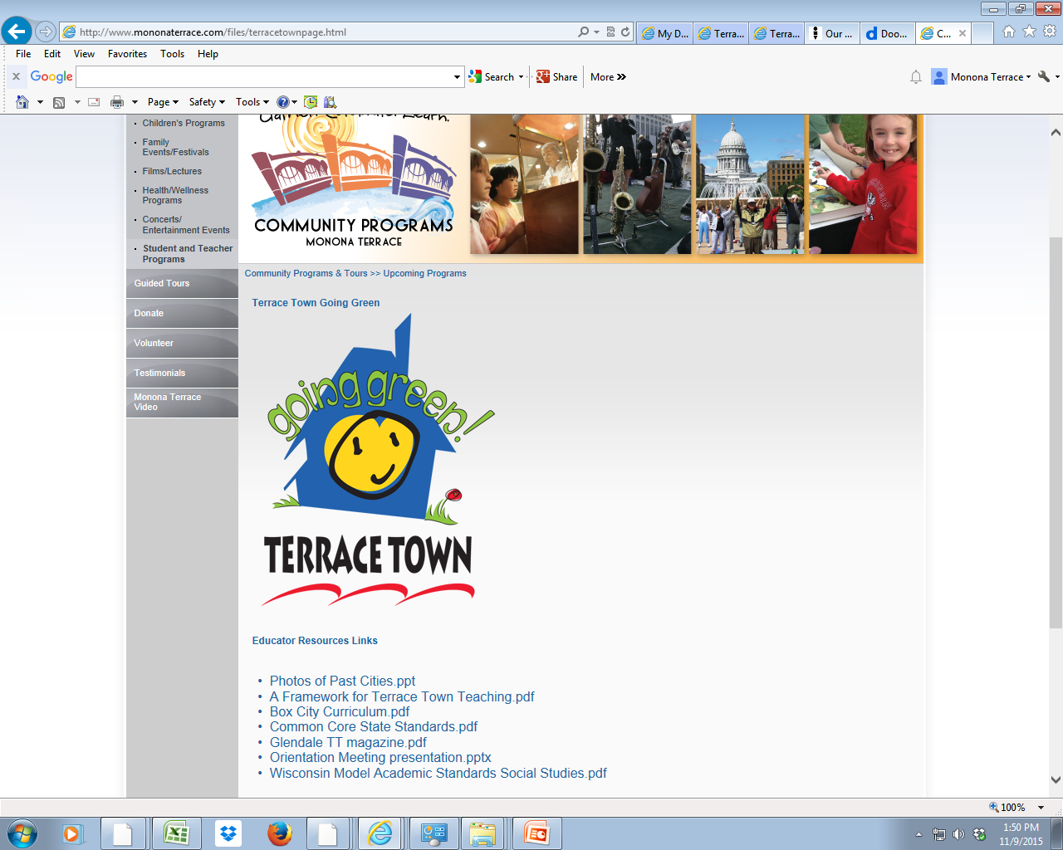
Resource links http://www.mononaterrace.com/terrace-town-resources

Slide 8
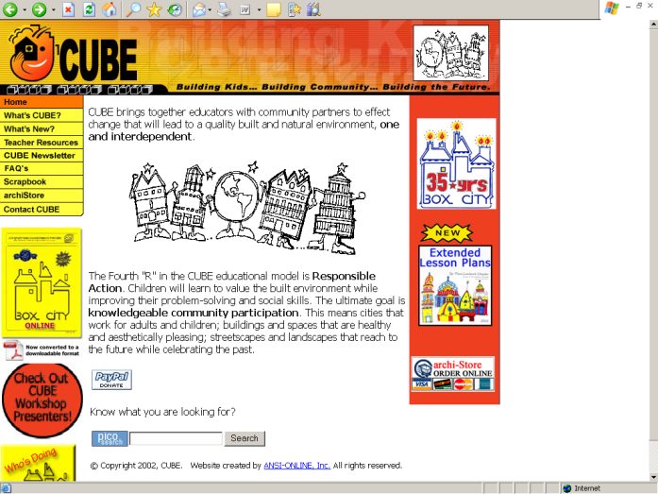
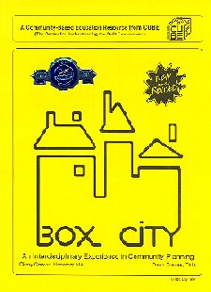
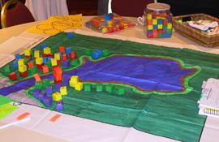
The Curriculum
“Box City”
  from the Center for Understanding the Built Environment (CUBE) www.cubekc.org

Slide 9
The Curriculum
Is not an “add-on” Meets standards in social studies, math, science, language arts, and visual arts
Uses the design process Imagining the world differently from the way it is
Develops visual literacy
Project-based
Connects to community with rich, real-life applications, encouraging participation

Slide 10
What is our community’s sense of place?
Historic resources that allow compare/contrast of then and now
What are the landmarks or special places, both everyday and extraordinary?
Design a postcard or bumper sticker for your neighborhood or community.
Map the special places: monuments, significant buildings, your walk to school, your favorite park

Slide 11
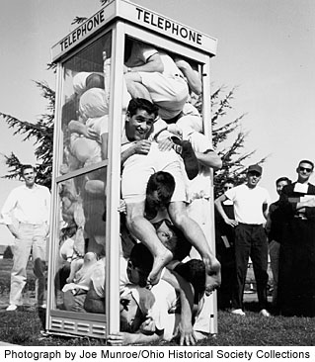
What makes a community livable and sustainable?
Does the community incorporate….
Mixed Use
Transportation Options
Diversity
Urban Centers
Public Spaces
Community Identity
Preserve Natural Resources
Open Spaces
Taken from “Livability 101”:
http://www.mayorsinnovation.org/images/uploads/pdf/7_-_Livability_101.pdf

Slide 12
What makes a community livable and sustainable?
Are the buildings green?
Building Siting
Reusing Buildings
Daylighting
Green Roofs
Materials
Energy Efficiency
Water Efficiency
Renewable Energy …. Among others

Slide 13
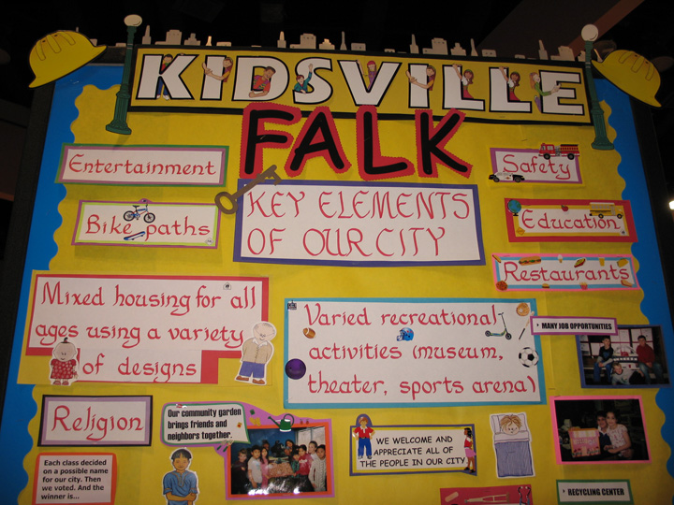
What do we put in our box city?
Start with a “bill of rights”
What places do we need? Instead of McDonald’s, think “places to eat”
Brainstorm ideas, then develop rules that ground…
Land use lessons: Geoblock game
Develop design guidelines and revisit throughout the process
Who makes decisions?
Role Play!
Notes:
Dreux will do activity here and then back to Heather

Slide 14
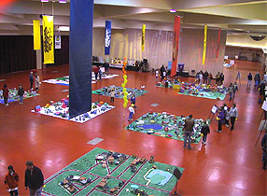
How will we build it?
You’ll build on a “lot size” no larger than 16 x 36ft per school. Typically the base is a tarp/s from a hardware store.
Materials range from recycled to craft supplies like pipe cleaners and construction paper.
The best building material is recycled stuff from home.
Focus is on process, not product!!

Slide 15
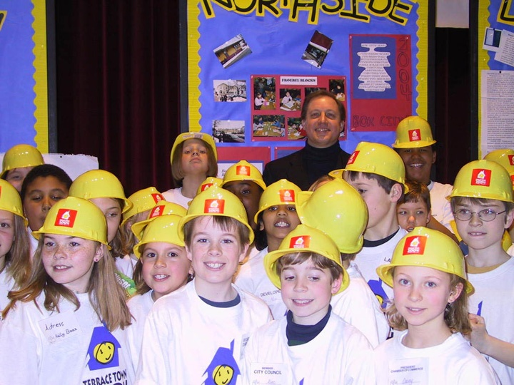
How will we build it?
Occurs in last few weeks (allow 3) leading up to School Event
All hands on deck!
Art teacher can be a good partner
Students can work individually to create homes & team up to do larger buildings

Slide 16
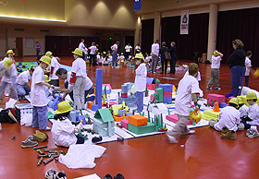
How will we build it?
Scale vs. Proportion
Some care about precise scale and others don’t, depending upon their academic objectives
For those who use pre-made boxes, the recommended scale is 1/8”
Get creative with homemade engineer’s scales out of popsicle sticks or other materials
Notes:
Dreux will do activity here and then back to Heather

Slide 17
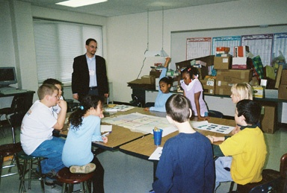
Mentor/Classroom Partnership
Our Volunteer Mentors are
professionals and students
in sustainable fields,
architecture and
planning.

Slide 18
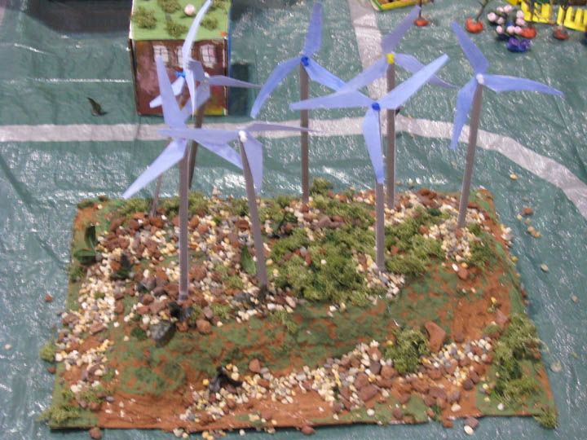
Mentors are asked to…
Visit a classroom 4-6 times
Present and facilitate activities
Attend the School Building Day at Monona Terrace
Notes:
Introduce Dreux

Slide 19
Successful Partnerships
Mutual respect of partners’ time
Mutual respect of partners’ expertise
Communication prior to visit that identifies what mentor will present and when
Teachers will share any particular teaching objectives and will advise on age-appropriateness.
Mentors will add value by adding real-world experience to class activities and discussion

Slide 20
Scheduling!
Teachers must recognize that mentors volunteer work time and do not always have the flexibility to move their visits
Mentors must recognize that classrooms adhere to strict schedules and that it can be difficult to reschedule

Slide 21
Great activities with mentor as facilitator
Conduct a walk around the block
Leading the discussion of what should go in the city… And where
Learning about scale
Green buildings and sustainable city design
Notes:
Dreux will do activity here and then back to Heather

Slide 22
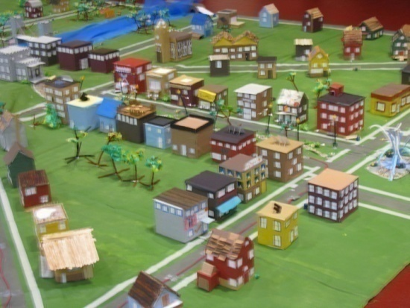
Things to do soon…
Begin to review BC curriculum (and order boxes if you wish)
Determine size of your city- you can use as much of a 16 x 36 ft lot but not more
Book your bus for Monona Terrace trip
Start collecting materials
Document your classroom activities
for display on a posterboard at
Terrace Town- take photos!
Not too early to introduce books
& vocabulary on cities, architecture, sustainability
Notes:
Stress process over product.
This is not about who has the best looking city.
Show video, then Dreux

Slide 23
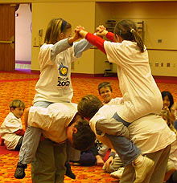
Monona Terrace’s Role
To support and provide resources for teacher and mentor participants
Host and coordinate in-service and culminating events
Act as a clearinghouse for curriculum, books, websites, materials

Slide 24
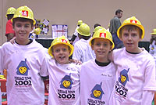
Terrace Town
Cities that work for kids work for everybody.
-- Ginny Graves

Slide 25
You Can Do This!
Questions?
Heather Sabin (608) 261-4015 hsabin@mononaterrace.com
www.mononaterrace.com/terrace-town-resources

