Slide 1
A Child Friendly City is a Healthy City for All
Terrace Town 2018, Monona Terrace

Slide 2

Environmental Design Lab (www.edl.wisc.edu)
Department of Planning and Landscape Architecture
University of Wisconsin-Madison

Slide 3
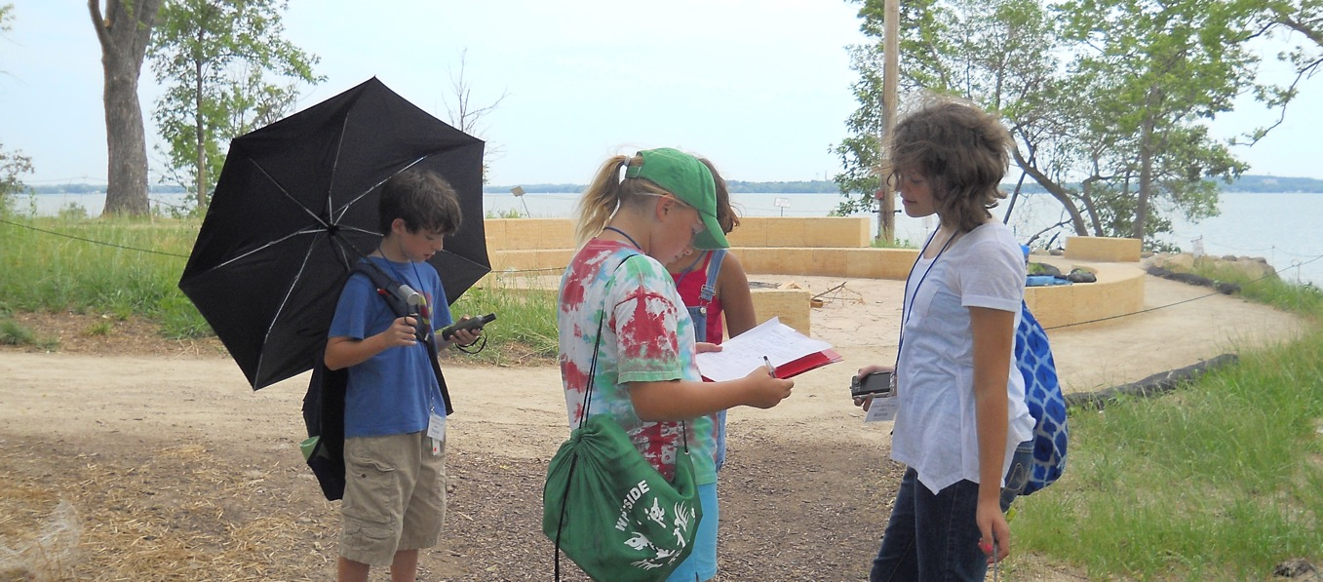
First Principle: Kids are experts in their own lives.

Slide 4
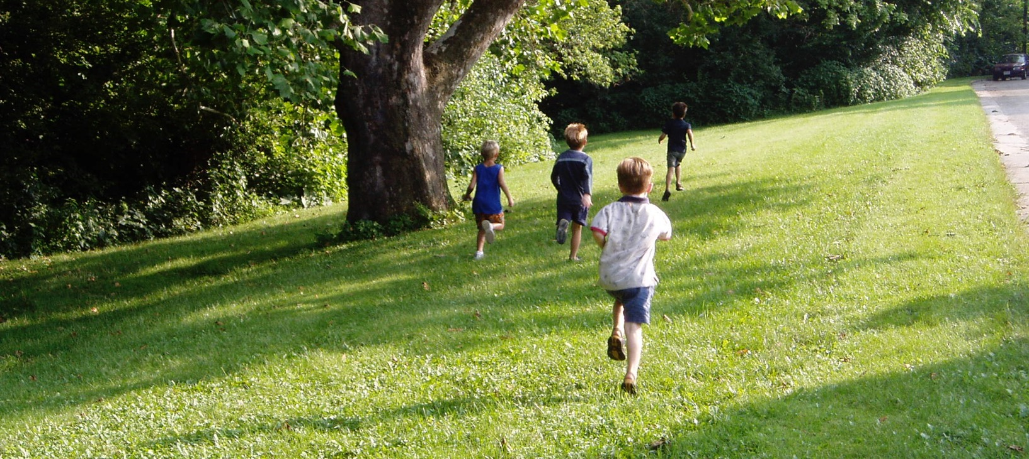

Slide 5
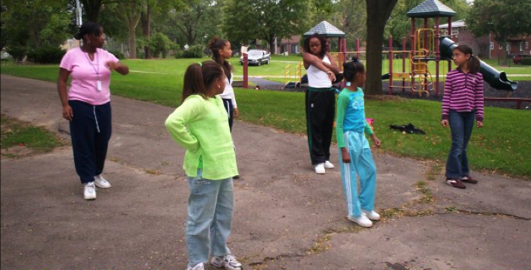

Slide 6
Where did you play as a 9-year-old?

Slide 7
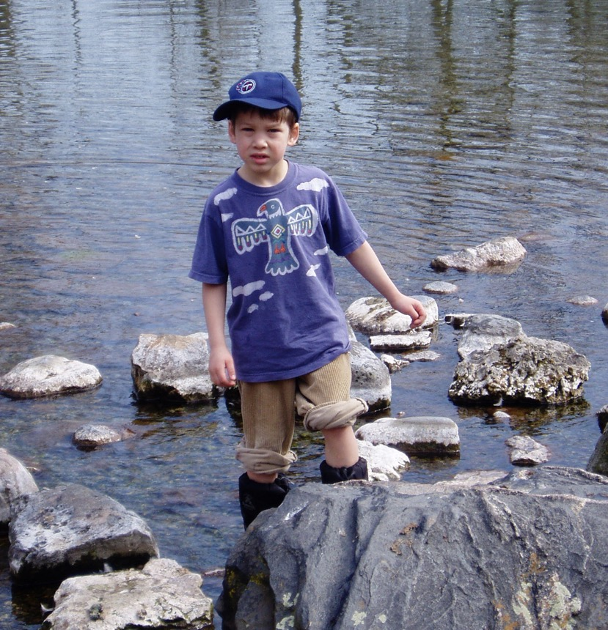
What is play?
And, what are playgrounds?
Freely chosen
Intrinsically motivated
Self-directed
Free play
Safe places
Available places
Everywhere

Slide 8
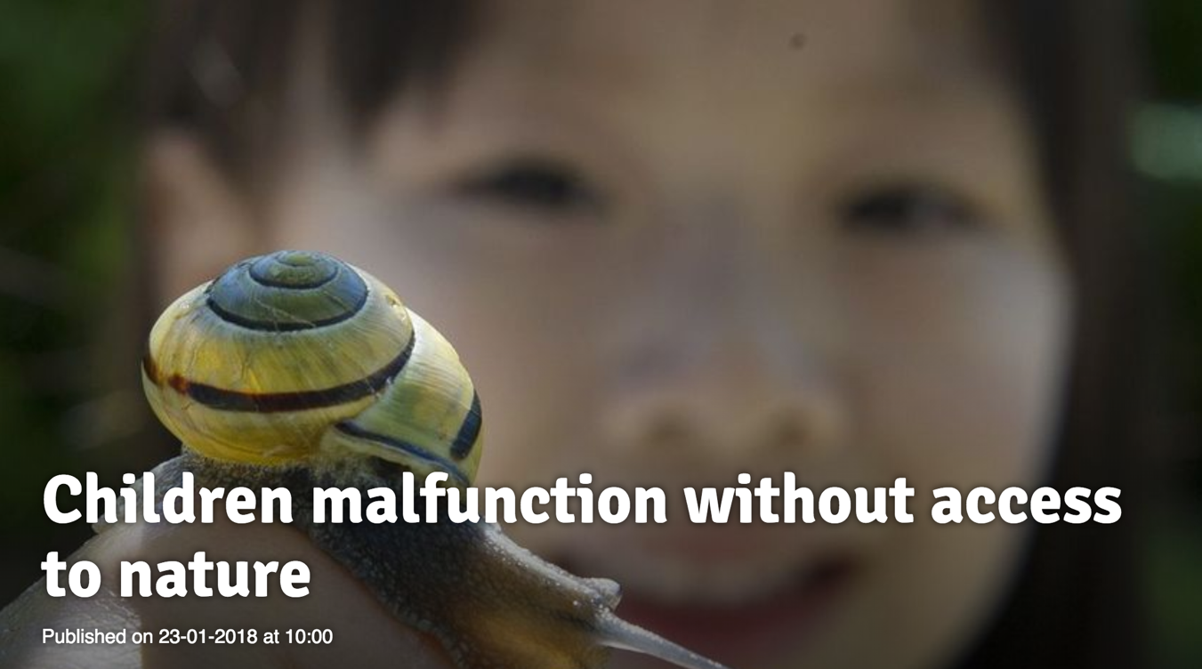

Slide 9
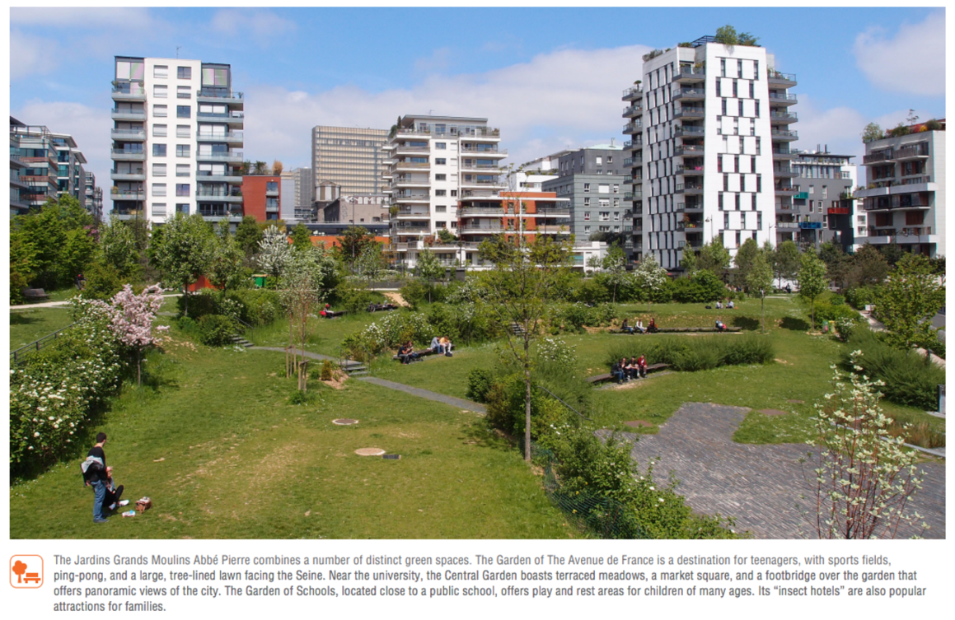

Slide 10
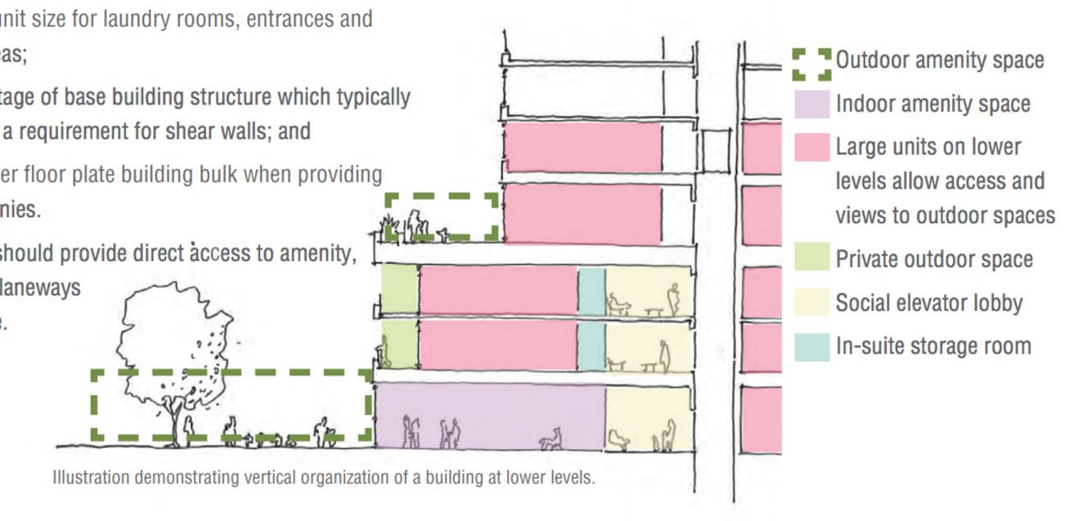
Growing Up: Planning for Children in New Vertical Communities, Toronto, 2017 https://www.toronto.ca/city-government/planning-development/planning-studies-initiatives/growing-up-planning-for-children-in-new-vertical-communities/

Slide 11
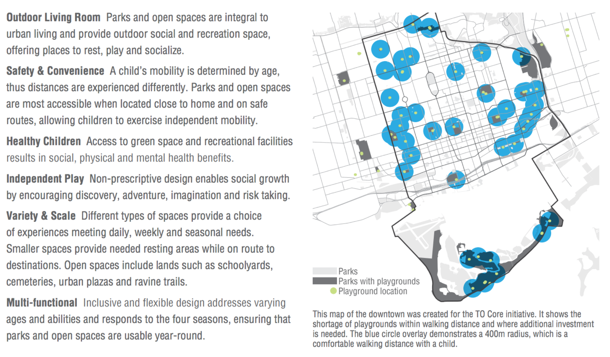

Slide 12
10 ways to design a great city (Adrian Voce)
End the domination of traffic over the streets (i.e. roads) where most children live. Pedestrianised areas, home zones and play streets should be the norm for urban communities.
Prioritise the design element of public space and housing in new developments, to embed playful affordances within the built environment.
Break the mould of the public playground: children’s space to play should not be defined by fences, safety surfaces and equipment but integrated throughout a liveable, intergenerational landscape.
Allow unplanned space to evolve according to communities’ use of it. This will tend to give rise to the spatial ‘fields of free action’ (Kytta, 2004) that children will populate and animate with their play.
Build and staff more traditional adventure playgrounds, especially in the most deprived areas, where safe public space is rare.
Make parks work for everyone, including teenagers. Too many public parks are effectively no-go areas for a city’s youth, who are designed out as a perceived threat to genteel society and manicured floral displays.
Make childcare services truly child- (as distinct from parent-) friendly, by staffing them with qualified playworkers. Teaching assistants, however dedicated, naturally tend to apply the same behavioural regime that operates in the classroom – effectively consigning some children to 8 hours or more of school per day.
Welcome children into public space by banning ‘mosquito devices’, encouraging and supporting ‘playing out sessions’, and reviewing how anti-social behaviour is defined.
Open up school grounds for neighbourhood play. Schools are by far the greatest recipient of public funding for children and yet ­– even leaving aside questions about education and curriculum – are massively under-utilised as community assets, being gated and out-of-bounds for all who do not attend, even when school is out.
Develop safe routes to schools, parks and play areas. Mobility is a key: the child friendly, playful city will have a web of safe, accessible and familiar routes to give children the connectivity that adults take for granted.

Slide 13
Resources
Child Friendly Cities (UN) http://childfriendlycities.org/
European Network of Child-Friendly Cities https://www.childinthecity.org/
Growing Up: Planning for Children in New Vertical Communities
  https://www.toronto.ca/city-government/planning-development/planning-studies-initiatives/growing-up-planning-for-children-in-new-vertical-communities/

