Slide 1
Transportation in Terrace Town
Shawn Koval
Safe Routes to School
Healthy Kids Collaborative
Notes:
Share objectives: 1) Encourage your thinking so you can encourage your students’ thinking about transportation in your terrace town by presenting you with a few central questions you can take in whichever direction you’d like; 2) Outline a few transportation-related lesson ideas that you could use in your classroom

Slide 2
“How are people going to get from place to place in your town?”
Notes:
Cities as organisms; transportation systems as circulatory system

Slide 3
DESIGN CHALLENGE!
You need a car to get around in most American cities.
Automobiles pollute our air and many people—including kids—do not or cannot drive.
We need your help to design a transportation system that is SUSTAINABLE and KID FRIENDLY!
(Reference: Martoni, John. Metropolis: A Green City of Your Own! 2010.)

Slide 4
Mini-Lesson #1:
Transportation Modes & Means

Slide 5
Modes of Transportation
Public
Bus
Train
Ferry
Private (Motorized)
Car
Motorcycle
ACTIVE!
Walking
Biking
Wheeling
Which is best for your town?
Why?
Multiple modes? Why/why not?
Benefits of each? Downsides of each?
Notes:
One way to lay the groundwork for your students’ exploration of this question is to do an overview of the various modes of transportation.

Slide 6
SAMPLE LESSON OUTLINE
Present images of street with several modes of transportation; have students list all they see in image (and any modes they know that are not present)
Whole class share out
Organize students into small groups; assign a mode of transportation to each group
Ask groups to discuss and list “pros” & “cons” of their transportation mode. Record on easel/notepad if possible.
Small groups present to whole class
DECISION TIME! Have students choose which mode(s) they want in their Terrace Town through a consensus-building activity of your choice. THEN...
START BUILDING!

Slide 7
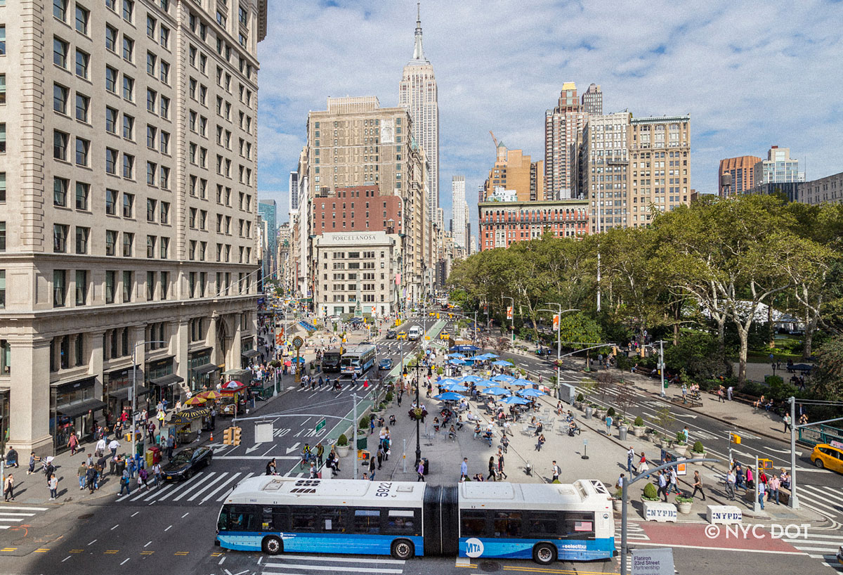

Slide 8
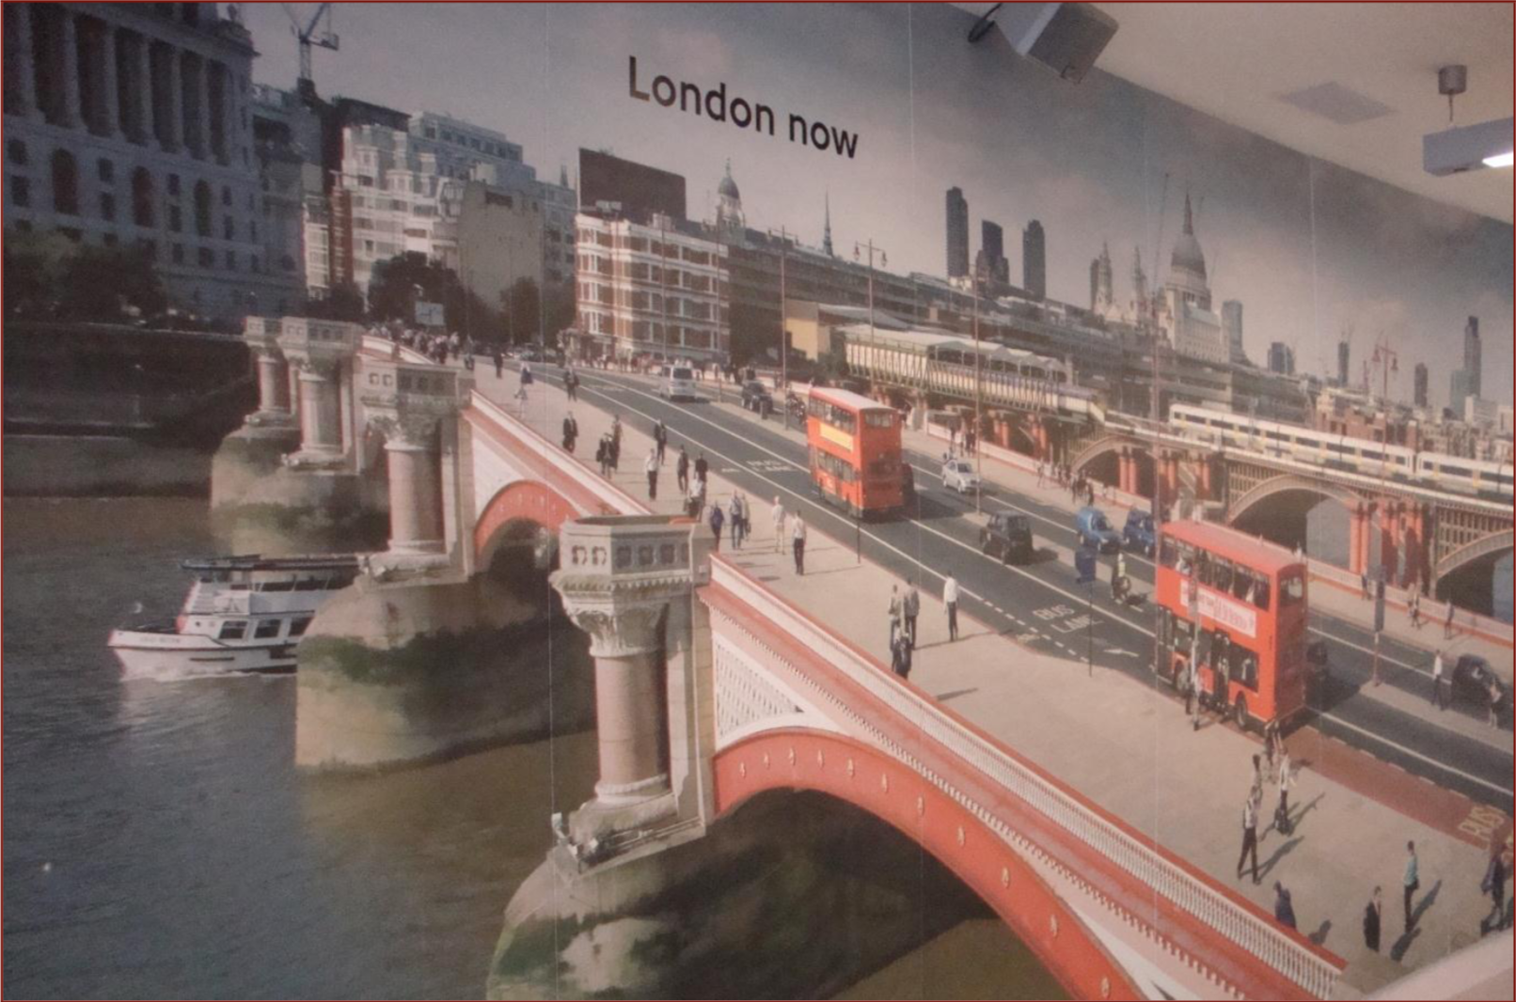

Slide 9
“What makes for a good street?”

Slide 10


Slide 11
Complete Streets
Access for all people regardless of age and ability
Supports multiple modes of transportation
  Walking
  Bicycling
  Wheelchair use
  Cars
  Public Transit
Linked to improved safety, health, economic, and environmental outcomes
A Framework for Inclusive Street and Transportation System Design

Slide 12
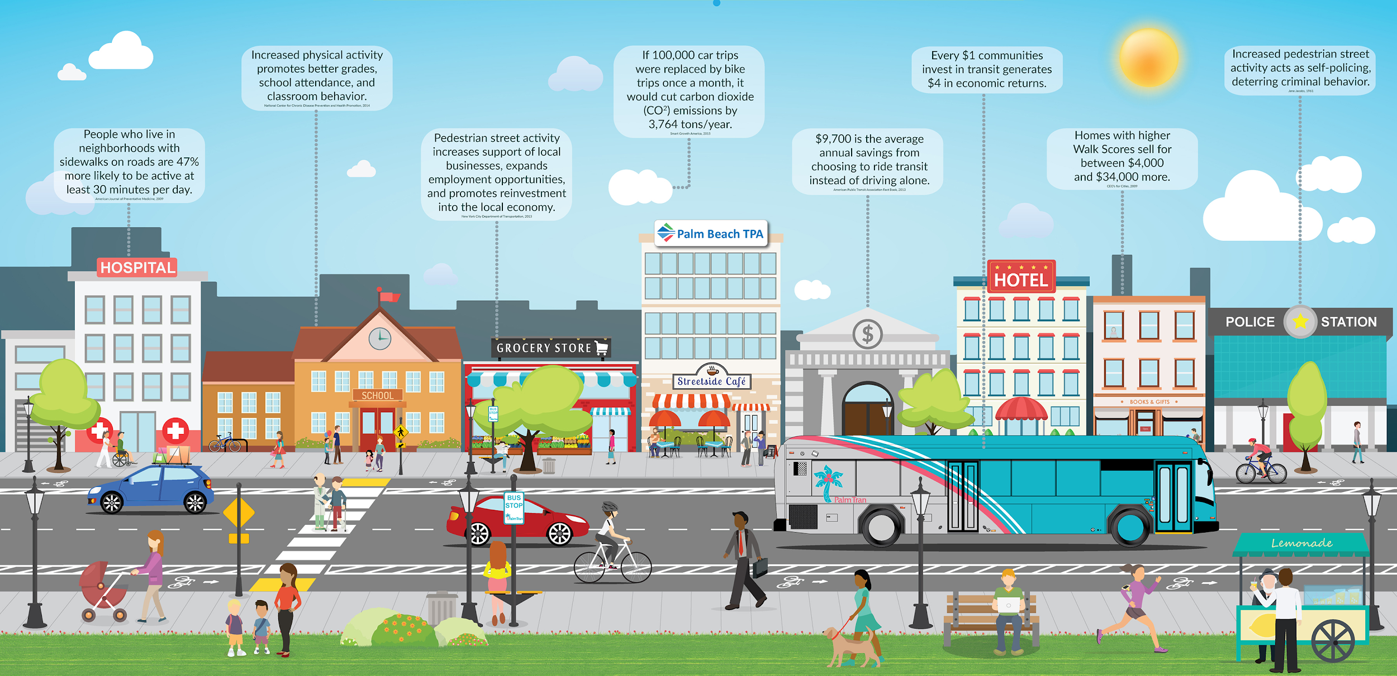

Slide 13
Mini-Lesson #2: Street Design

Slide 14
SAMPLE LESSON OUTLINE: VISUAL PREFERENCE SURVEY
Present images of various streetscapes
  Separated pedestrian path
  Tree-lined street with sidewalk, bike lanes
  Sidewalk and street on commercial strip
  Local highway with no sidewalks or bike lanes
Have students rank which they would prefer to walk, bike, etc. on or through
Discuss rankings as class. What did they choose? What did they like, not like?
DECISION TIME! Have students choose which street design(s) they want in their Terrace Town through a consensus-building activity of your choice. THEN …..
START BUILDING!

Slide 15
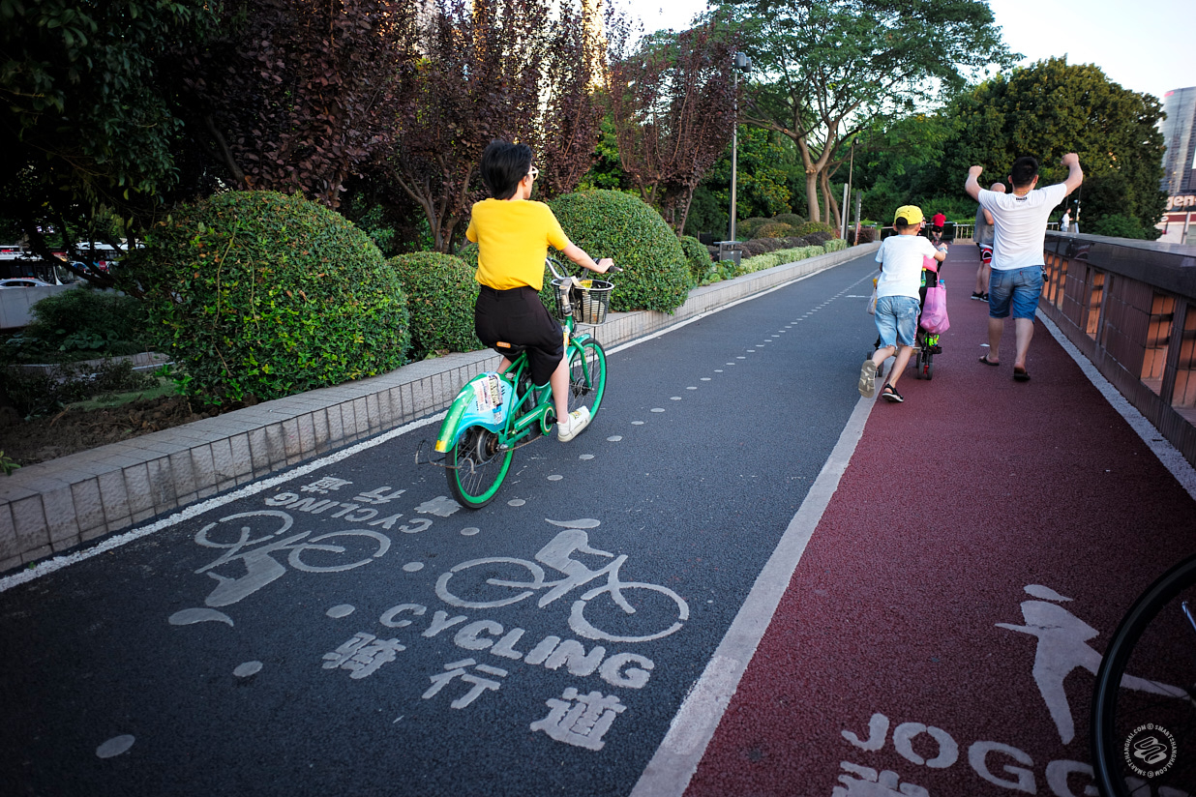
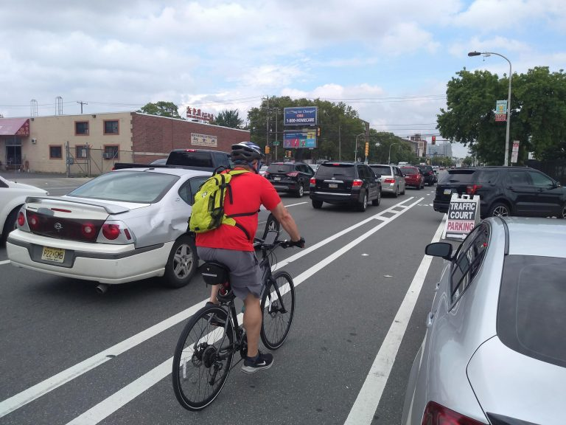
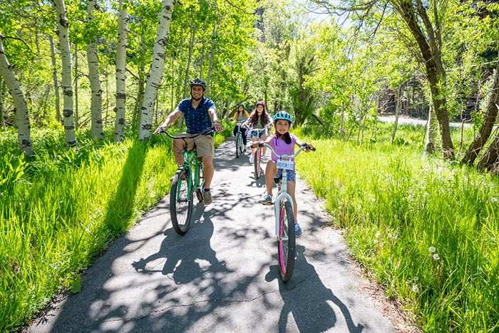
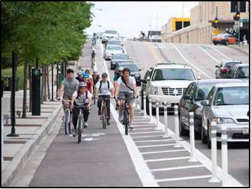
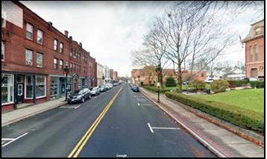
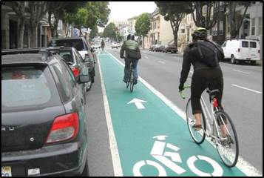
1
2
3
4
5
6

Slide 16
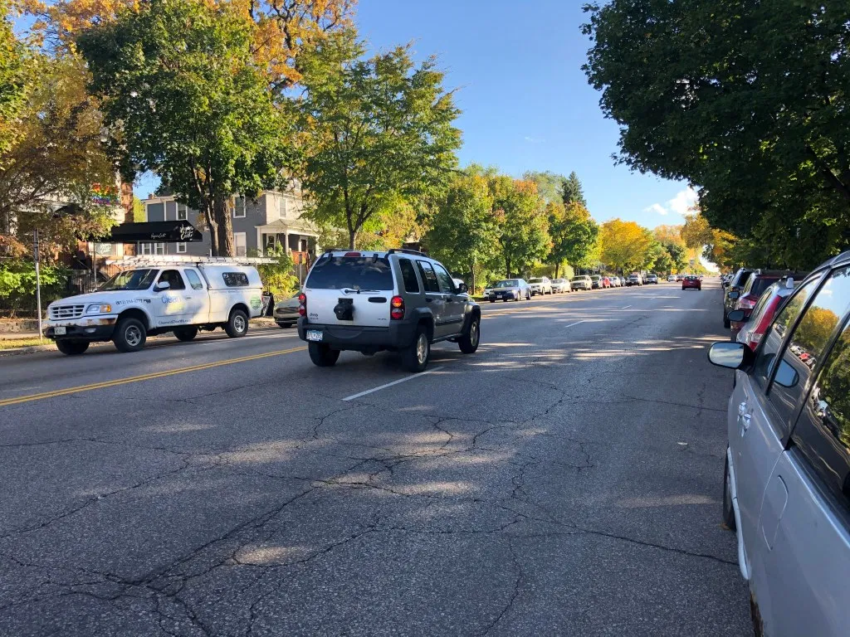
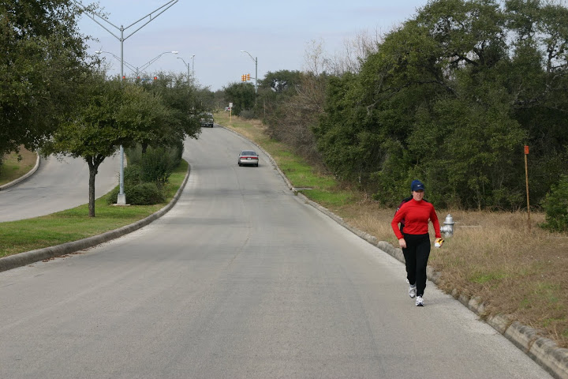
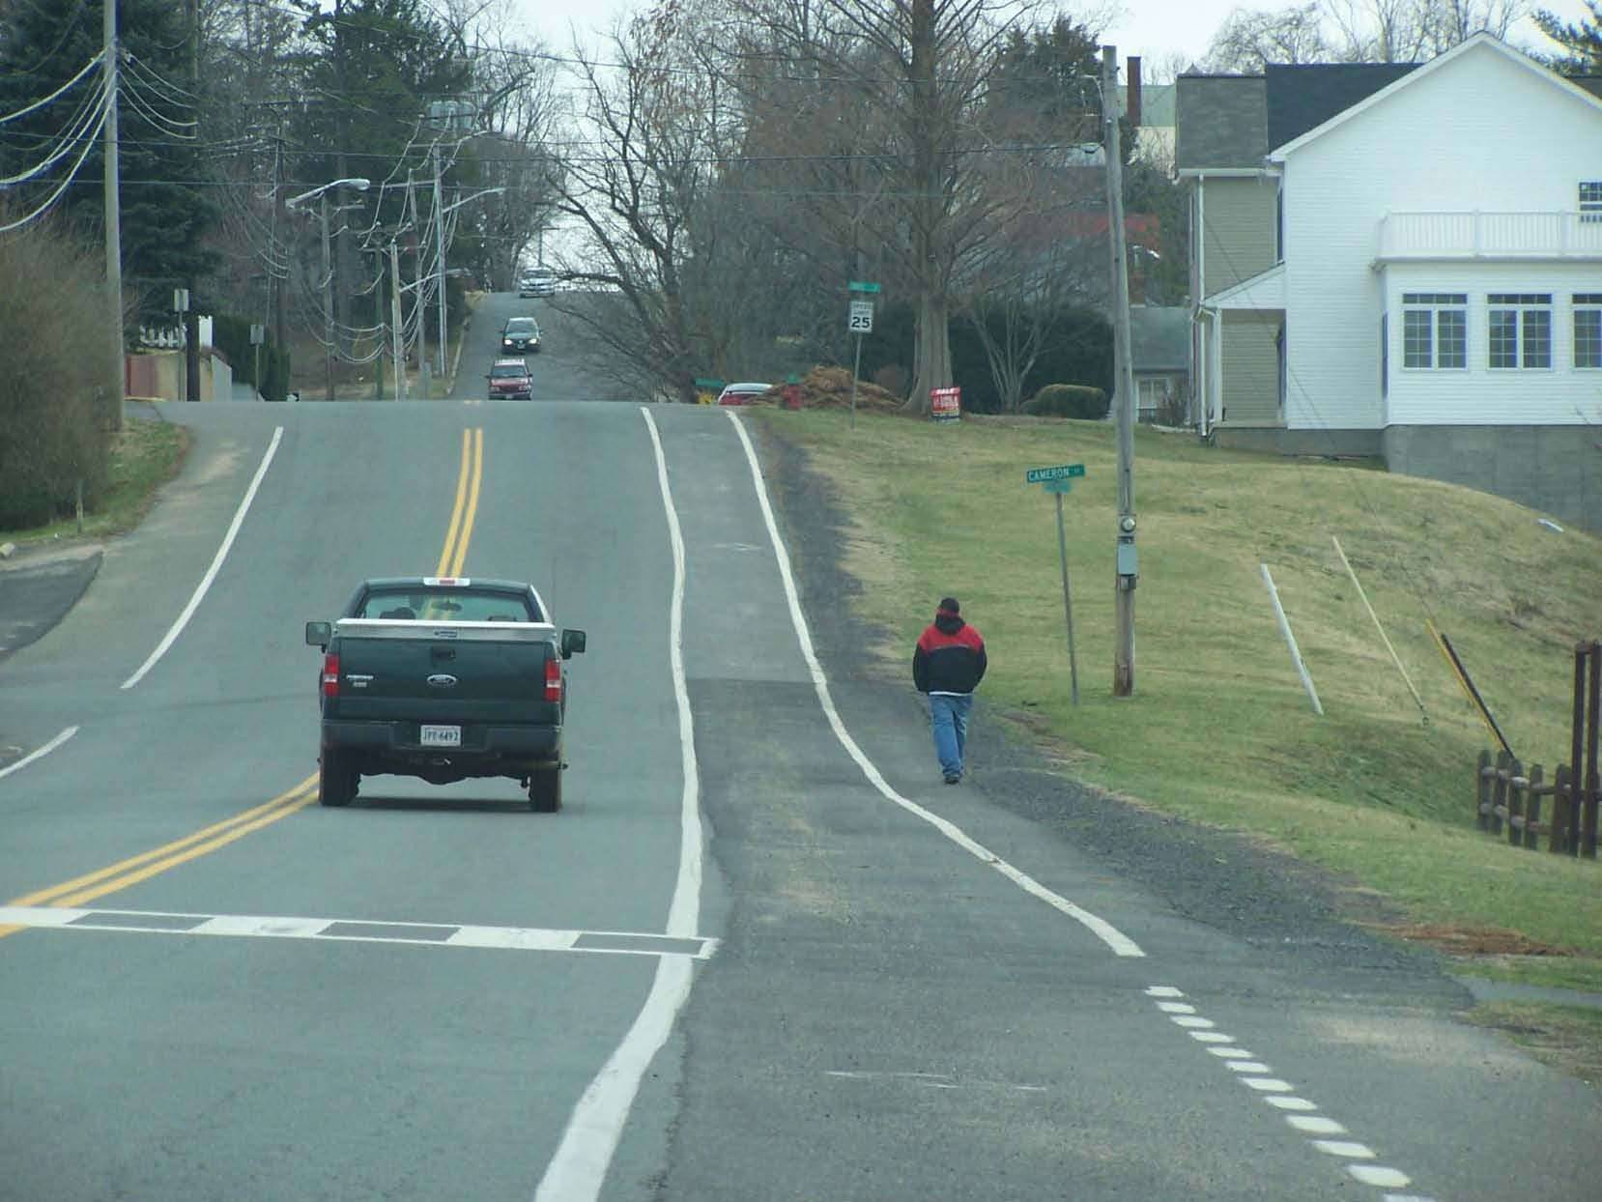
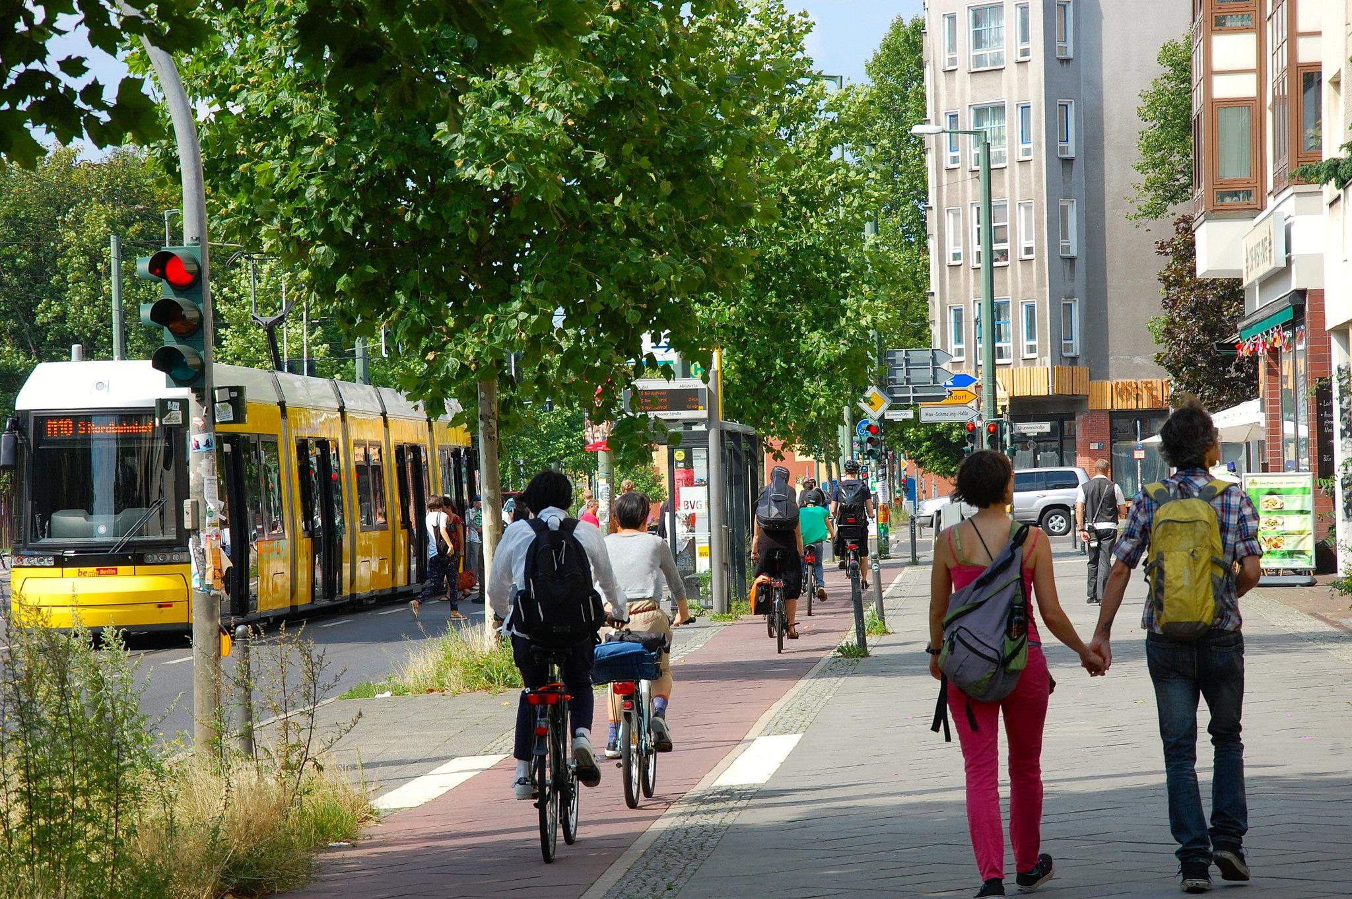
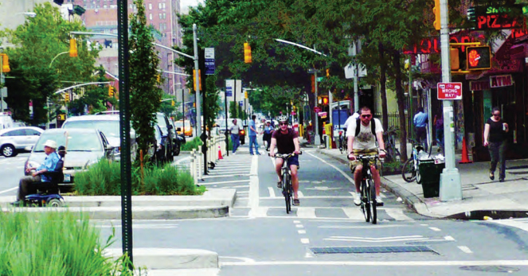
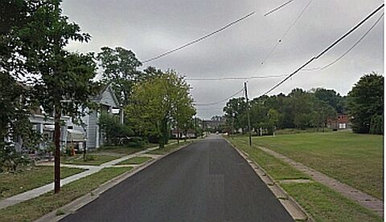
1
2
3
4
5
6

Slide 17
What makes for a good transportation/ street system?

Slide 18
Mini-Lesson #3: Transportation Networks

Slide 19
SAMPLE LESSON OUTLINE: ROUTES & CONNECTIONS
Present two maps to students
  One “traditional”neighborhood with gridded streets + one “suburban” with dead-end/
  “Dead-worm”development
  Use real maps showing their school and the surrounding neighborhoods vs. another neighborhood or school that looks different than their own
  Mark several destinations/landmarks and public transit lines for students (see below)
Ask students to trace routes between a variety of destinations on both maps (home, school, grocery store, park, parent/family member’s job, friend’s house)
Have students compare the possible routes, measure shortest routes on each map
Discuss findings as a class
DECISION + PLANNING TIME! Ask students to plan a network of transportation paths to connect the districts, public spaces, and landmarks they’ve designed for their Terrace Town. GET THOSE ART MATERIALS OUT!

Slide 20
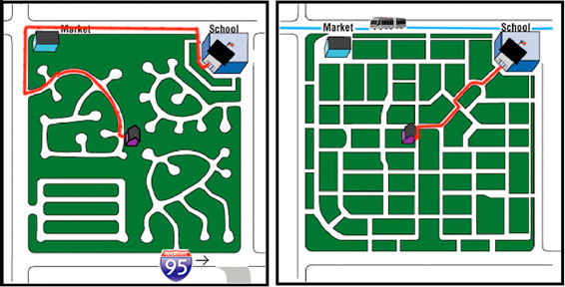

Slide 21
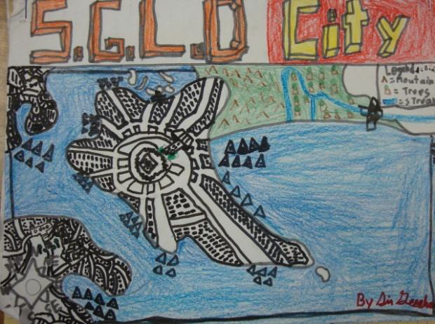
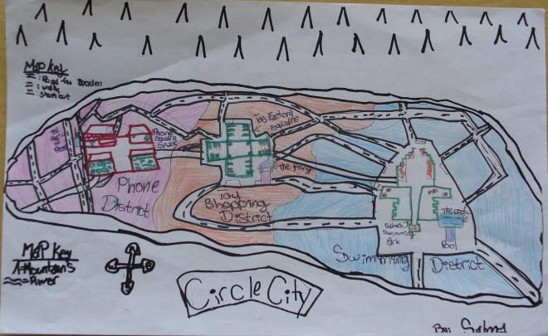
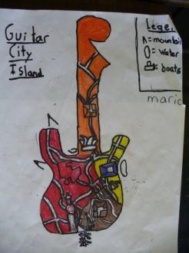
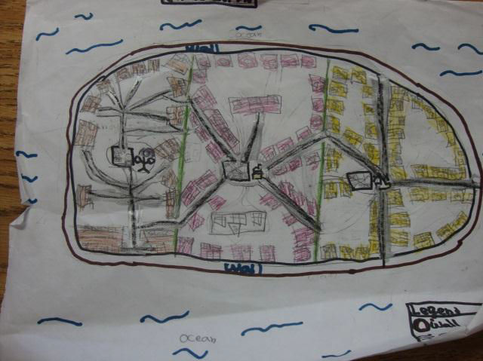

Slide 22
Writing/Language Arts Activity
Describe your transportation system in a paragraph.
TOPIC SENTENCE: Define transportation system.
SUPPORTING DETAILS: Describe the modes of transportation and path system you designed for your city.
CONCLUDING SENTENCE: How is your transportation system kid-friendly and green (sustainable)?

Slide 23
Word Work!
transportation
mode
mobility (justice)
fossil fuels
route
pedestrian
access
path
complete streets
Transportation vocabulary

Slide 24
Going Deeper...
LINKED LEARNING! Make lessons into **WALKING FIELD TRIPS**
“If you could create a new vehicle or way of getting around, what would it be?”
  Alternative fuels (wind, solar, biofuel, tidal)
  New technologies (vactrains or vacuum tube rail, maglev, driverless cars)
Climate Change
Mobility Justice

Slide 25
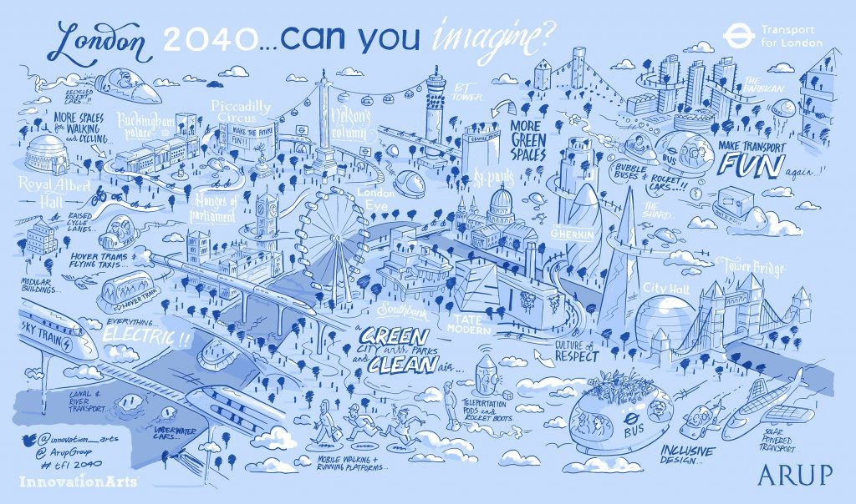

Slide 26
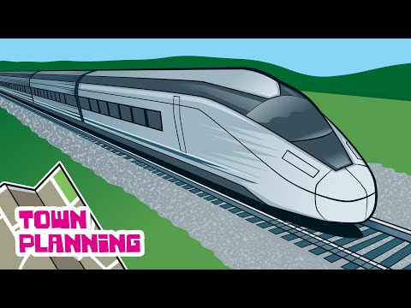
RESOURCES
Metropolis: A Green City of Your Own curriculum (online; free)
Agent Plan-It: Town Planning for Kids videos (YouTube series of 10; free)

Slide 27
OPEN FORUM
Q/A
Veterans share past experiences, best practices

Slide 28


Contact:
Shawn Koval
SKoval@UWHealth.org

Slide 29
Transportation Construction Hacks with Heather!

