Slide 1
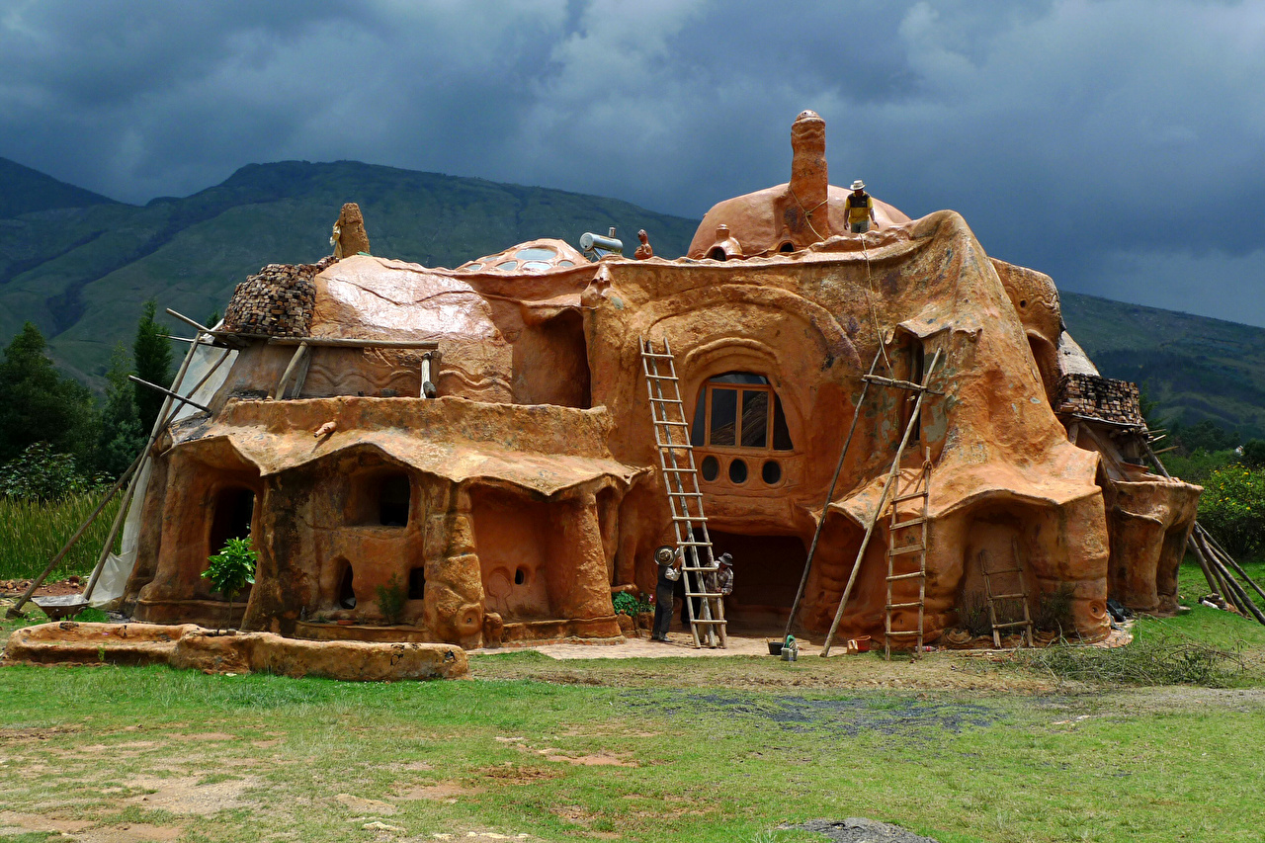
ARCHITECTURE
DENSITY COMMUNITY SCALE HOME
Sub-Urban Community
Semi-Urban Community
Urban Community

Slide 2
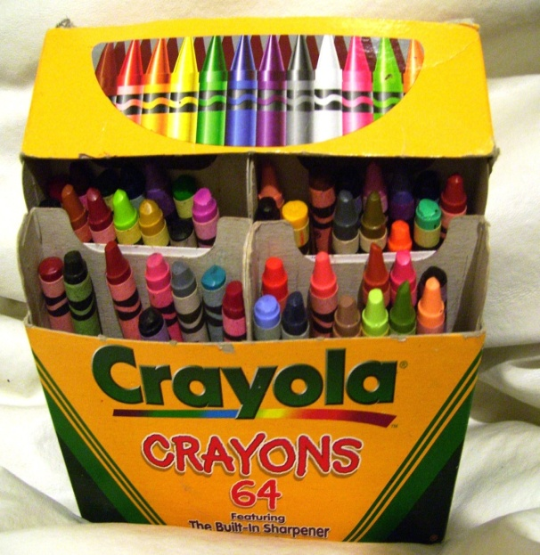
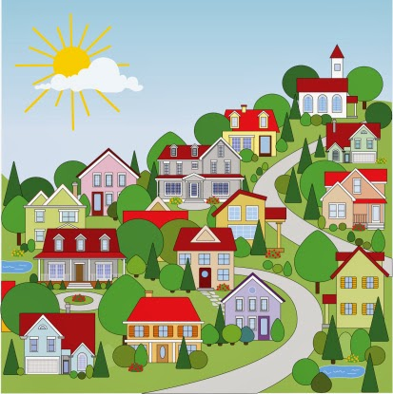
ARCHITECTURE
DENSITY
COMMUNITY
SCALE
HOME

Slide 3
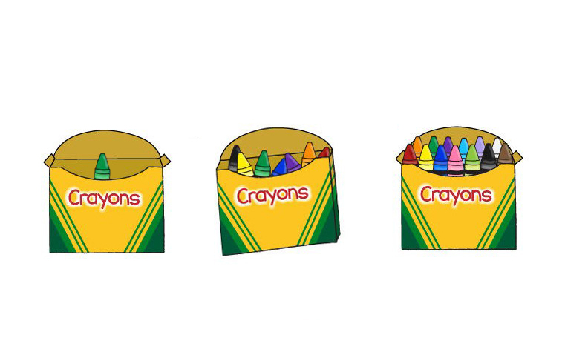
DENSITY
THE PRECENTAGE OF THE AMOUNT OF STUFF IN A BOX
SMALL DENSITY
10%
MEDIUM DENSITY
50%
LARGE DENSITY
100%

Slide 4
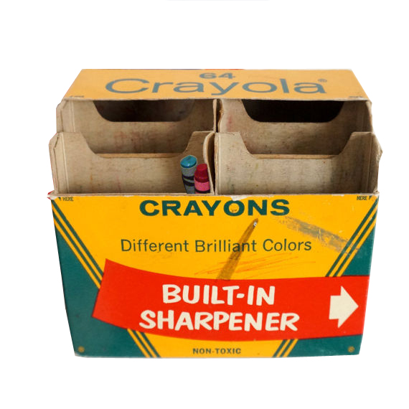
LOW DENSITY

Slide 5
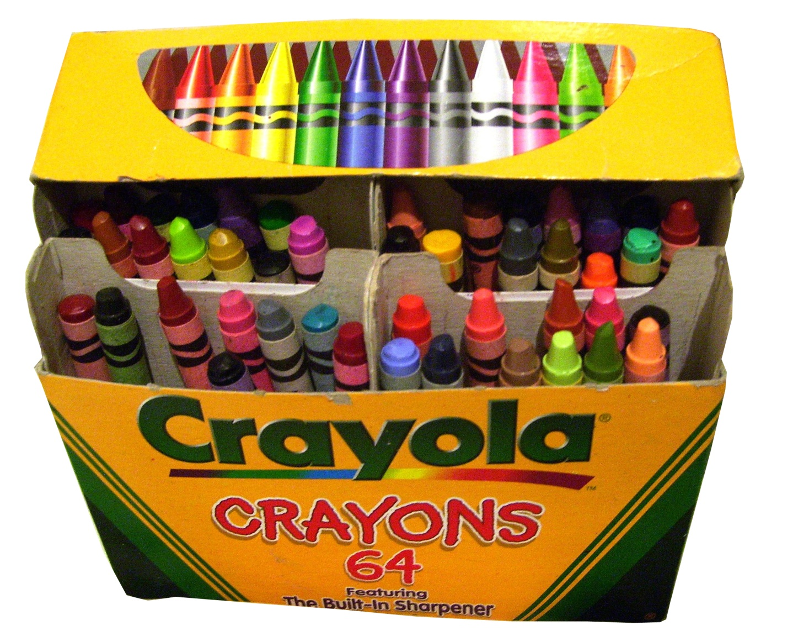
HIGH DENSITY

Slide 6
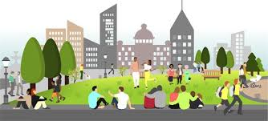
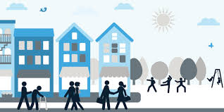
COMMUNITY
MANY DIFFERENT KIND OF PEOPLE LEARNING TOGETHER
PEOPLE WITH COMMON INTERESTS LIVING IN AN AREA TOGETHER

Slide 7
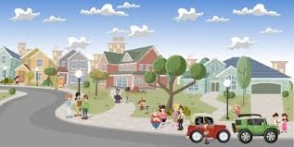
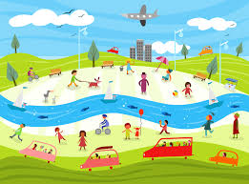
COMMUNITY
PEOPLE HAVING THE SAME SOCIAL AND ECONOMICAL INTERESTS PLAYING TOGETHER
DIFFERENT KIND OF PEOPLE IN A COMMON LOCATION WORKNG TOGETHER

Slide 8
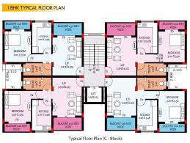
SCALE
An Architect's scale is a specialized ruler designed to help the drawing and measuring of
Architectural drawings such as: floor plans, elevations, perspective images and models.
This is a very useful tool for master planning different types of communities.

Slide 9
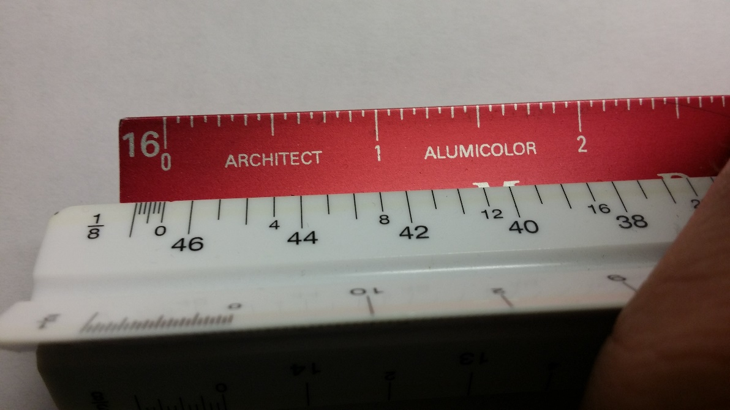
SCALE
AT 1/8”= 1’-0” SCALE. ONE OF THE BLOCKS IS ABOUT THE SIZE OF YOUR CLASSROOM.
PUT ONE MORE BLOCK ON TOP AND IT IS THE SIZE OF THE TYPICAL HOME.
EXAMPLE: 1”= 8’-0” AT 1/8” SCALE SO 4”= 32’-0”

Slide 10
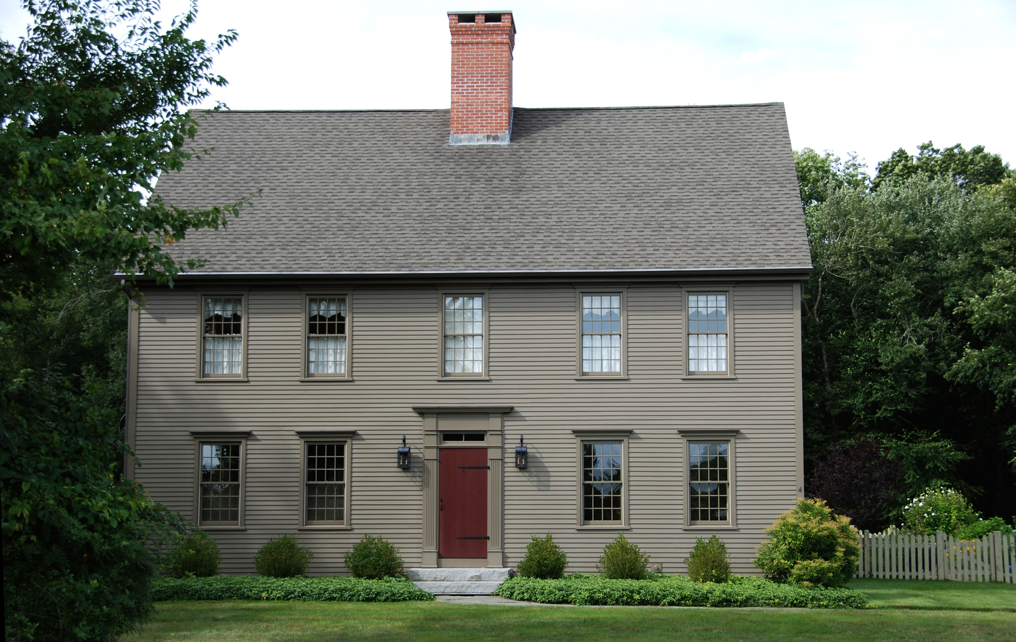
HOME
THE PLACE WHERE SOMEONE LIVES

Slide 11
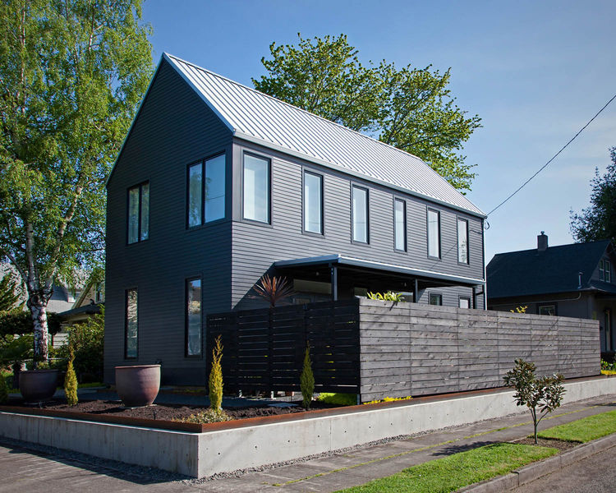
HOME

Slide 12
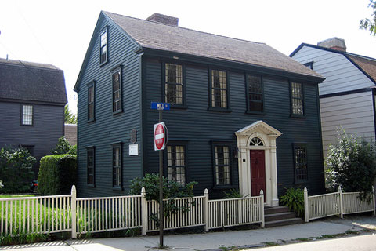
HOME

Slide 13
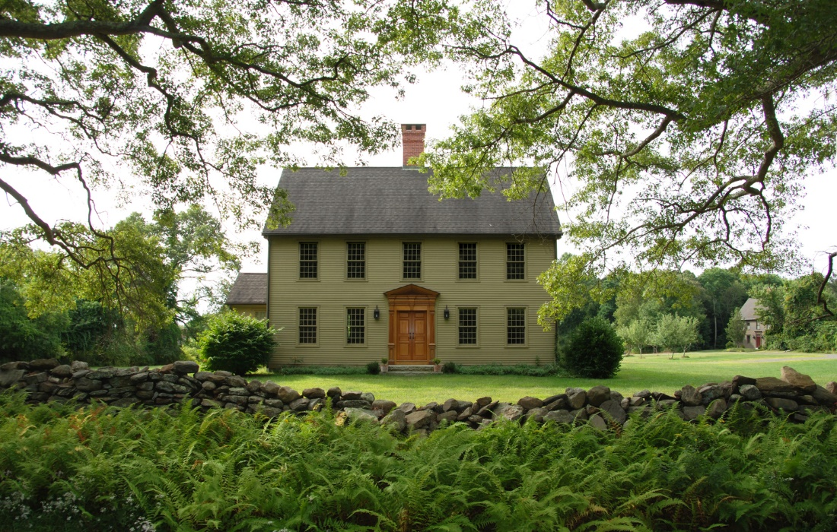
HOME

Slide 14
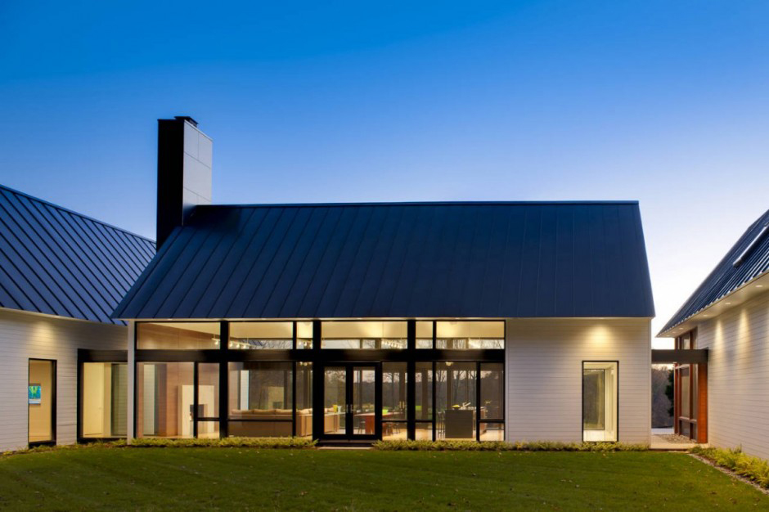
HOME

Slide 15
COMMUNITY TYPES
SCALE
DENSITY
HOME
Sub-Urban Community
Land + Lots + Houses + Shopping + Schools + Parks = Low Density
Semi-Urban Community
Row Houses + Townhomes + Apartments + Shopping + Schools + Parks = Medium Density
Urban Community
Buildings + Condos + Offices + Shopping + Schools + Parks = High Density

Slide 16
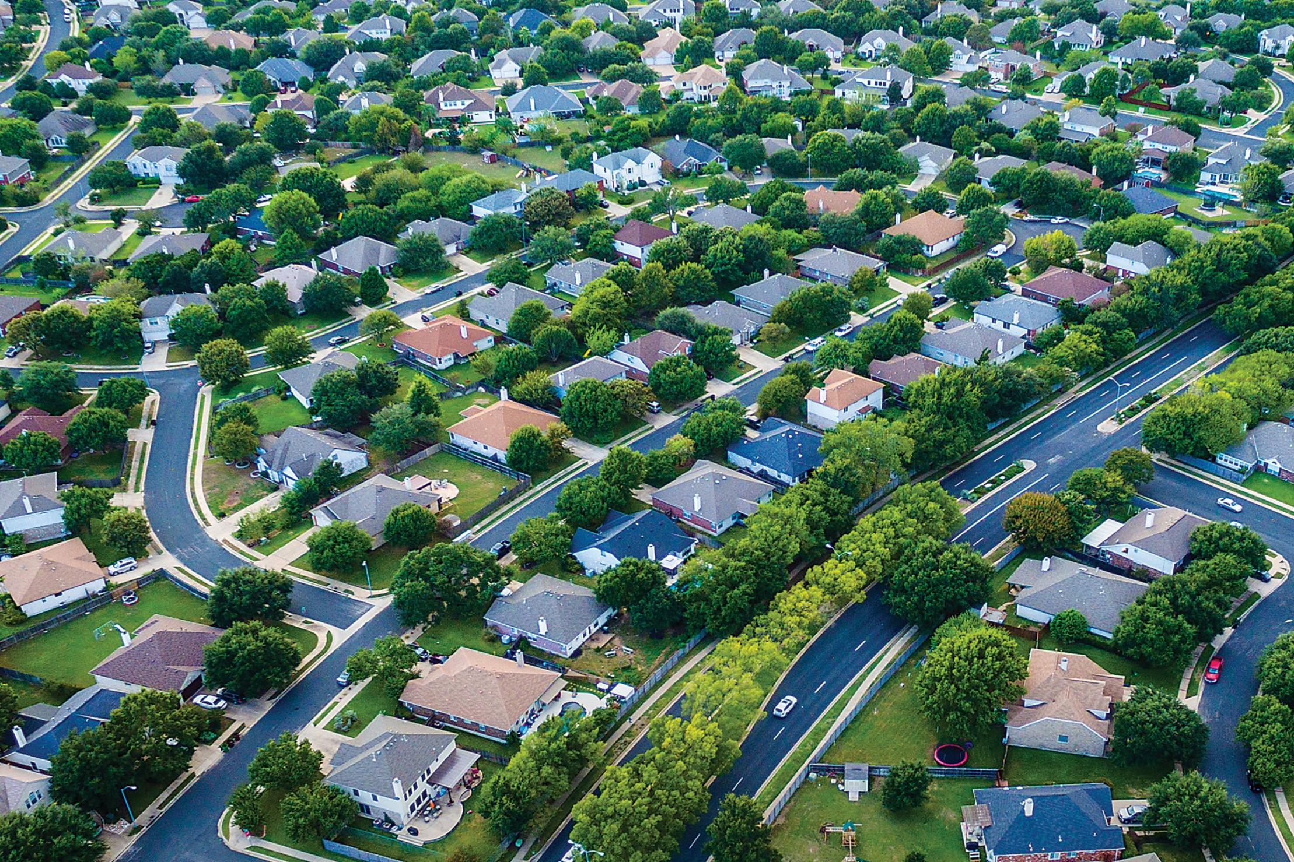
Sub-Urban Community
Land + Lots + Houses + Shopping + Schools + Parks = Low Density

Slide 17
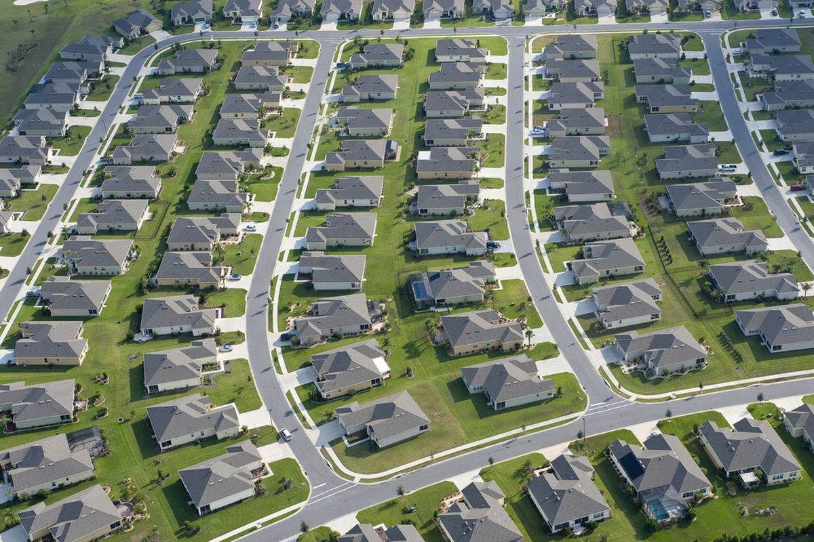
Sub-Urban Community
Lots + Houses + Shopping + Schools + Parks = Low Density

Slide 18
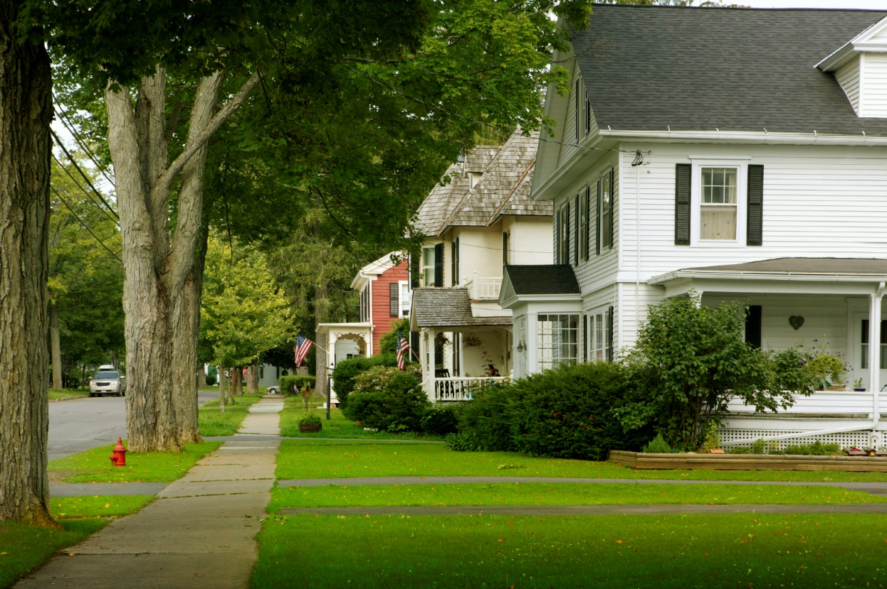
Sub-Urban Community
Lots + Houses + Shopping + Schools + Parks = Low Density

Slide 19
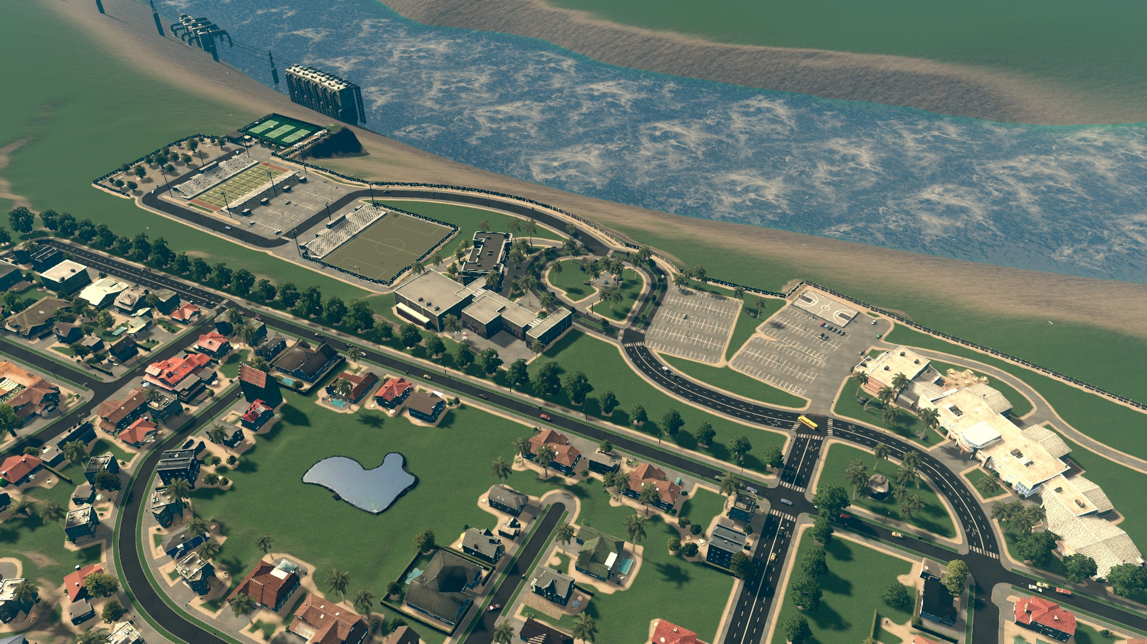
Sub-Urban Community
Lots + Houses + Shopping + Schools + Parks = Low Density

Slide 20
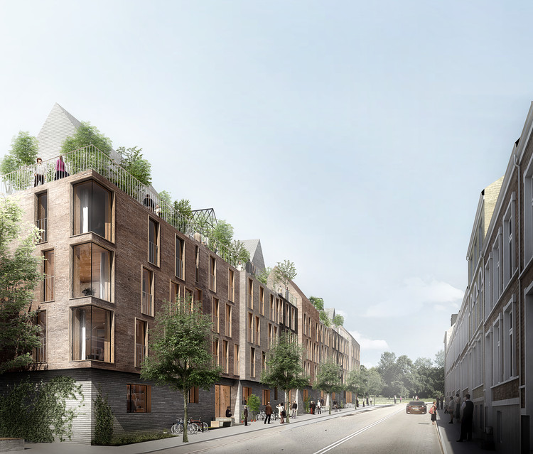
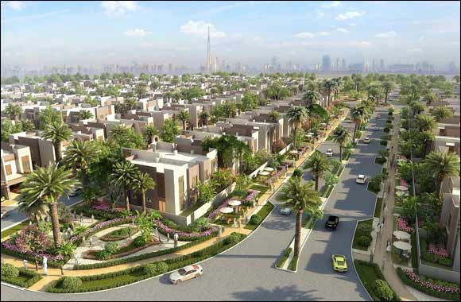
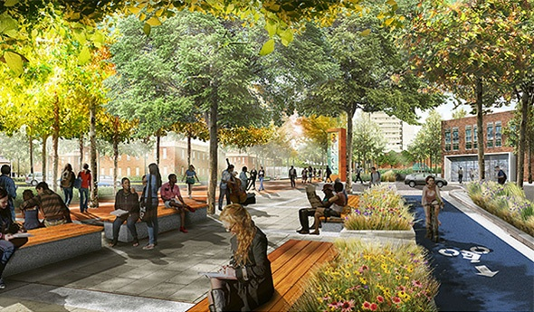
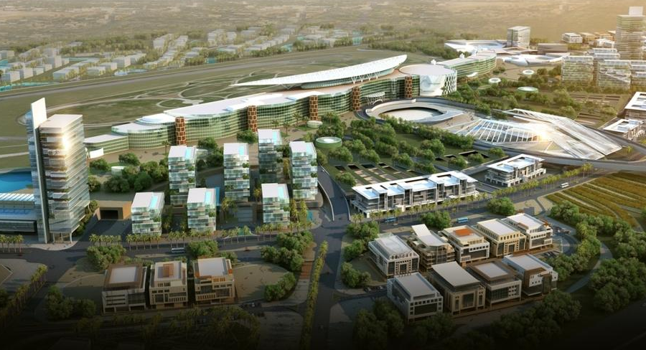
Semi-Urban Community
Row Houses + Townhomes + Shopping + Schools + Parks = Medium Density

Slide 21
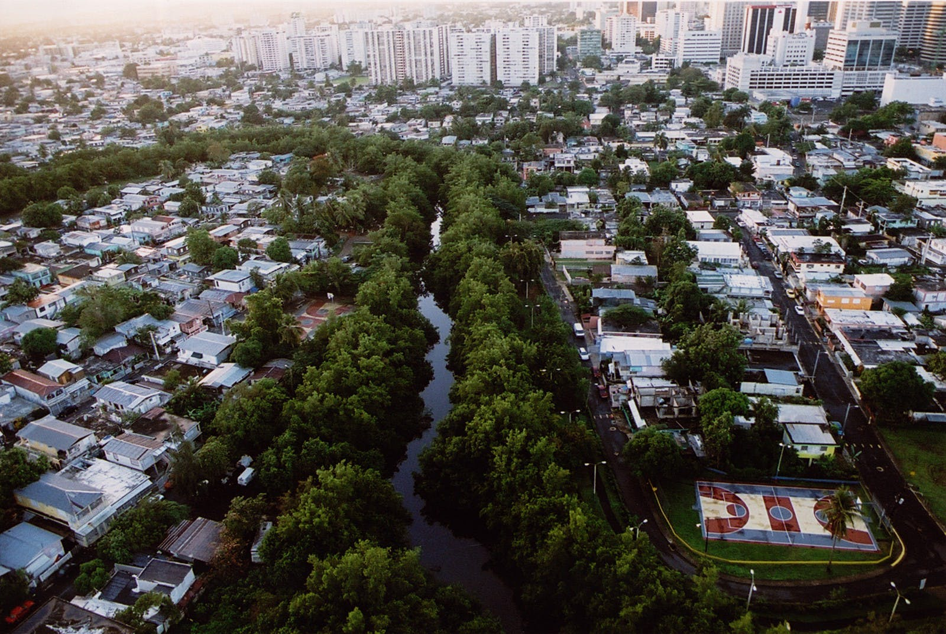
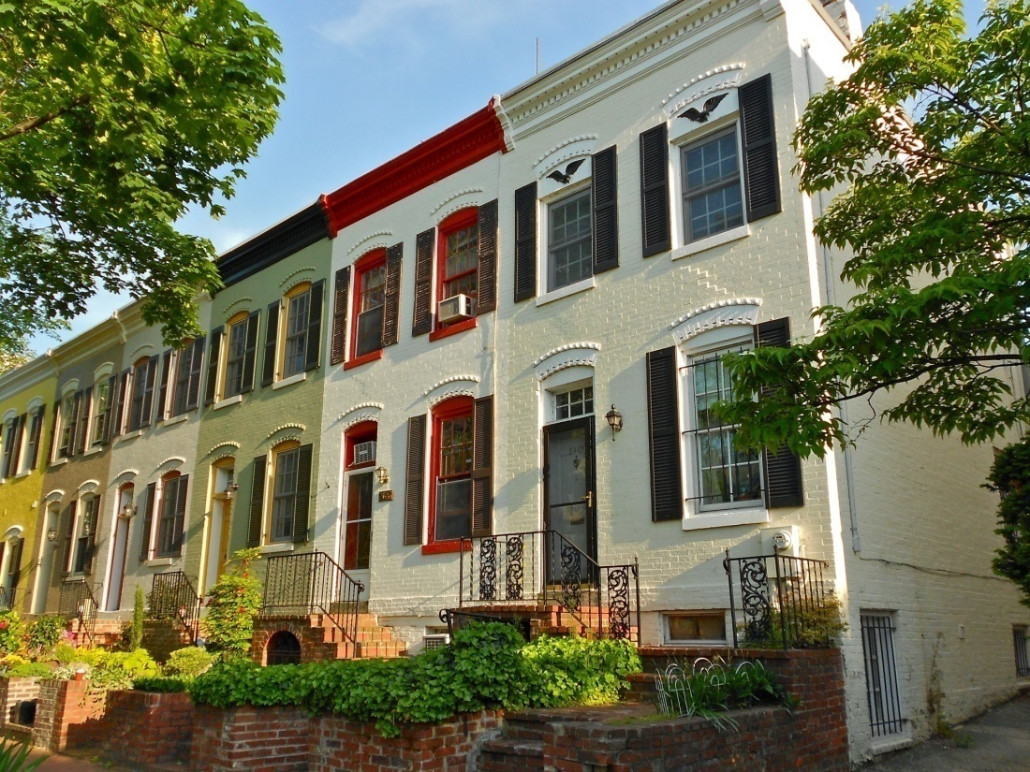
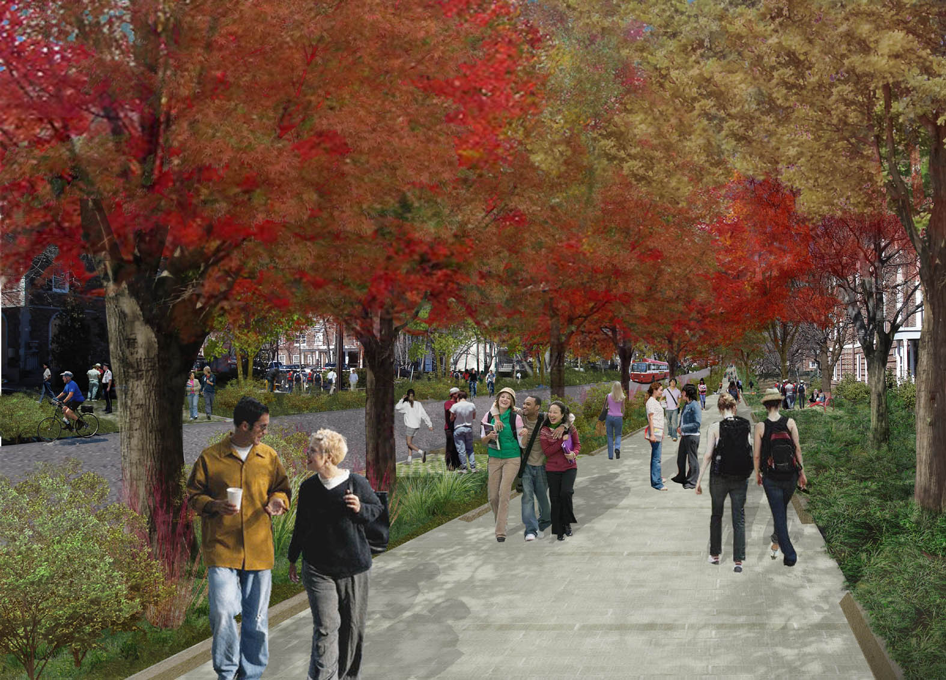
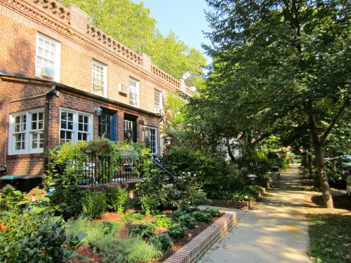
Semi-Urban Community
Row Houses + Townhomes + Shopping + Schools + Parks = Medium Density

Slide 22
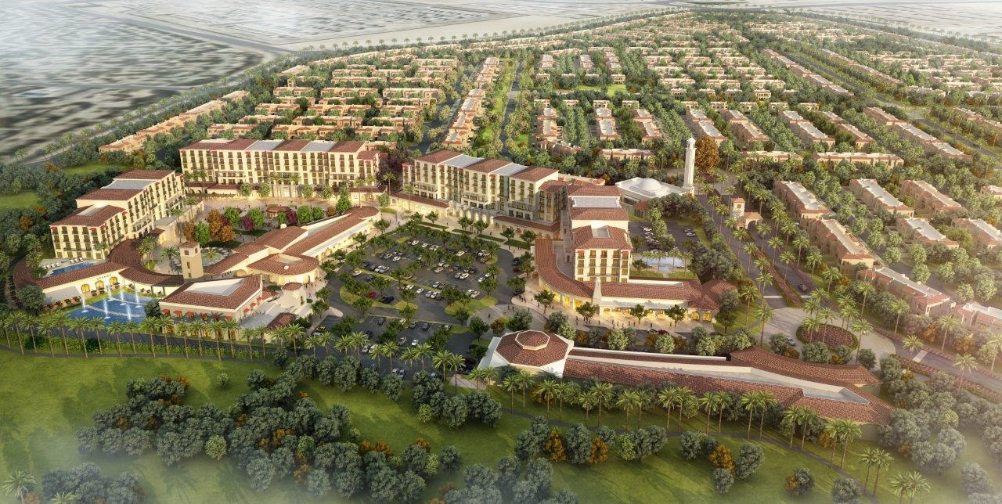
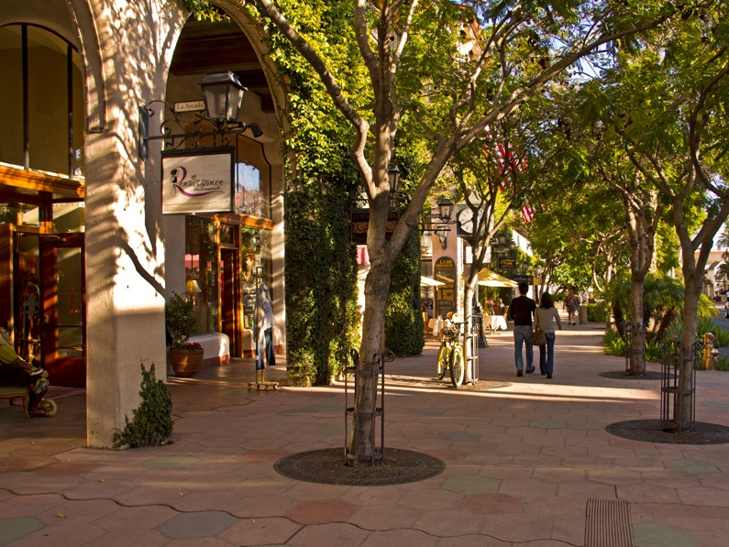
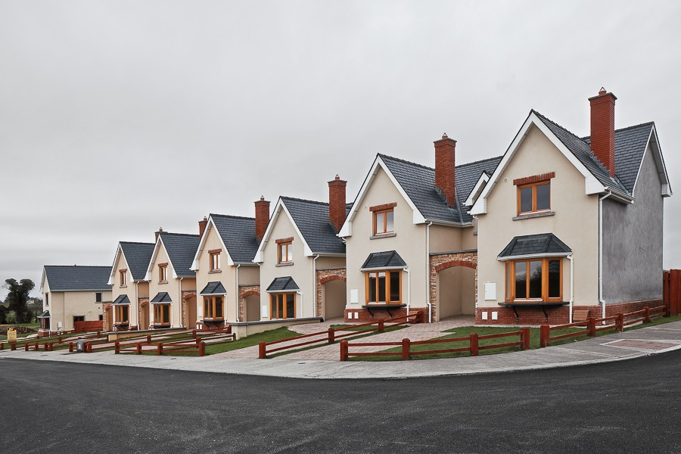
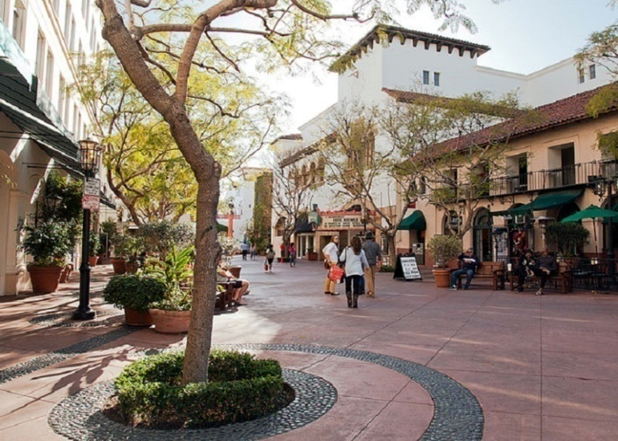
Semi-Urban Community
Row Houses + Townhomes + Shopping + Schools + Parks = Medium Density

Slide 23
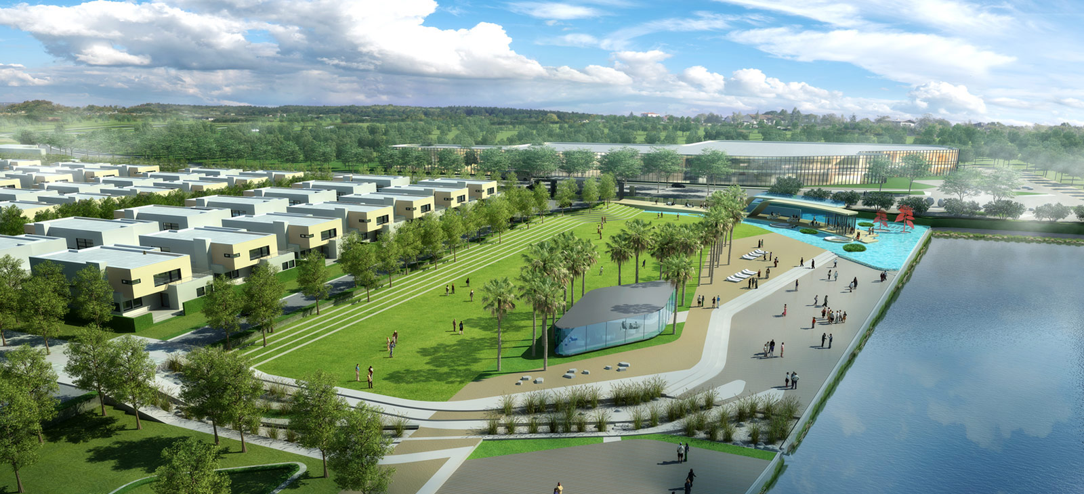
Semi-Urban Community
Row Houses + Townhomes + Shopping + Schools + Parks = Medium Density

Slide 24
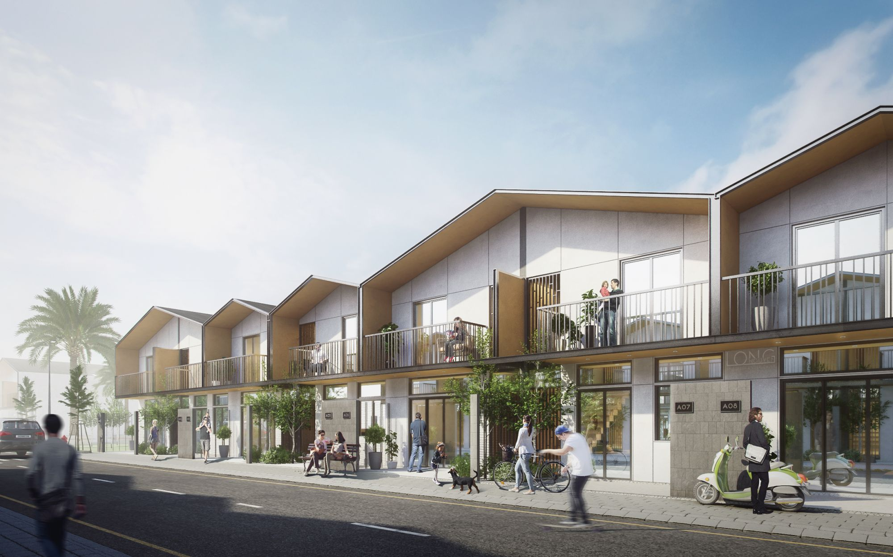
Semi-Urban Community
Row Houses + Townhomes + Shopping + Schools + Parks = Medium Density

Slide 25
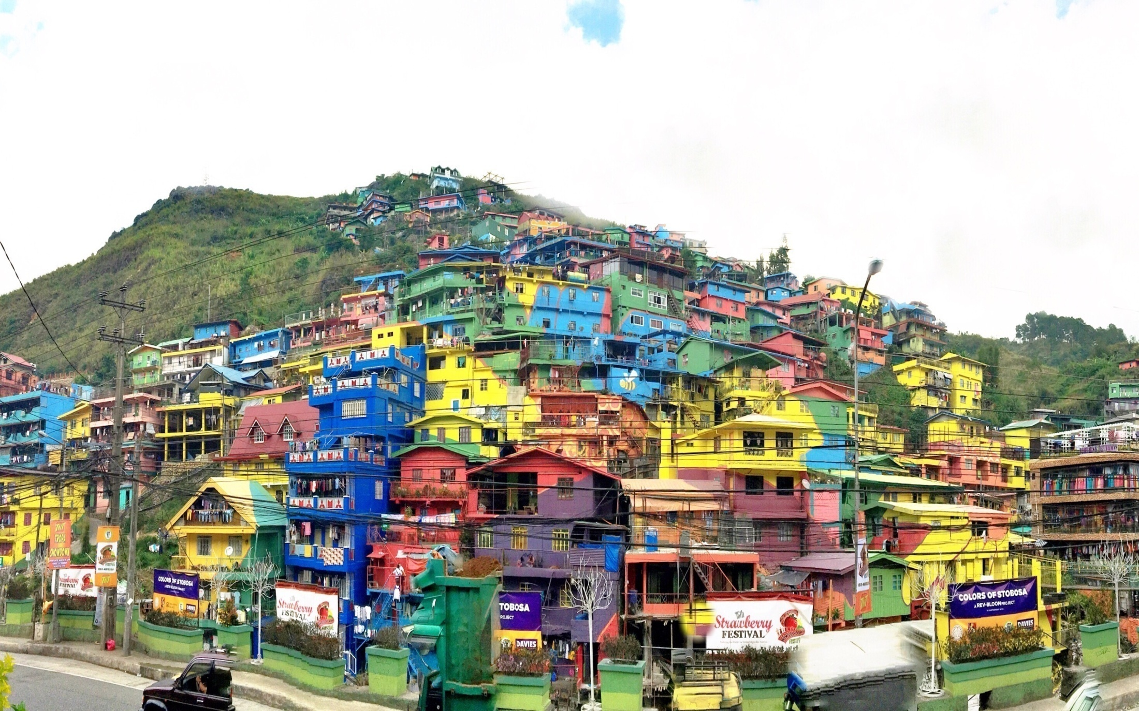
Urban Community
Buildings + Apartments + Shopping + Schools + Parks = High Density

Slide 26
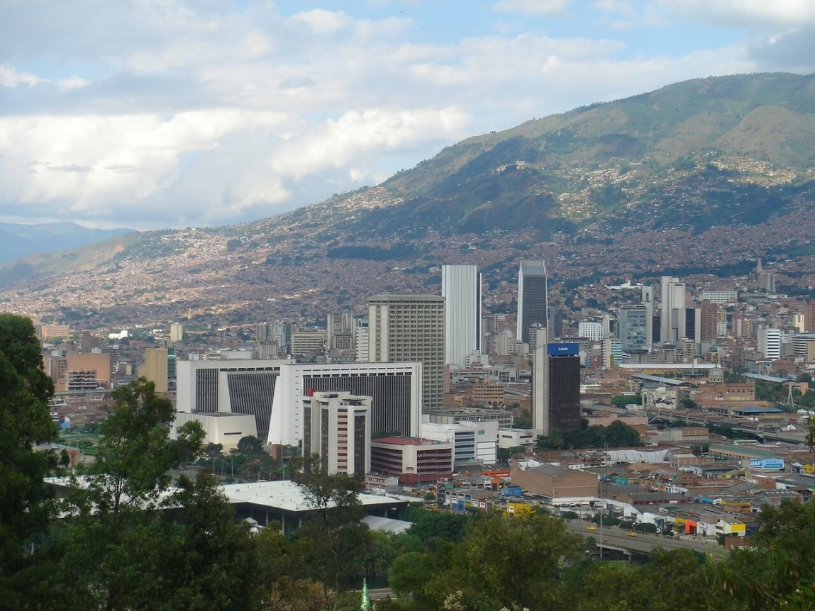
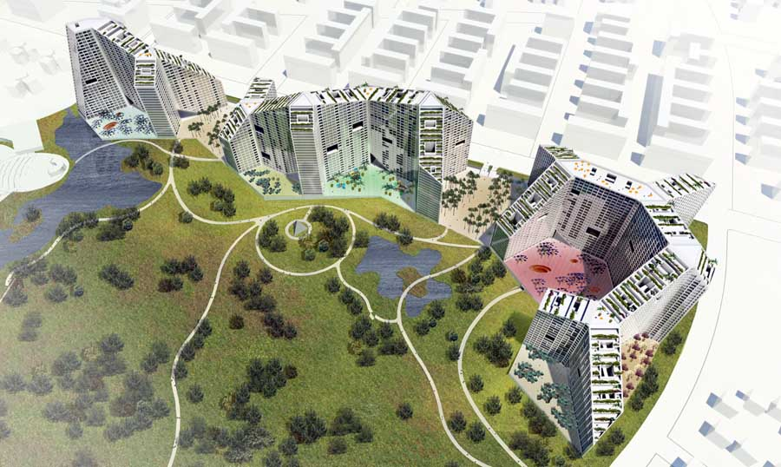
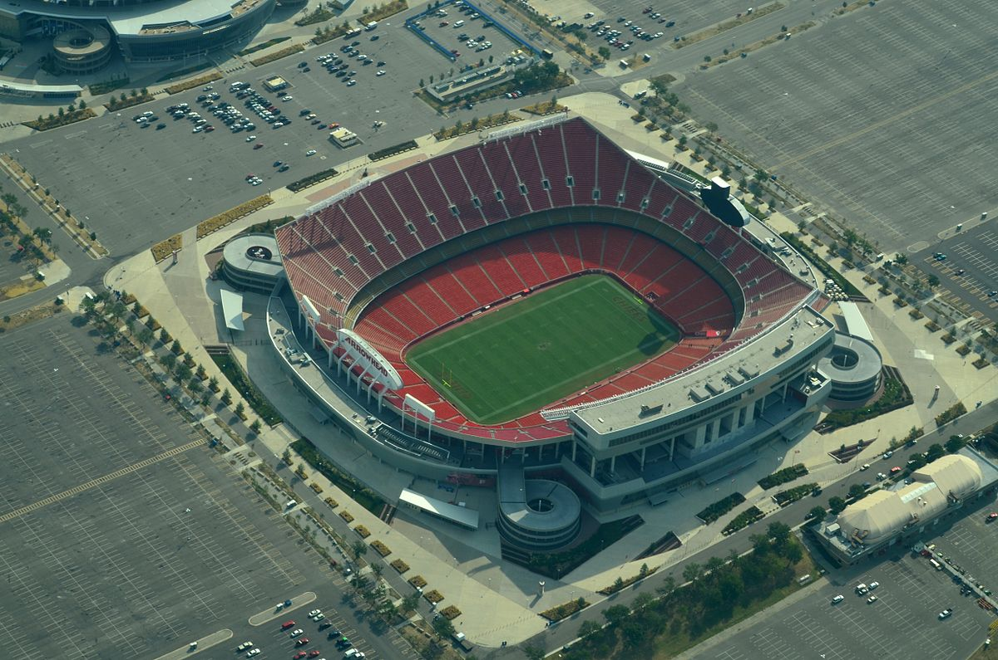
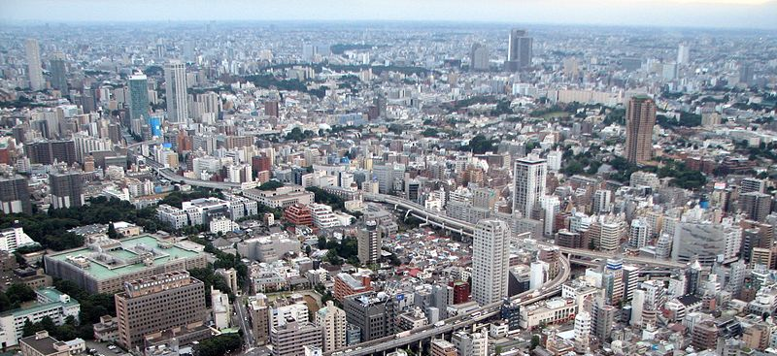
Urban Community
Buildings + Apartments + Shopping + Schools + Parks + Stadiums = High Density

Slide 27
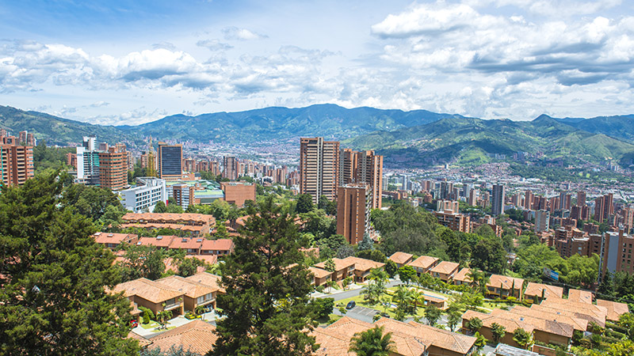
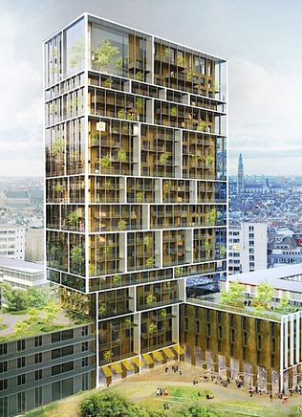
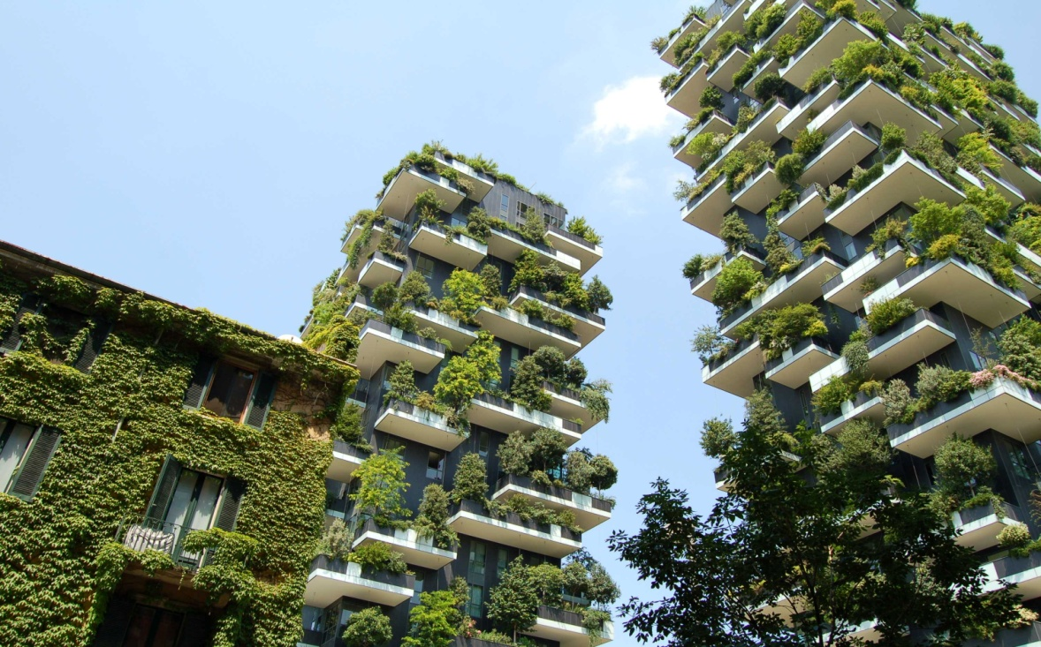
Urban Community
Buildings + Apartments + Shopping + Schools + Parks + Stadiums = High Density

Slide 28
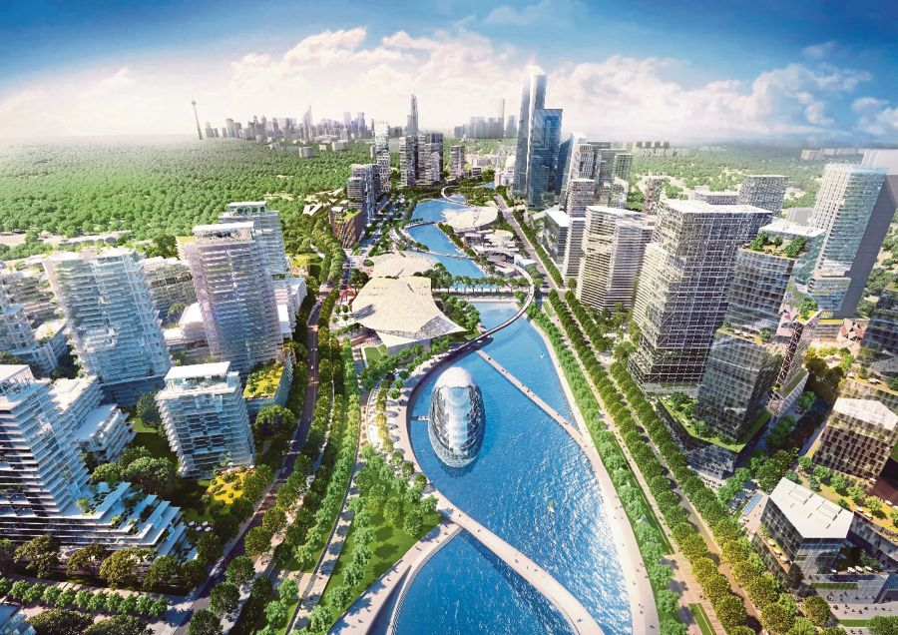
Urban Community
Buildings + Apartments + Shopping + Schools + Parks + Stadiums = High Density

Slide 29
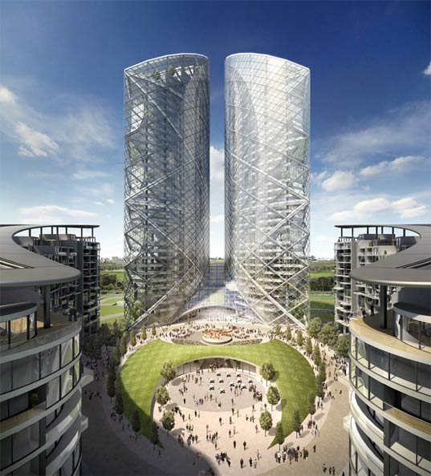
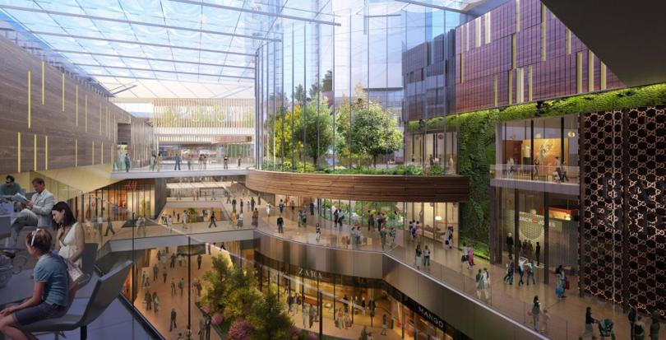
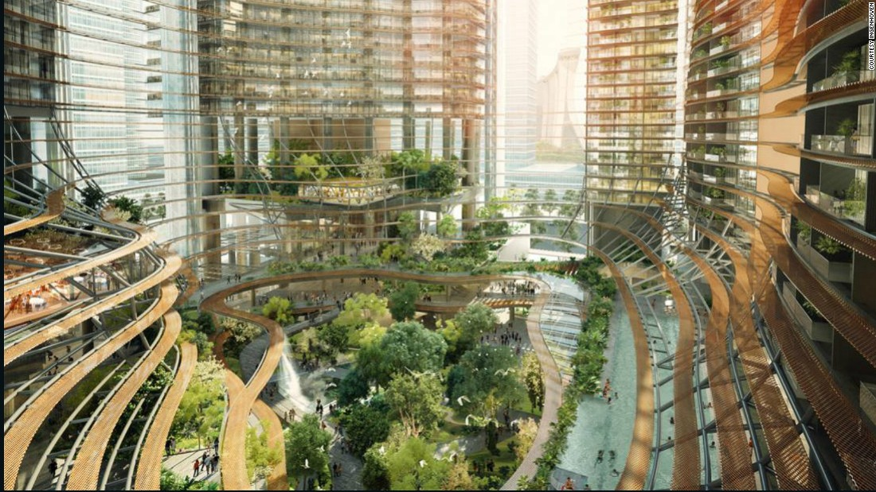
Urban Community
Buildings + Apartments + Shopping + Schools + Parks + Stadiums = High Density

Slide 30
Urban Community
Buildings + Apartments + Shopping + Schools + Parks + Stadiums = High Density

Slide 31
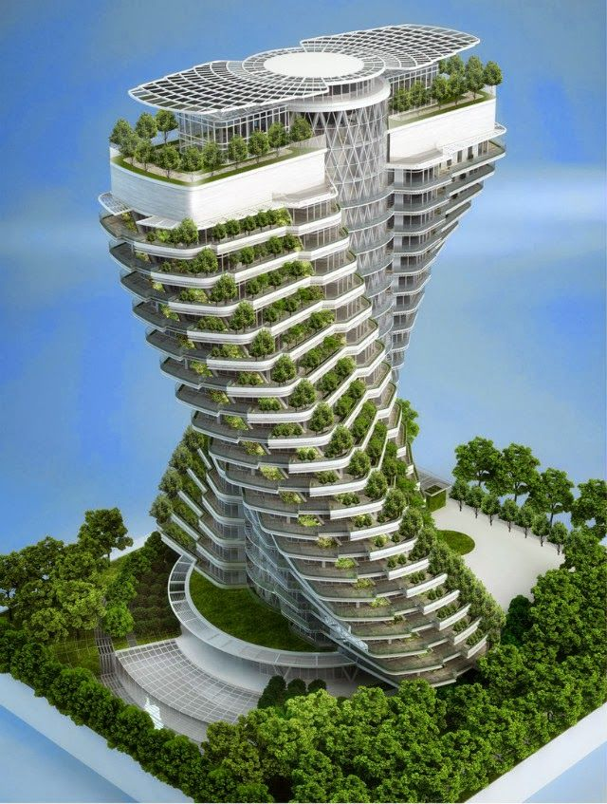
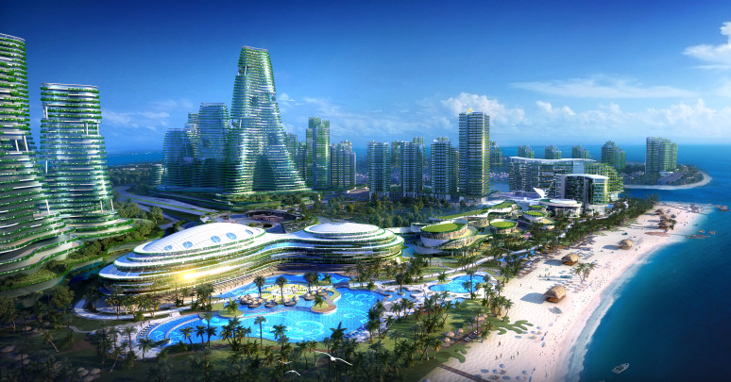
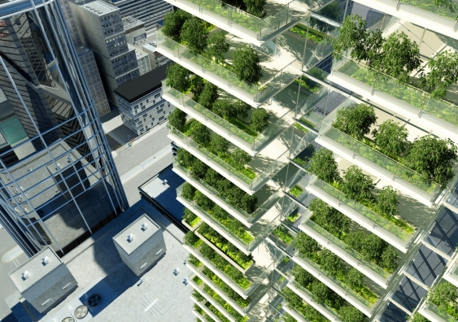
Urban Community
Buildings + Apartments + Shopping + Schools + Parks + Stadiums = High Density

Slide 32
ARCHITECTURE
DENSITY COMMUNITY SCALE HOME

